Slide 1
Update on the Fort Worth Initiative Presented to the Board of Regents
THE TEXAS A&M UNIVERSITY SYSTEM
May 19, 2022

Slide 2
The Original Proposal
Redevelopment of the Law School and three TAMU-owned surface parking lots east of the school
The projects would be carried out in phases as a funding plan emerges and modified according to actual needs and results.

Slide 3
The Redevelopment
Building 1: Law & Education Building—To accommodate Law School growth and other programs by System universities.
Building 2: Research Alliance Building—To house research centers and other research and workforce activities, primarily by System agencies and the HSC.
Building 3: The Gateway Center—It would replace the Law School and would be the complex’s ‘front door,” providing added Law School space, administrative offices and conference space for professional development programs.
The three buildings will be on the upcoming Capital Plan, If the Board gives approval today.

Slide 4
Current Activities
Discussions are continuing with officials from Fort Worth and Tarrant County on the details of the project.
Dr. Joe Elabd and Dr. David Stack are working with the universities and agencies on programming and space requirements.
The Law School is completing a POR for its eventual space needs.
The project will be added to the 5-year Capital Plan if the Board approves today.
Programs of Requirements for all three buildings will be completed this summer.
Dr. Kim McCuiston, currently director of the Tarleton Chisholm Trail campus, will become Director of the Ft. Worth downtown campus to manage operations onsite on June 1.
An Engineering Academy in cooperation with Tarrant County College was announced on May 13, 2022.
Preparations are being made for initial System presence in downtown Fort Worth next Fall.
The main current challenge is high construction cost estimates owing to supply chain problems and inflationary surge.

Slide 5
Timeline and Progress
November 2020 First meeting with City and County officials
November 2021 MOI signed with City, County, Forth Worth Now
November 2021 Public announcement of “Aggieland North”
January 2022 Work on Program of Requirements begins
January 2022 Meetings with City and County on details
May 13, 2022 Engineering Academy announced
May 19, 2022 Projects added to Capital Plan
June 1, 2022 Dr. Kim McCuiston joins as Director, FW Campus
Summer 2022 Architecture/design process begins
Fall 2022 “Early Start” programs begin in Fort Worth
Spring 2023 Target for construction approval by Board
Summer 2023 Construction begins
Winter 2024-24 Completion of Building 1 and possibly Building 2

Slide 6
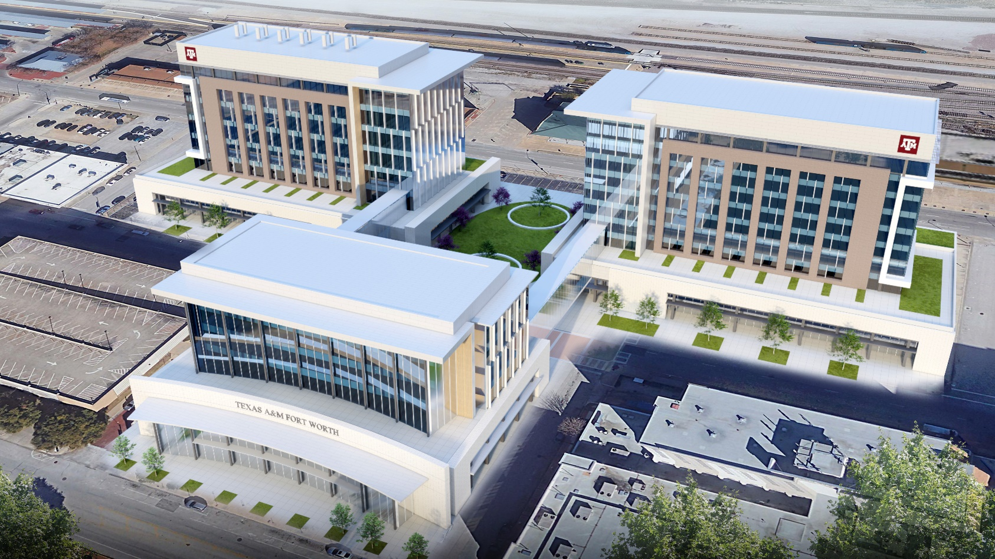
Current Rendition of Complex (Looking East)

Slide 7
Looking Northeast

Slide 8
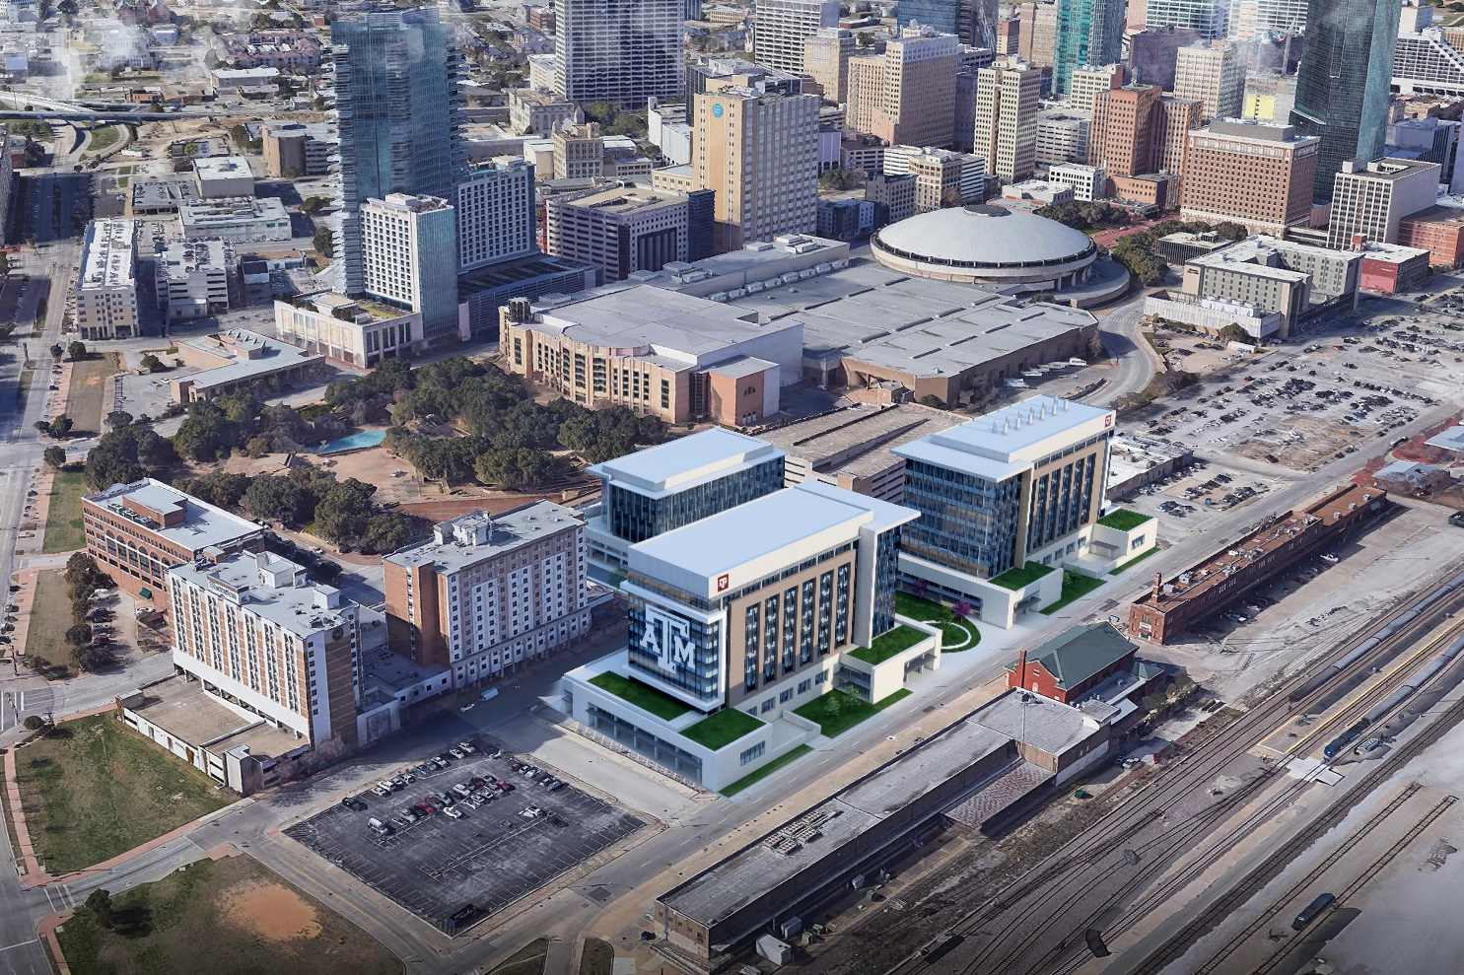
Looking Northwest

Slide 9
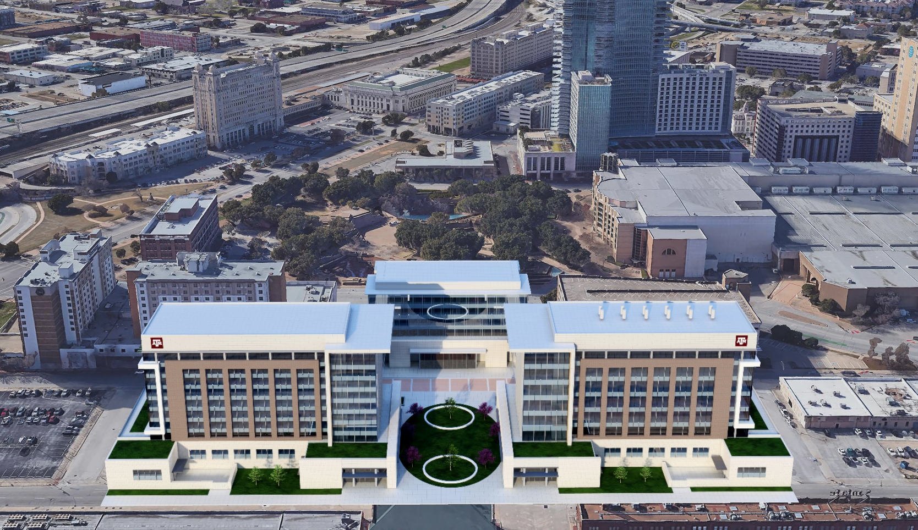
Looking West

Slide 10
Questions?

