Slide 1
Welcome
Thank you for attending our presentation! This survey is three (3) questions, and your participation will help military-affiliated students and resource providers better understand their community and how to address their needs. Your answers are completely anonymous and will be used to crowd-source ideas for getting feedback on our military-affiliated student communities.

Slide 2
VALOR²/PLAN Don & Ellie Knauss Veteran Resource & Support Center Division of Student Affairs SGM Donald Freeman, USA Retired David Haney ‘23, Student Veteran
Serve Well Those Who Have Served!

Slide 3
Looking back on your experience as a student veteran, what questions do you believe resource providers should have asked you?
Looking back on your experience as a resource provider, what questions do you believe student veterans should have asked you?
Notes:
The idea is that asking the right questions lead to addressing the best answers. Typically, if your have that conversation, it will lead to answers that did not initially exist.

Slide 4
History
History & Why we started
2012 (VRSC Office Opens)-2015 Student Workers
No formal training or advising role
2015-2019 PAVE (Peer Advising for Veteran Education)
Formal Peer Advisor Training and Resources From U of M
2019-2021 VALOR (Veteran Aggie Leaders for Outreach and Resources)
Formal Peer Advisor Training, Outreach, and Resource Provider
2022-Current VALOR² (Veteran Aggie Leaders for Outreach, Research, and Resources)
Formal Training to include National Peer Mentoring Certification
Outreach and Engagement
Peer to Peer Research
Provide Data to Resource Providers
Exporting the Effort: PLAN (Peer-Led Assessment of Needs)

Slide 5
VALOR²/PLAN
Needs Expressed
Resource Alignment
Resource/ Service Providers
Leadership/Decision makers
Student Veteran
PLAN
PLAN
Needs Addressed
Needs Reported
Notes:
Peer student veterans can ask especially insightful questions of other student veterans. Their insights about satisfaction and relevance of resources are relayed to the leadership/decision makers and resource/service providers. Transactional to Transformational.

Slide 6
PLAN
Start with “Why”
We believe in transforming the higher-ed veteran experience.
We believe in challenging those who provide services and resources to their veteran community to be transformational not transactional.

Slide 7
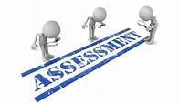
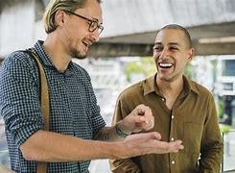
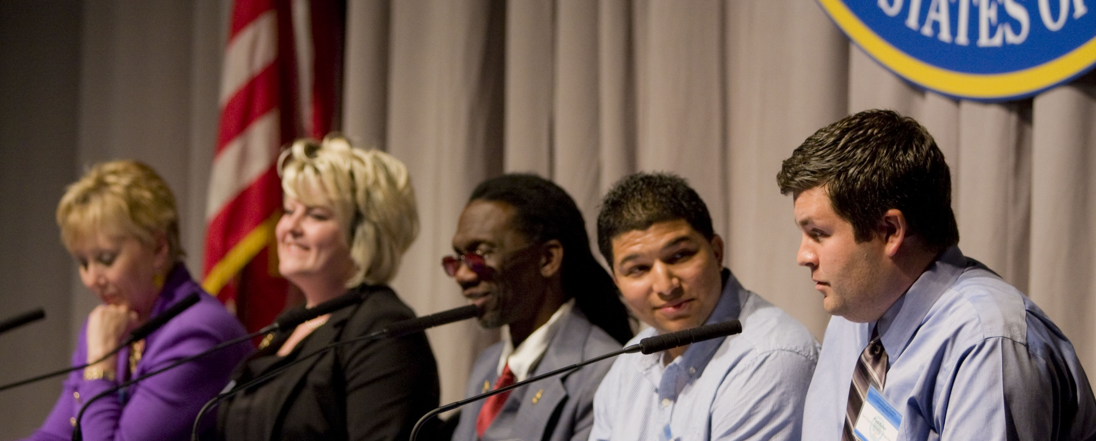
PLAN
“How”
Needs Assessment (3/3000+)
Surveys (23/1800+)
Peer-to-Peer Discussions/Face-to-Face interaction (40+/~200)
Round Table Talks (6/42)
Panels (1/21)
“Who”
VA Work-Study/Consumers of Veteran Resources
Experiencing the same challenges
Unique perspective
Not seen as authority figures
Notes:
HOW-
Collect feedback on Aggie Veteran experiences through surveys, assessments, roundtable talks, and daily "water cooler" interactions
Analyze feedback
Translate that feedback into reoccurring themes
Present the evidenced-based findings to resource providers and decision makers.
WHO-
We are experiencing the same things as the respondents
We have past and present shared experiences
We are a part of the community of people from whom we are gathering feedback
Meaning we are able to be more intuitive in what questions to ask
AND we are able to interpret the feedback through shared contexts

Slide 8
PLAN
“What”
Help identify the most up-to-date, innovative services and resources that our veteran community desires
Allow resources providers and decision makers to directly address the students' needs and concerns
Activate the student veteran community to invest in the change that affects them.
Using national averages only gets you so far. Knowing your community takes you the rest of the way.
Notes:
FIRST BULLETPOINT:
Peer-led research allows more robust feedback from the communities that are immediately affected by the resources being provided
Peer-led research can be easily integrated into current projects
SECOND BULLETPOINT:
We move from learning ABOUT our student veterans to learning FROM our student veterans
THIRD BULLETPOINT:
It increases student veterans' awareness of their own situations
Encourages student veterans to be more proactive in activating change (personally or within their peer

Slide 9
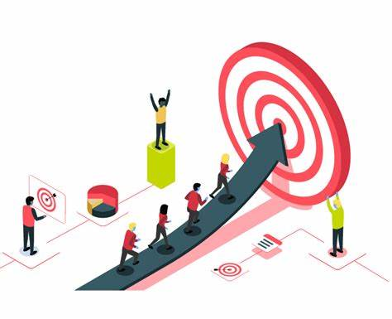
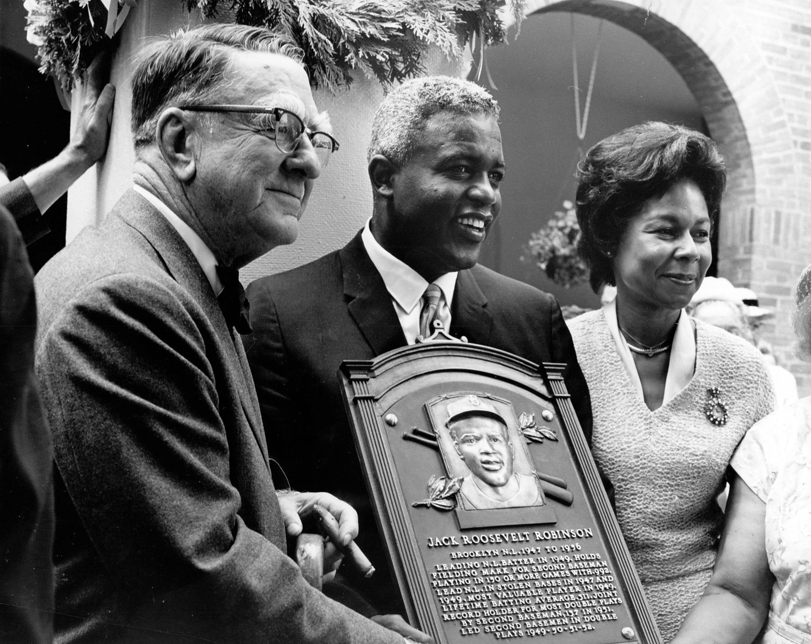
PLAN
“Impact”
Increased student veteran engagement
Aggie Veteran Canvas Community
59,525 Hits from 08/28 - 10/9
VRSC Student Worker Information Hub Website
*Aggie Veteran Day Zero*
Increased diversity among participants
VALOR² Website
"A life is not important except in the impact it has on other lives.“
- Jackie Robinson
Notes:
Increased student veteran engagement
Aggie Veteran Canvas Community
59,525 Hits from 08/28 - 10/9
VRSC Student Worker Information Hub Website
*Aggie Veteran Day Zero*
Increased diversity among participants
VALOR2 Website
Where we post redacted reports of our findings; self-made training videos; and information and resources that we have found useful
https://sites.google.com/tamu.edu/valor2/home

Slide 10
PLAN
“Where”
Make it yours
Website
LMS
Peer Mentoring (Eduology)
Assessment Methods
Mechanics-Qualtrics
How do you use the data?
Contributor or Consumer?
Information to Application
“When”
“Start where you are. Use what you have. Do what you can.”
-Arthur Ashe
Notes:
Make the PLAN yours = use the resources available
You can use any of the free website platforms out there to create your own hub
You can embed surveys or reports
Even discussion boards to crowd source ideas
LMS = Learning Management Systems
There is most likely a way for you to tap into LMSs like:
Canvas or Blackboard
Great way to reach your audience without adding extra work or adding to EMAIL FATIGUE
Tap into Peer Mentoring programs
We use Eduology
Mentoring programs are a great way for student workers working on your PLAN to gain some important soft skills:
Active Listening
Interpersonal communication
Impromptu need assessment and resource triaging
Assessment methods
Many free platforms
Google Forms
Microsoft Forms
Survey Monkey
Etc.
Does your school have any that you could piggyback off of?
Qualtrics
Offers more in-depth data collection and analysis
How do you use the data?
Are you a Contributor?
Do you use the data to collaborate with other departments or resource providers? Do you share interpretations of the findings back with the student veterans?
Or are you a consumer?
Do you keep the data for your own use?
Being a contributor is essential for establishing TRANSFORMATIONAL relationships, relationships that are continual, they encourage buy-in, and they establish trust
Being a consumer creates an environment of TRANSACTIONAL relationships
These relationships are grounded on reciprocity = "I need something, you can give it to me, end of relationship."
The relationship is only worth transaction involved at that moment.
Information to Application
It's important to be deliberate in how you use the feedback
Is it reasonable? Is It actionable? Does it require being critical (in a healthy way, of course) of your own methods and possible cognitive biases?
Arthur Ashe-American professional tennis player. He won three Grand Slam titles in singles and two in doubles. Ashe was the first black player selected to the United States Davis Cup team, and the only black man ever to win the singles titles at Wimbledon, the US Open, and the Australian Open. He retired in 1980.
Simon Sinek
https://www.bing.com/videos/search?pglt=41&q=the+why&cvid=6a8baaa6a2cb4cd991ebccdefb66b009&gs_lcrp=EgZjaHJvbWUqBAgAEAAyBAgAEAAyBAgBEC4yBAgCEAAyBAgDEAAyBAgEEAAyBAgFEAAyBAgGEAAyBAgHEAAyBAgIEAAyBwgJEEUY_FXSAQgyMTc4ajBqMagCALACAA&PC=U531&ru=%2fsearch%3fpglt%3d41%26q%3dthe%2bwhy%26cvid%3d6a8baaa6a2cb4cd991ebccdefb66b009%26gs_lcrp%3dEgZjaHJvbWUqBAgAEAAyBAgAEAAyBAgBEC4yBAgCEAAyBAgDEAAyBAgEEAAyBAgFEAAyBAgGEAAyBAgHEAAyBAgIEAAyBwgJEEUY_FXSAQgyMTc4ajBqMagCALACAA%26FORM%3dANSAB1%26PC%3dU531&view=detail&mmscn=vwrc&mid=484371BAB50BEE96D615484371BAB50BEE96D615&FORM=WRVORC

Slide 11
What is your PLAN?

Slide 13
Looking back on your experience as a student veteran, what questions do you believe resource providers should have asked you?
Looking back on your experience as a resource provider, what questions do you believe student veterans should have asked you?
Notes:
The idea is that asking the right questions lead to addressing the best answers. Typically, if your have that conversation, it will lead to answers that did not initially exist.

Slide 14
Looking back on your experience as a student veteran, what questions do you believe resource providers should have asked you?

Slide 15
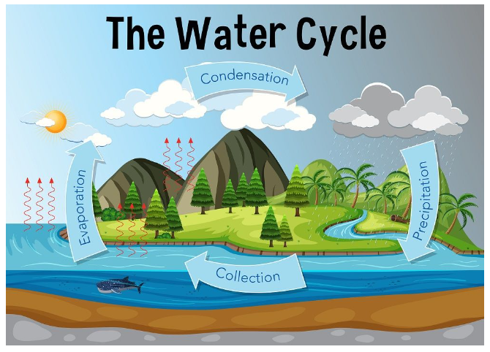
Biology Dictionary
VALOR² gathers human intelligence (HUMINT). Think of HUMINT as the moisture in a water cycle. Where does rain come from?

Slide 16
VALOR² gathers human intelligence (HUMINT). Think HUMINT - humidity, like a water cycle. Moisture is the human intelligence. Where does rain come from?
Not the sky...it comes from the ground - through evaporation of moisture from the surface of the Earth.

Slide 17
Feedback sent up to resource providers, directors, and higher-echelon organizations
Feedback is used to sustain, improve, and create resources
Resources are provided to student veterans
Biology Dictionary
VALOR² collects ground-level insight

Slide 19
Stakeholder Flowchart
Director
Assistant Director
Aggie Veterans
Academic Resources
VET+MAP
Career Resources
SVA
VALOR² Student Leader
Admissions
Well-Being
Financial Resources
Transition Success
VA Resources
VALOR² Team
Et al.
Et al.

