Slide 1
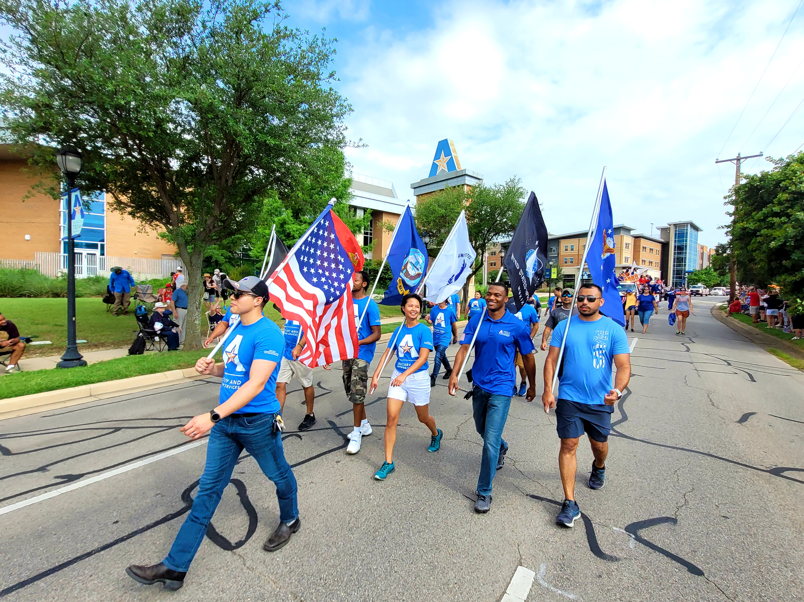
Veterans’ Edge:
Implementing and Operating a Peer Mentor Program on Campus
James M. Kumm Ed.D.
Executive Director Military and Veteran Services
The University of Texas at Arlington

Slide 2
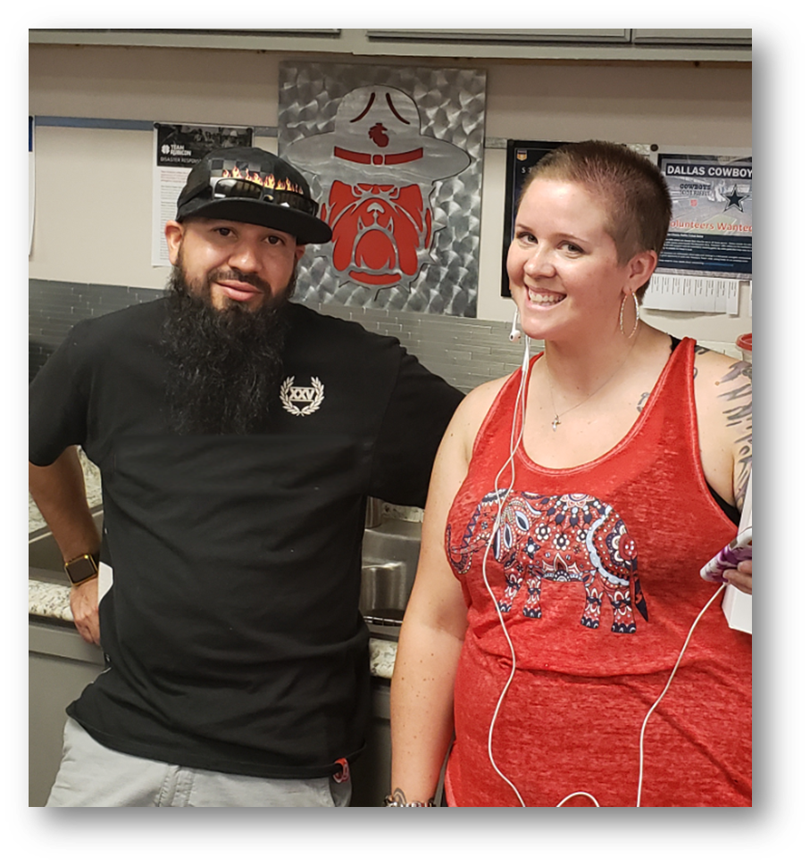
How It Began
Sir do you remember the U.S. Military Sponsor Program?
2018
We need that here!
Military Sponsorship
A Service Member transferring to a new duty station is typically paired with a sponsor who is similar in rank and family status.
Service Members will work with their sponsor throughout the moving process. Requirements for sponsors vary by service.
Once the Service Member arrives, the sponsor will typically want to meet with them and their family to show them around or help them through in-processing.
https://www.militaryonesource.mil/benefits/military-sponsorship/

Slide 3
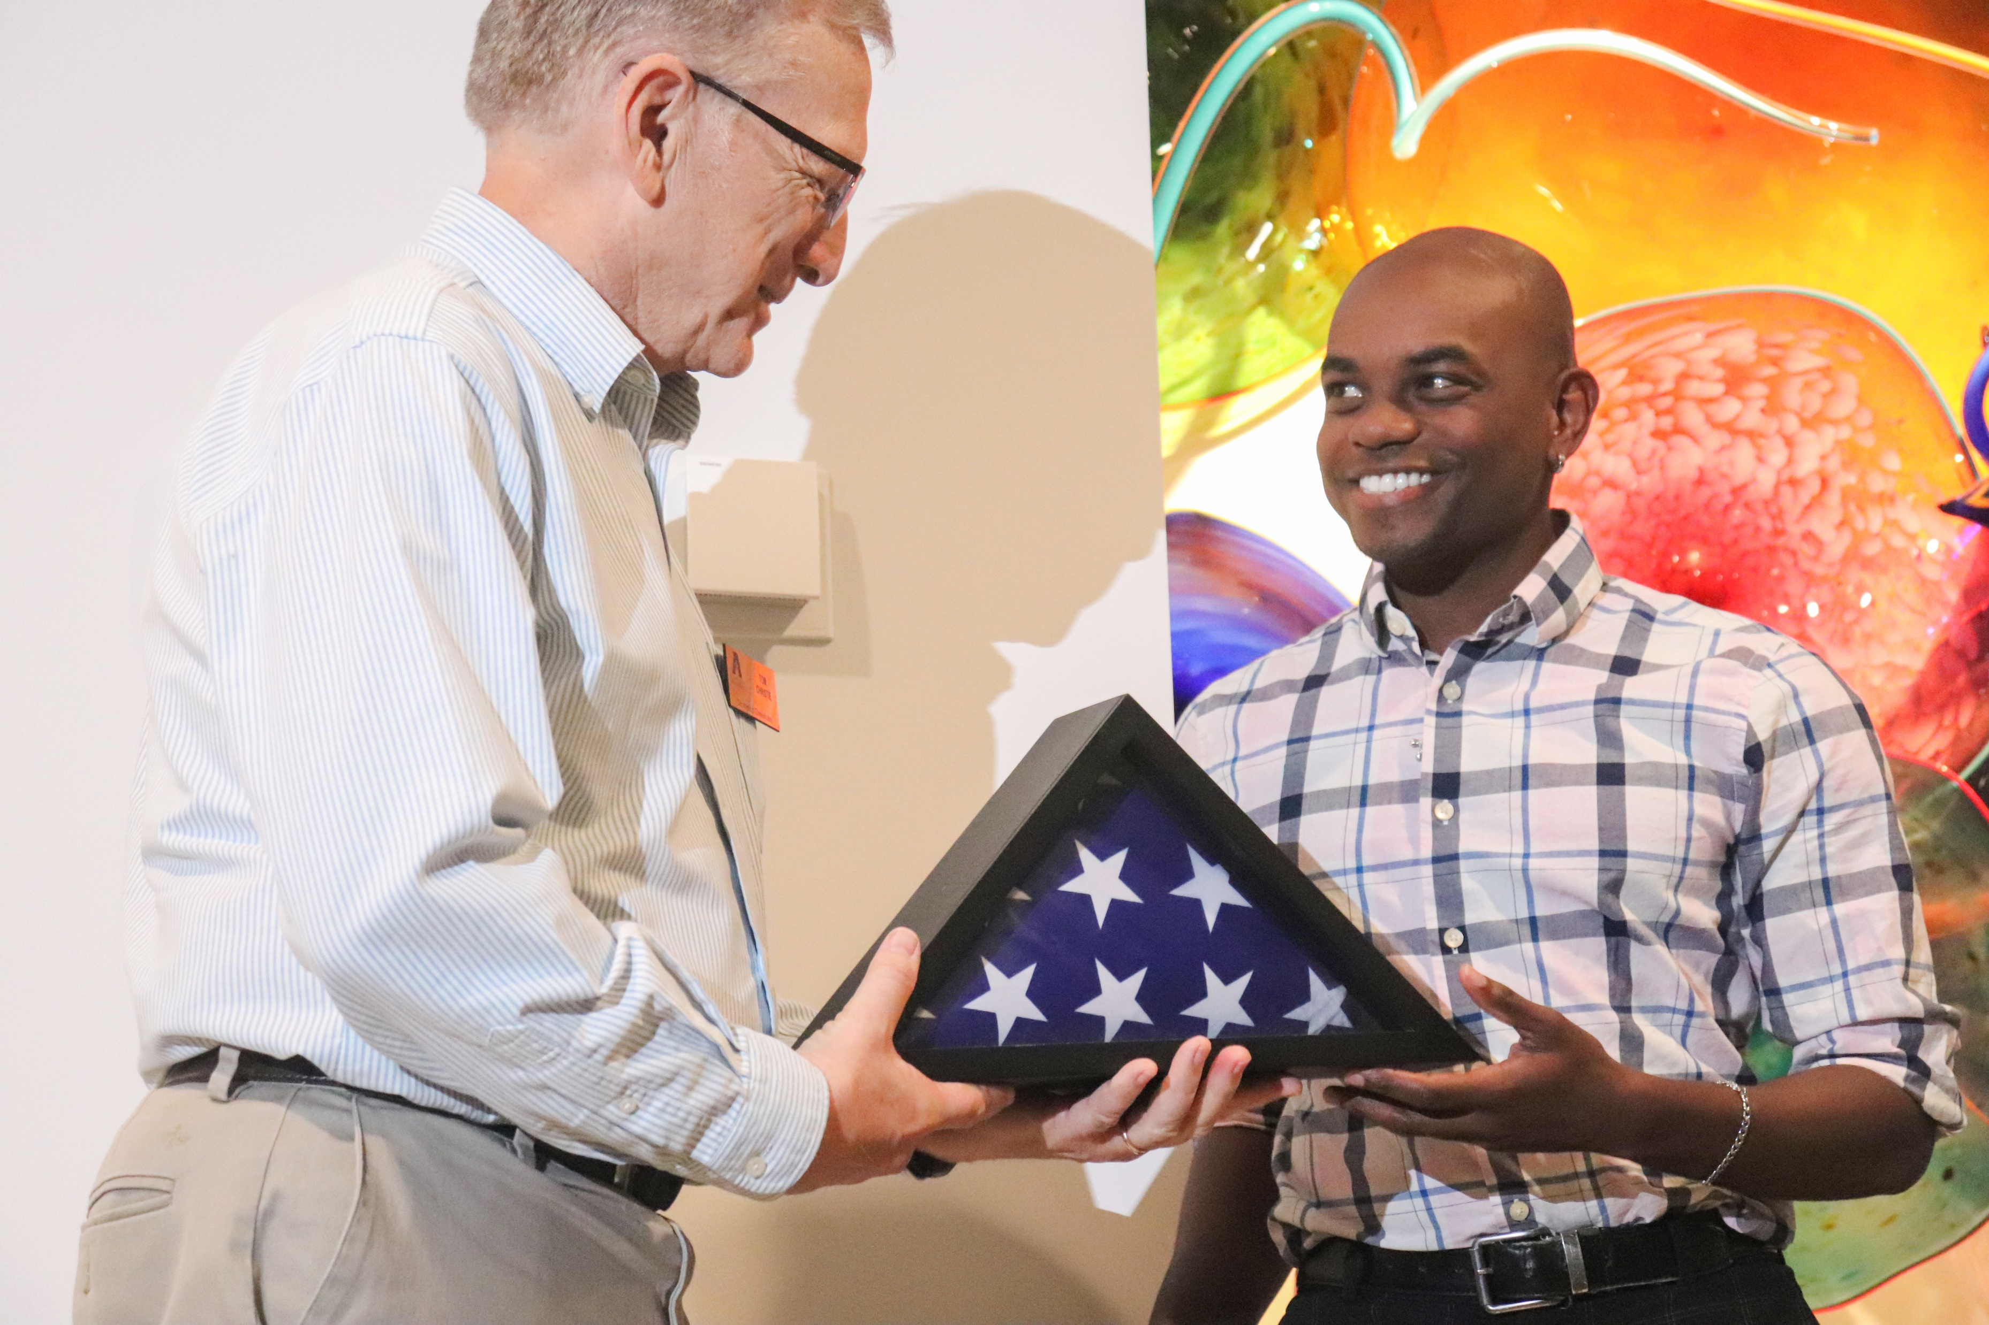
The Template
The Total Army Sponsorship Program is designed to help commanders enhance resiliency among Soldiers and Family members and to ensure smooth transitions into the Army or into new units. TASP helps commanders successfully receive and integrate Soldiers and Families into their units, installations, facilities and communities.
Good sponsorship promotes:
Successful adjustment for newcomers
Morale
Well-being
Readiness
Adaptation
Successful missions
The Role of a Sponsor
Sponsors ease the transition process through familiarity, reliability and trust. Sponsors help lower risk factors that lead to negative experiences for Soldiers and DA Civilians and increase protective factors.
https://www.armyresilience.army.mil/TASP/role-of-a-sponsor.html

Slide 4
Key benefits of Peer Mentor Programs for Military-Connected Students.
Smooth Transition to Academic Life:
Peer mentors can help student veterans navigate the transition from military service to the academic environment, providing guidance on academic policies, procedures, and resources (Smith, 2015).
Enhanced Academic Performance:
Student veterans who participate in peer mentor programs tend to perform better academically due to the support, study strategies, and time management skills they receive (Hoyt & Leierer, 2016).
Reduced Sense of Isolation:
Peer mentors can create a sense of belonging and reduce feelings of isolation by fostering connections with fellow student veterans, leading to increased retention rates (Petkus, 2019).
Mental Health and Well-being:
Peer mentor programs can offer a support system for addressing mental health challenges, such as PTSD or anxiety, through shared experiences and access to resources (Savarese et al., 2016).
Employment and Career Development:
Peer mentors can guide student veterans in career development, resume building, and networking, which can help them successfully transition to civilian careers (Jasmin et al., 2018).
Access to Campus Resources:
Peer mentors can help student veterans become aware of and effectively utilize campus resources, such as counseling services, disability accommodations, and veteran-specific services (Wright et al., 2018).
Improved Sense of Self-efficacy:
Interaction with peer mentors can enhance self-confidence and a sense of self-efficacy among student veterans, leading to increased empowerment and engagement (Turner & Turner, 2018).
Faster Adjustment to College Life:
Peer mentors can facilitate a quicker adjustment to the college environment, helping student veterans become familiar with the campus and its culture (Laanan et al., 2010).
Enhanced Communication Skills:
As mentors, student veterans can develop improved communication and leadership skills, which can be valuable in their future careers (Cseh & Kleve, 2018).
Community and Networking:
Peer mentor programs can foster a sense of community and create opportunities for networking among student veterans, which can be beneficial for academic and career pursuits (Lis, 2012).

Slide 5
Homegrown or Canned?
Our Goals:
Create a free to students resource that mirrors the U.S. Military Sponsor Program allowing Junior & Senior Level Military-Connected Students to help new UTA Military-Connected Students with:
Transitioning into UTA
Campus Navigation
Involvement & Engagement
Resource Identification/Referral
Academic Assistance
Career Readiness
Resources Available in 2018
$0 Budget
Two Volunteer Student Veterans
MAVS Staff & Three semi intrigued Faculty Members
PAVE is a peer support program that connects incoming student veterans on college campuses with student veterans who are trained as Peer Advisors who can help them navigate college life, address challenges they may face, refer them to appropriate resources on and off campus, and provide ongoing support.
PAVE is a partnership between the Eisenberg Family Depression Center at the University of Michigan and Student Veterans of America.
Terms of partnership
Schools selected to become PAVE Partner Campuses
must agree to the following:
Attend a 1-day virtual training
Sign a brief contract with the University of Michigan that outlines the scope of the program, cost, and terms of use
Agree to keep track of the number of student veterans who get services through the program, the concerns they identify, and the school resources used
Be willing to secure arrangements with on and off campus resources for veterans
Licensing fees
Cost for Year 1: $8,500 Cost for Year 2 and each subsequent year: $5,500

Slide 6
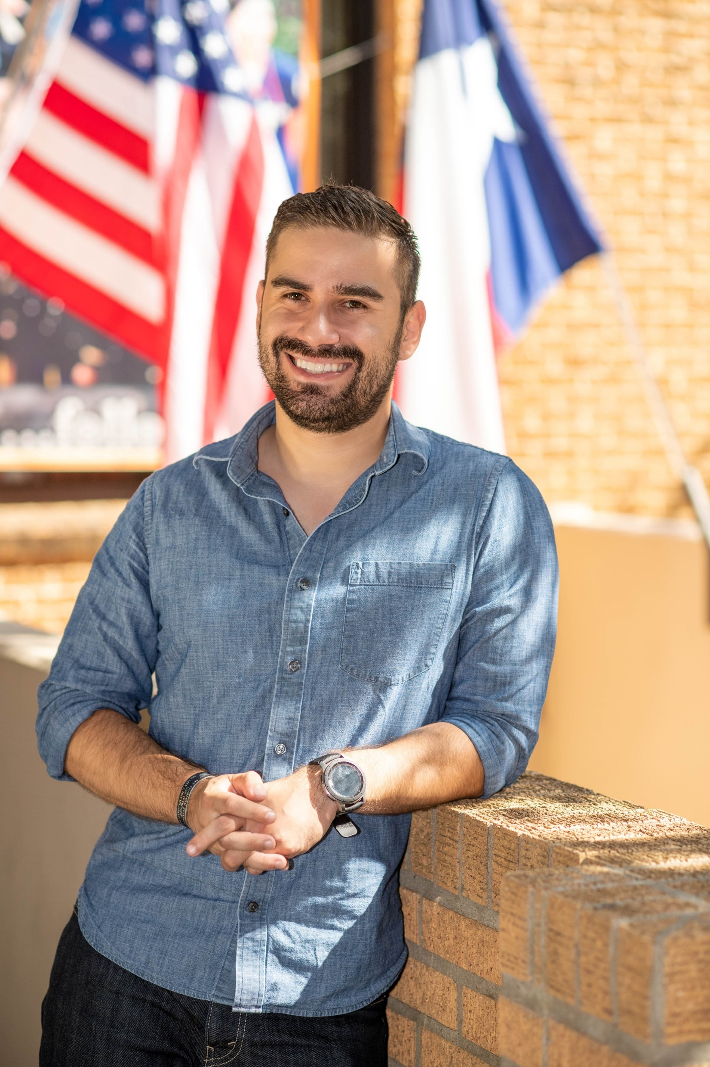
UTA Veteran’s Edge Peer Mentor Program is Born
What is Veteran’s Edge Peer Mentorship?
The Veteran’s Edge Peer Mentorship is a program where established junior and senior level
military-connected students’ mentor incoming military-connected students. A Peer Mentor
can help encourage student involvement in any student-oriented activity. From resource
referral to academic support, mentors provide the necessary tools for student success.
Why Veteran’s Edge Peer Mentorship?
Military-connected students may need educational assistance, help finding resources, or
sometimes personal guidance. Peer Mentors are a resource for the UTA military-connected
student. The program is free, and designed for all Military-Connected Students, but participation is not required.
How Can a Peer Mentor Help?
Mentors are NOT meant to do their mentees’ homework or help them to bypass set
University policy and procedures. Rather mentors are meant to be a resource in obtaining
proper academic assistance, navigating obstacles unique to military-connected students,
and connecting with campus and community resources.
Mentors in the program are military-connected students themselves, who are familiar with and know how to navigate the obstacles many of our military-connected students face in working toward achieving degrees.
Veteran’s Edge provides students the opportunity to build camaraderie amongst military-connected students and provides the tools necessary to assist those who may be struggling.

Slide 7
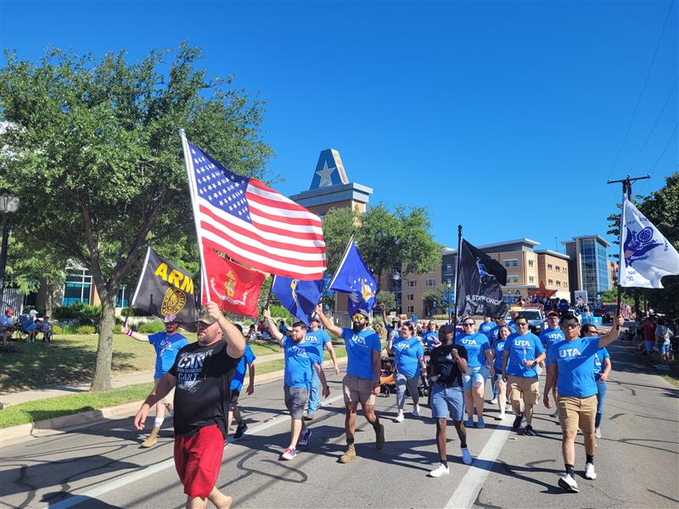
Mentor Expectations
Peer mentors are subject to all UTA Staff and Student Worker policies, and UTA Military and Veteran Services department expectations.
Mentors must:
Be currently enrolled at UTA
Work an average of 3 hours per week
maintain a cumulative GPA of 2.5 or better
Adhere to the UTA Student Code of Conduct
Create and maintain a Mentee Record of Engagement (MRE)
Attempt to connect with assigned mentees 3 times a semester
Be a good representative of UTA Military and Veteran Services
Attend the Division of Student Affairs Student Employee Training
Market, encourage, and document participation of mentees at campus programs/events
Meet with The Military and Veteran Services Coordinator at least once every two weeks
Participate in additional trainings as needed to acquire a comprehensive knowledge of UTA resources
Participate in a minimum of five Military and Veteran Services supported activities/events each semester
(Fourth of July/Homecoming parades, and all military appreciation sporting events are required for mentors unless prior excusal is received)
A Mentor will be terminated immediately from their position if they withdraw from the university, fail to meet listed requirements, violate the UTA student code of conduct, or are found engaging in activities unbecoming of a UTA Military and Veteran Services Veteran’s Edge Peer Mentor.

Slide 8
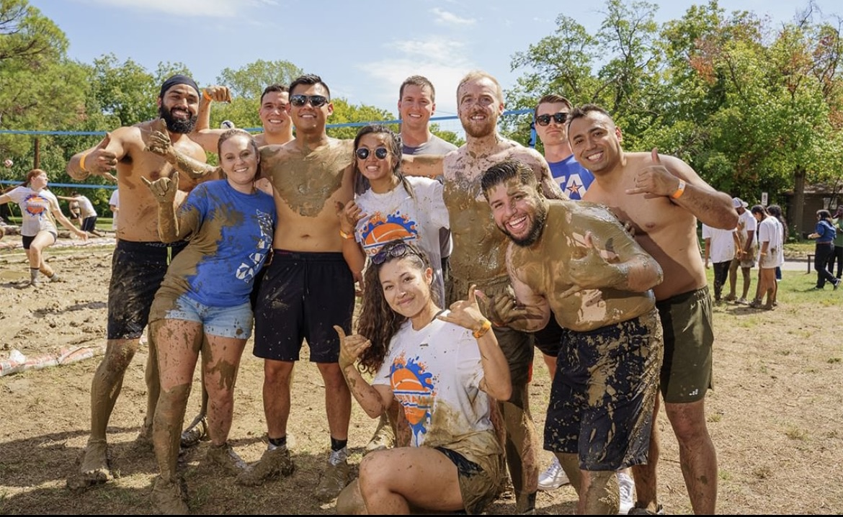
Training Mentors
UTA Campus Resources/Services:
The Office for Students with Disabilities
Counseling and Psychological Services
UTA Career Development Center
UTA Division of Student Success
UTA Follett Leadership Center
Student Money Management
Veterans Education Benefits
Campus Tutoring Center
Maverick Advantage
Participation in Key Campus Events
Faculty/Staff Recognition of Military Service Breakfast
Beginning of the Semester Calling Campaign
UTA Military Appreciation Athletics Events
UTA Homecoming Parade/Activities
Arlington Independence Day Parade
Fall Resource Fair/Welcome
National Night Out
Fresh Check Day
Off Campus Resources/Services:
Combined Arms/Texas Veterans Network
The Department of Veterans Affairs
Texas Veterans Commission
Wounded Warrior Project
The Mission Continues
Arlington VetCenter
Peer mentors are trained to assist mentees in areas they are having difficulty related to student success at UTA, to include but not limited to being their first point of contact in referring/connecting with UTA campus resources, marketing events and opportunities, and reporting signs of struggle.

Slide 9
Impact
17
Peer Mentors
5 Per Semester
65%
Male
35%
Female
88.2%
Veteran
11.8%
Dependent
97.9%
Undergraduates
76.5%
First Generation

Slide 10
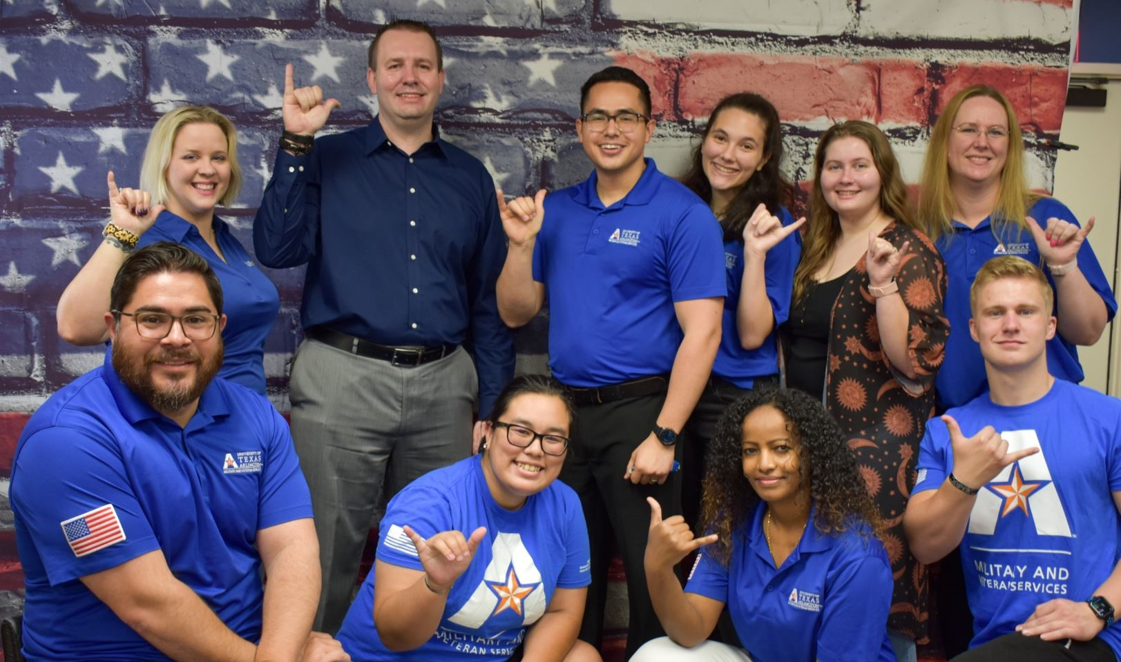
Funding
University of Texas at Arlington Veteran's Edge Mentoring Project Budget
Academic Year 2023-2024 | Expense
Peer mentor wages: 5 mentors @ $12/19hr wk/40 wks a year | $45,000.00
Marketing and recruitment: Advertising materials and giveaways | $3,000.00
Professional Development: Mentor and staff training | $2,000.00
Events: Career Development and Student Engagement | $2,000.00
TOTAL | $52,000.00
SPONSORSHIP
FUNDING
STUDENT SERVICE FEE ALLOCATION
DONATION

Slide 11
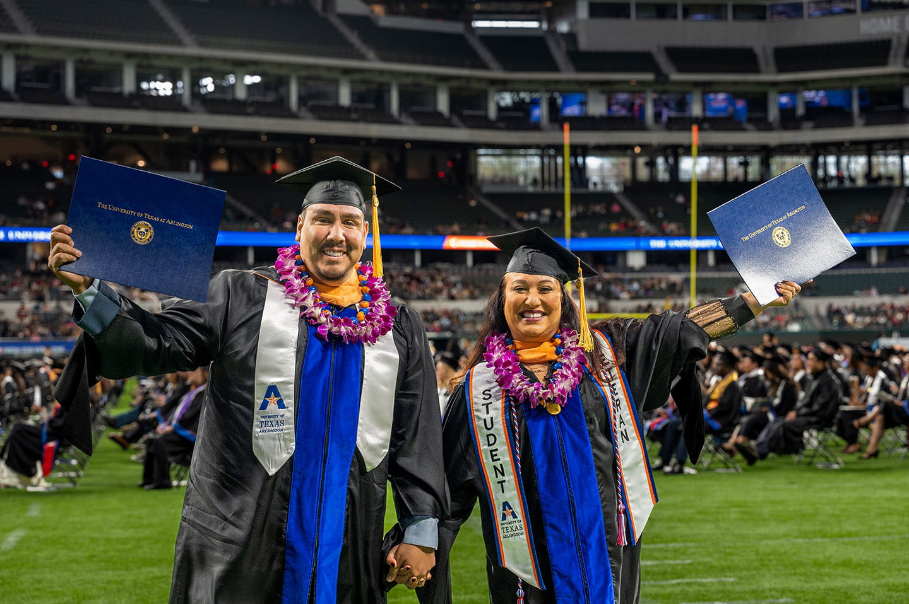
Maintaining/Evolving the Program
Identify Goals that Align with the University/College Strategic Plan
Create a Clear, Realistic, Flexible, and Easily Understood Vision
Student, Guided, Owned, and Operated
Tell the Story Frequently and Often
Seek Various Funding Sources
Transparent Communication
Celebrate Your Students
Engage the Community

Slide 12
Convincing Leadership
Research and Planning:
Identify the need and demand for a Peer Mentor program. Is there a gap in the current offerings, or is this program essential for addressing emerging trends or student needs?
Gather data and evidence to support your proposal. This might include market research, surveys, or consultations with relevant stakeholders.
Define the program's objectives, expected outcomes, and potential impact on the university and its community.
Create a Detailed Proposal:
Develop a comprehensive proposal that outlines the program's purpose, curriculum, target audience, and expected benefits.
Include a clear and concise executive summary at the beginning of the proposal for quick understanding.
Provide a detailed program outline, including learning outcomes, and a timeline for implementation.
Include a budget that covers both the startup costs and ongoing operational expenses.
Build a Team:
Assemble a team of highly motivated students, faculty, and staff who will be responsible for designing, implementing, and managing the program.
Highlight the qualifications and expertise of each team member in the proposal.
Engage Stakeholders:
Identify and engage key stakeholders, such as faculty members, students, alumni, industry partners, and relevant university committees or departments.
Seek their input and support for the new program.

Slide 13
Convincing Leadership
Alignment with University Goals:
Clearly demonstrate how the proposed program aligns with the university's mission, vision, and strategic goals.
Risk Analysis:
Identify potential challenges and risks associated with the program and explain how you plan to mitigate them.
Financial Projections:
Present a financial plan that includes revenue sources and expected costs.
Highlight potential sources of funding, including grants, donations, or partnerships.
Implementation Plan:
If the program is approved, create a detailed plan for its implementation, including hiring staff, marketing, and student recruitment.
Timeline and Milestones:
Provide a timeline for the program's development, including key milestones and deadlines.
Monitoring and Evaluation:
Establish a system for ongoing monitoring and evaluation to ensure the program's success and make necessary adjustments.

Slide 14
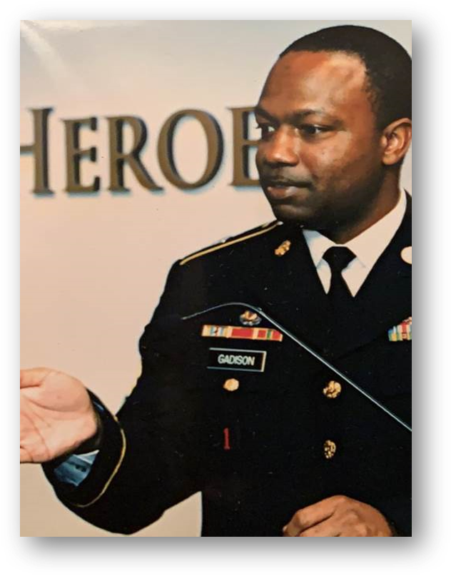
“UTA was the last school I applied to and the first school that I heard back from. I have received tremendous support from Veteran Services, faculty, the Political Science Department, and the College of Liberal Arts.”
Derron (Edwin) Gadison
United States Army Retired
UTA 2022 (Political Science)

Slide 15
QUESTIONS?
Source: Marvel Studios 2013

Slide 16
References
Cseh, M., & Kleve, S. (2018). The role of peer mentoring in the support of military-connected students in higher education. Journal of Veterans Studies, 4(1), 87-99.
Hoyt, A., & Leierer, S. (2016). Establishing a peer mentor program for military-connected students: Benefits and challenges. Journal of College Student Retention: Research, Theory & Practice, 18(3), 270-284.
Jasmin, L. K., Gironda, R. J., & Rosopa, P. J. (2018). Impact of a student veteran peer mentoring program on student veteran adaptation to college. Journal of Student Affairs Research and Practice, 55(2), 144-158.
Laanan, F. S., Starobin, S. S., & Eggleton, T. J. (2010). An exploration of the relationship between peer mentoring training and student learning outcomes among peer mentors at a public four-year institution of higher education. Journal of The First-Year Experience & Students in Transition, 22(1), 7-27.
Lis, A. (2012). Supporting veterans in higher education through peer mentoring. Journal of College Student Retention: Research, Theory & Practice, 13(2), 143-162.
Petkus, E. (2019). Veteran students and peer mentoring: A study of military cultural competency. Journal of College Student Retention: Research, Theory & Practice, 22(3), 293-309.
Savarese, M., Sipos, K., & Wooten, N. (2016). Peer mentorship and veterans transitioning to college: A qualitative examination. Journal of Veterans Studies, 2(2), 1-11.
Smith, D. (2015). Exploring the influence of peer mentorship among student veterans in higher education. The Journal of Veterans Studies, 1(1), 68-80.
Turner, L., & Turner, K. (2018). Returning military veteran student success: Impact of a student peer mentor program. Journal of Military and Veterans’ Health, 26(1), 37-46.
Wright, E., Di Maria, L., Church, M., & Ayers, D. (2018). Peer mentor programs: An innovative approach to retention. Journal of College Student Retention: Research, Theory & Practice, 20(2), 169-191.

