Slide 1
Texas A and M University System Military – Affiliated Student Symposium
Local Government- The Career You Have Never Heard Of

Slide 2
AGENDA - What is “local government”? - Program Description - Jobs - Benefits - What’s next
Notes:
Hello everyone and thank you for joining us today. I am very excited to tell you about the Veterans Local Government Management Fellowship and how it can help you create a new talent pipeline.

Slide 3
More than 200,000 service members return to civilian life every year. Many want to continue a career in service.

Slide 4
ICMA’s Definition of “local government”
A city, town, village, township, borough, or county that has established by legal documents a form of government.

Slide 5
Counties
Public Health, Mental Health, Social Services, Schools, Community Colleges, Juvenile Detention, Soil & Water Conservation, Forest Protection, Medical Examiner, Register of Deeds, Ag Extension, +
Cities
Streets, Street Lighting, Traffic Engineering, Sidewalks, Electric & Gas Systems, Cemeteries, Cable TV
City or County
Aging Programs, Air Pollution Control, Airports, Alcoholic Rehabilitation, Ambulance Services, Animal Shelters, Armories, Art Galleries & Museums, Auditoriums & Coliseums, Beach Erosion Control/Hurricane Prep, Bus Lines/Public Transportation, Civil Defense, Community Action, Community Appearance, Community Development, Drug Abuse Programs, Economic Development, Fire Protection, Historic Preservation, Hospitals, Human Relations, Industrial Promotion, Inspections, Jails, Law Enforcement, Libraries, Manpower, National Guard, Off-Street Parking, Open Space, Parks, Planning, Ports and Harbors, Public Housing,
Recreation, Rescue Squads, Senior Citizens’ Programs, Sewage Collection & Disposal, Solid Waste Collection & Disposal, Storm Drainage,
Urban Redevelopment, Veterans’ Services, Water, Watershed Improvement
Purple = Positions in the military as well as municipalities

Slide 6
CONTINUE A CAREER IN SERVICE BY WORKING IN LOCAL GOVERNEMENT
Stable employment
Excellent Benefits
Professional development and upward mobility
Ample time off
Notes:
Communications
Bring awareness and tools to members on hiring Veterans
Bring awareness to Veterans of local government career

Slide 7
Opportunity!
State and local government = 13% of nations workforce
881K local government jobs available as of Nov 2022 – 8% of nations job openings
U.S. Bureau of Labor Statistics

Slide 8
Why local government?
In nearly 85% of U.S. cities there is a manager who oversees the day-to-day operations of the community
Local Government offers a broad range of service areas including public safety, public works, and economic development
It’s exciting and challenging work
86% Fellowship completion rating
Notes:
Main Effort to recruit military talent to local government

Slide 9
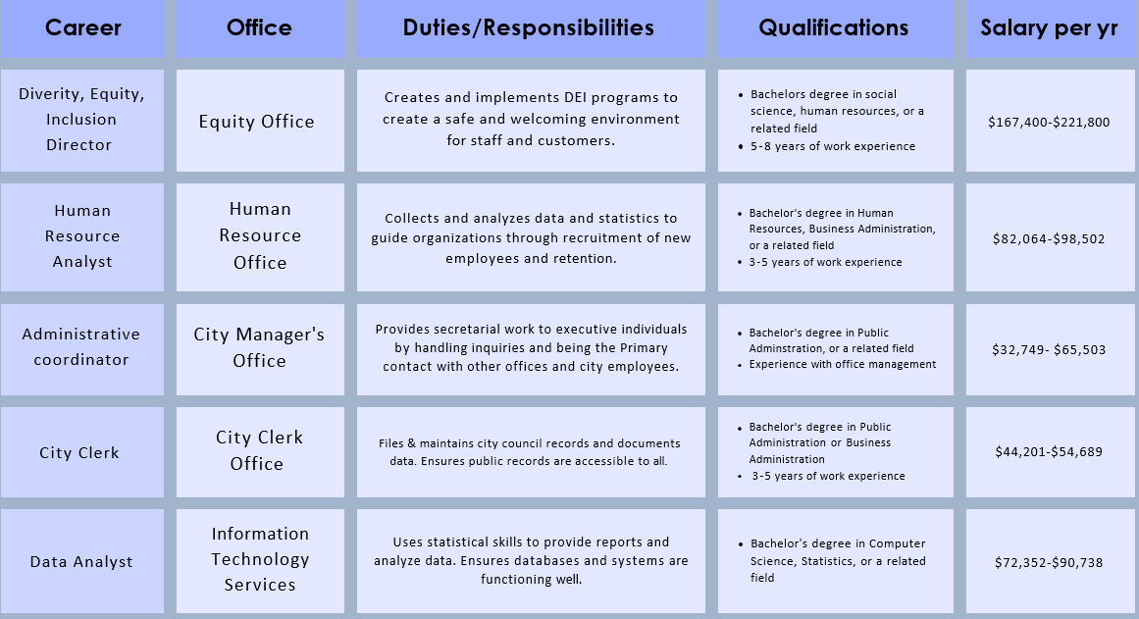
Five careers in management/administration

Slide 10
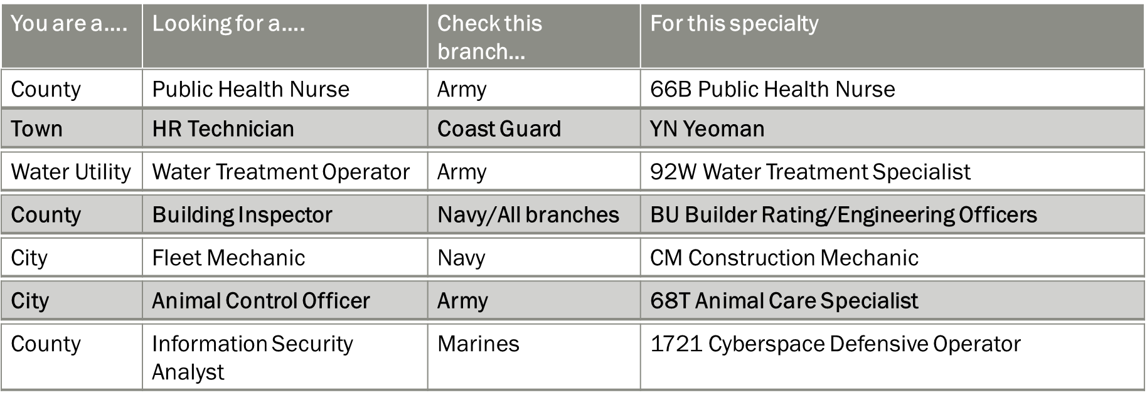
Matching positions to veteran Skillsets

Slide 11
what positions are available today?
Do a Google Search for your city/county webpage and then search “careers”
Use ICMA’s job center https://icma.org/job-center to find job postings
Search https://www.governmentjobs.com/
Read the Veterans Guide to Finding a Job in Local Government

Slide 12
Veterans Local government management fellowship (VLGMF)
The program matches transitioning service members with surrounding local government sponsors based on skills, education, experience and the preference of both parties
12-24 week program designed to provide hands on skills and mentorship to transitioning service members who want to continue to serve in local government
Notes:
We are a Department of Defense SkillBridge program, which means that the fellowship is marketed to transitioning servicemembers in the Army, Air Force, Navy, and Marines.
If your organization has been trying to become part of the SkillBridge program on your own, we are happy to assist you by allowing you to use ICMA’s Memorandum of Understanding with DoD while allowing you to do your own recruiting.
The program assigns a fellow to work in your office for as few as 12 weeks and up to 20 weeks depending on the fellow’s command and transition timeline. They work with your organization much like a grant funded volunteer.
When you are contacted to host a fellow in your community, you have the opportunity to review the application and resume, and interview the fellow prior to the final agreement.

Slide 13
Who are vlgmf?
Primarily Active Duty within 180 days of transition but Spouses/Retirees/Reserve/National Guard are eligible
Bachelor’s Degree and three years of leadership experience OR Associate’s Degree with five years of leadership experience OR enrolled in a program which will result in a higher education degree within three years
Must have strong desire to pursue a career in local government
Notes:
The program was originally designed to focus on senior enlisted and officers (CSM/O6) who wanted to become a town/city/county manager or assistant manager. Since that time the program has grown to also include those in early to mid-career stages.
They have as little as three years on the job leadership experience and as much 20+ years. Most junior enlisted (E4) have at least led small groups of 3-4 or been responsible for training up to 100s of people. Some have Masters degrees while some are still completing their Bachelors.
Many of them have never applied for a job or worked in a civilian organization. They have gone where the military needed them and never had to manage their own career. This is where your mentorship can greatly benefit them.

Slide 14
resources
https://icma.org/vlgmf/host-community-information
https://icma.org/building-veteran-fellow-work-plan
https://icma.org/documents/human-resources-recruitment-handbook-hiring-veterans-local-government-positions
https://www.tml.org/
https://www.tcma.org/
Notes:
Please check out the webpages listed here, we have several great resources, one of which is the human resources guide to hiring veterans into local government positions

Slide 15
How to prepare for a local government career – A Way
- Volunteer in your local community – Boards, Events, City Council
- Join a Professional Organization- Texas Municipal League, Texas City Manager Association
- Education- Masters in Public Administration, Certificates, Credentials: PMP, SHRM
- Veterans Local Government Fellowship (VLGMF)

Slide 16
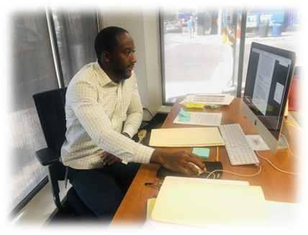
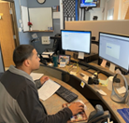
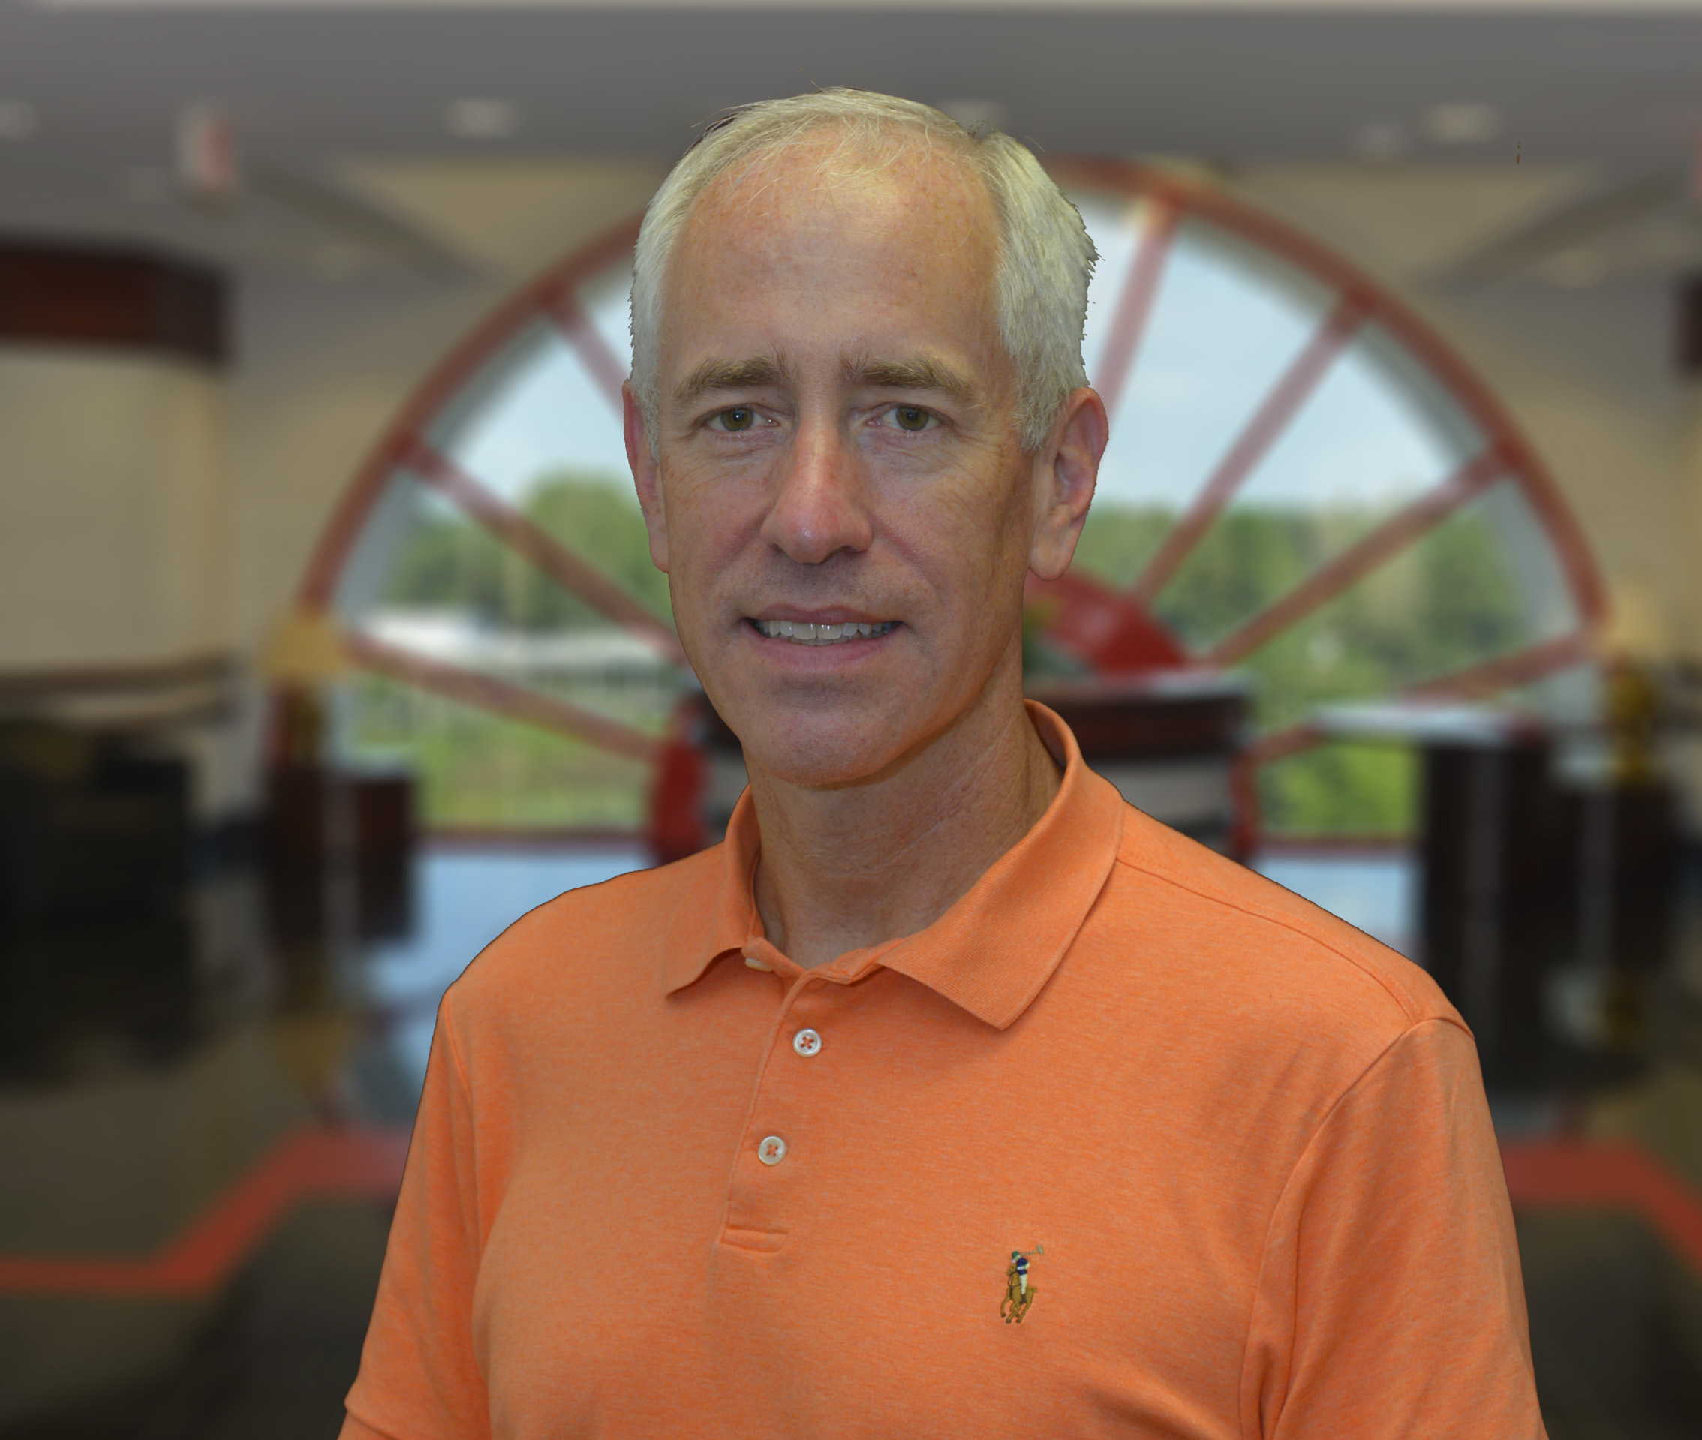
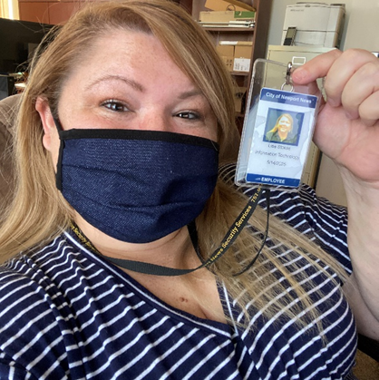
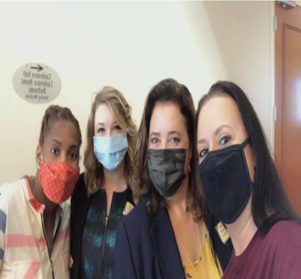
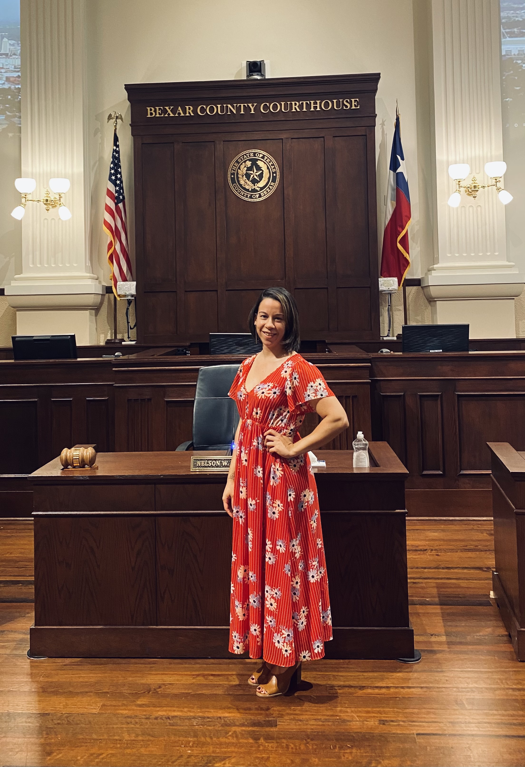
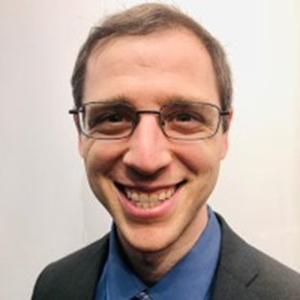
What’s next
Help spread the word about careers in local government!
E-mail: deanhuard@thehillstx.gov
Call: 254 314 7180

Slide 17
vetERANS IN LOcAL GOVERNMENT: STILL SERVING #Country and community

