Slide 1
TAMUS MILITARY-AFFILIATED STUDENT SYMPOSIUM

Slide 2
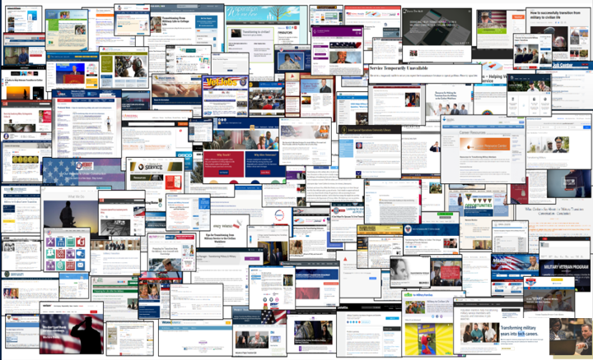
THE NEED
This is what military members face when they Google veteran resources or assistance.
Notes:
-Texas is home to more than 1.4 million veterans. Yearly, between 22,000 to 27,000 military service members return to Texas or remain in Texas upon exiting military service. (TVC 2021)
- More than 1,900 military/ veteran serving nonprofits in Texas

Slide 3
MAKING TEXAS THE FIRST INTERCONNECTED STATE FOR VETERANS
TEXAS VETERANS NETWORK
The Texas Veterans Network (TVN) is a statewide collaborative of more than 300+ veteran-serving, community-based organizations and government agencies that holistically serve the veteran and military community. Together we offer more than 1,500 resources for the military-affiliated community.

Slide 5
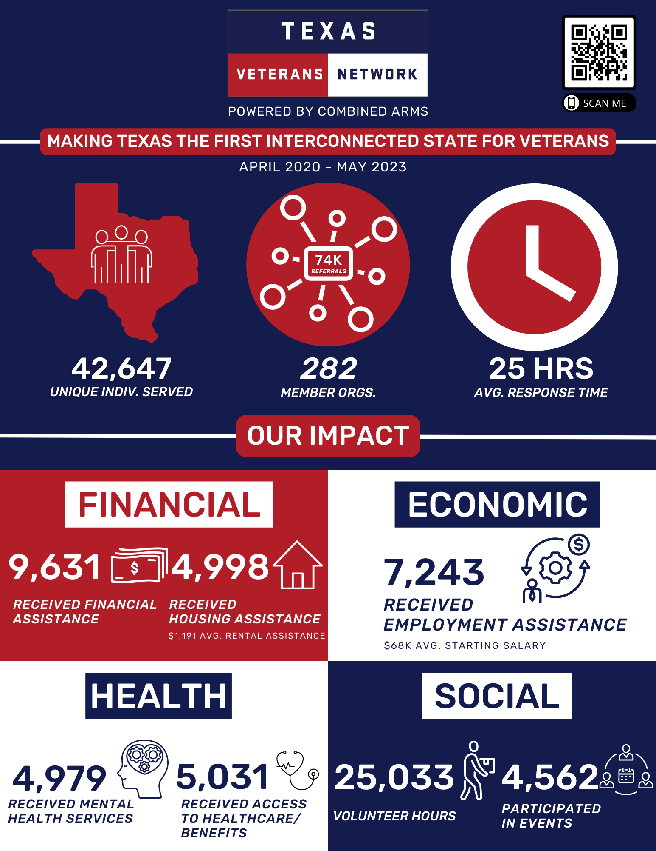
TEXAS VETERANS NETWORK METRICS
Highest needs:
Financial Assistance
Food Assistance
Career and Professional Services
Top Requested Organizations:
Texas Community/County Food Banks
Texas Veterans Commission
Wounded Warrior Project

Slide 6
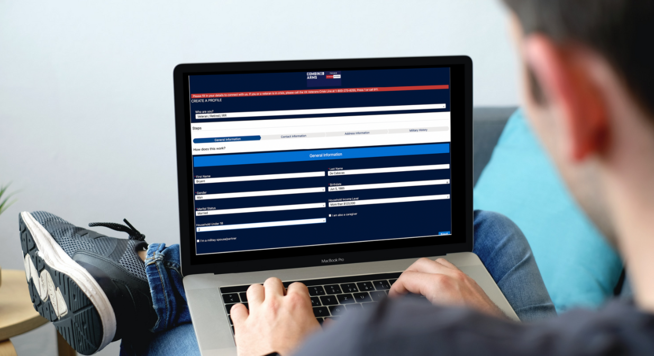
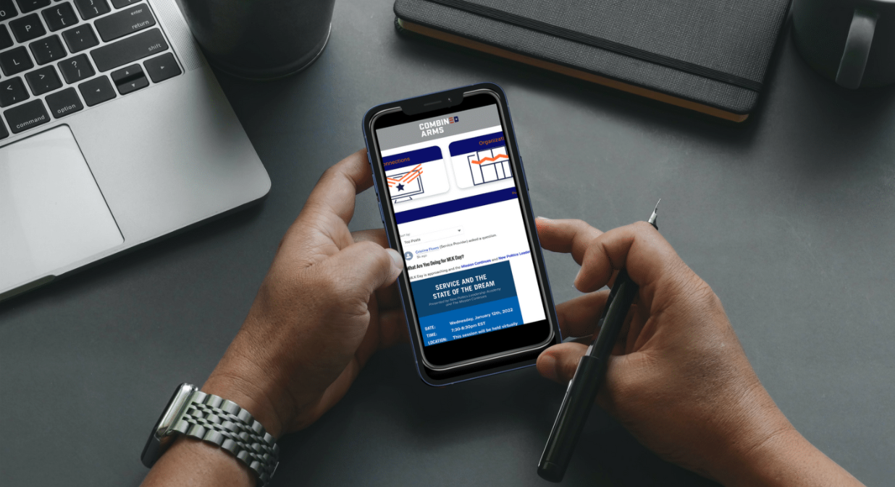
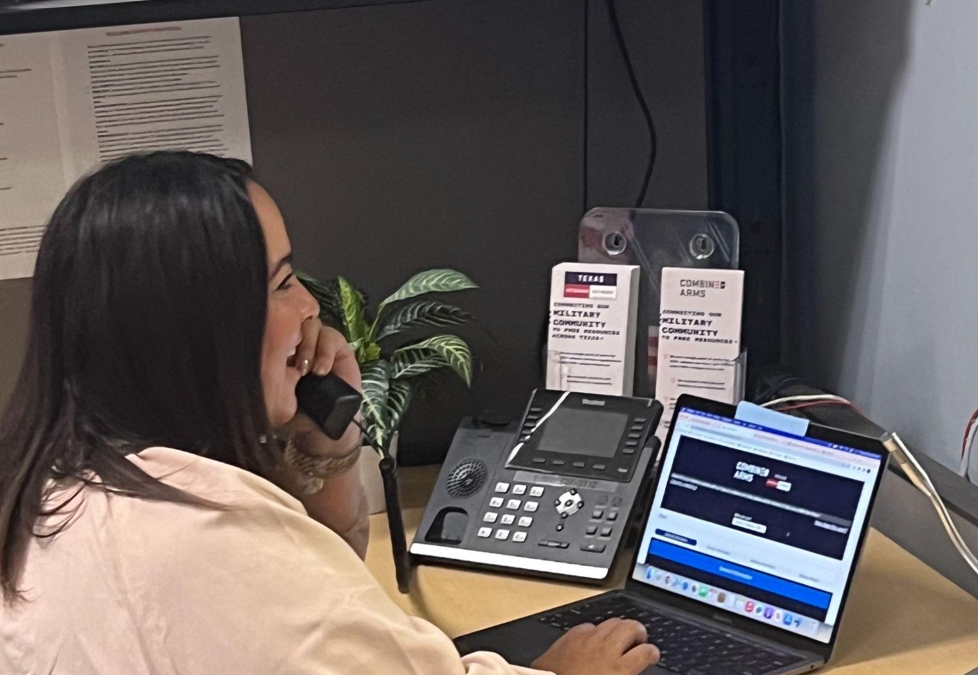
HOW TO CONNECT
SELF DRIVE
Send client the link, to Create a Profile on their own
Client will be able to self drive to the resources they need
COMMUNITY CONNECTOR
As a Member Organization or community ambassador, you can download the Combined Arms app and make referrals as a Community Connector
Click here to gain access
CALL INTAKE TEAM
TVN has a 24/7 phone line, with intake staff ready to connect veterans to the resources they need
Call 844-4TX-VETS

Slide 7
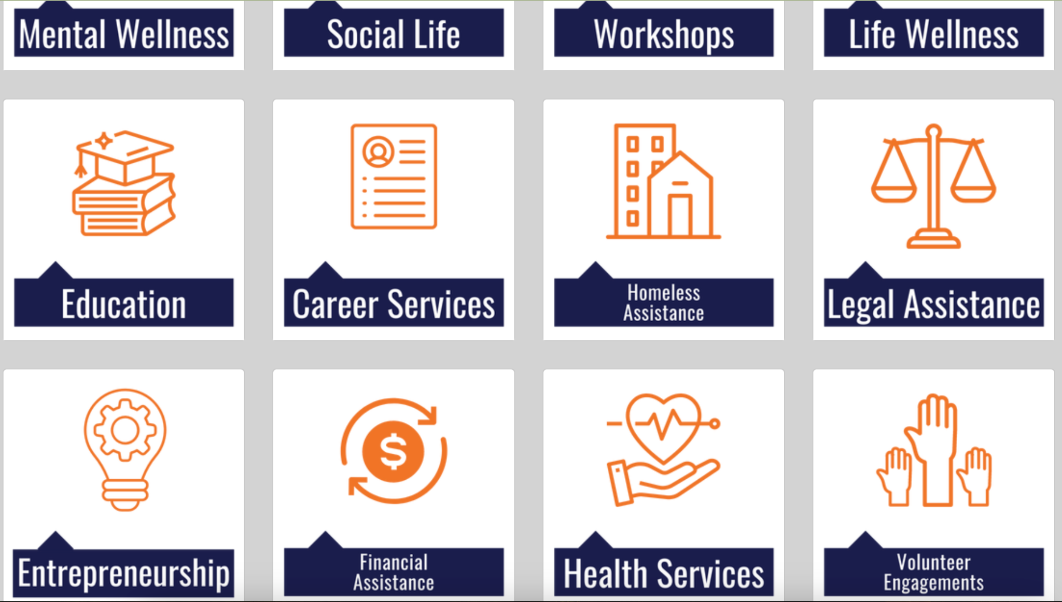

Slide 8
BENEFITS AS A MEMBER ORGANIZATION
MARKETING
COLLABORATION
DATA

Slide 9
MEMBER ORGANIZATIONS

Slide 10
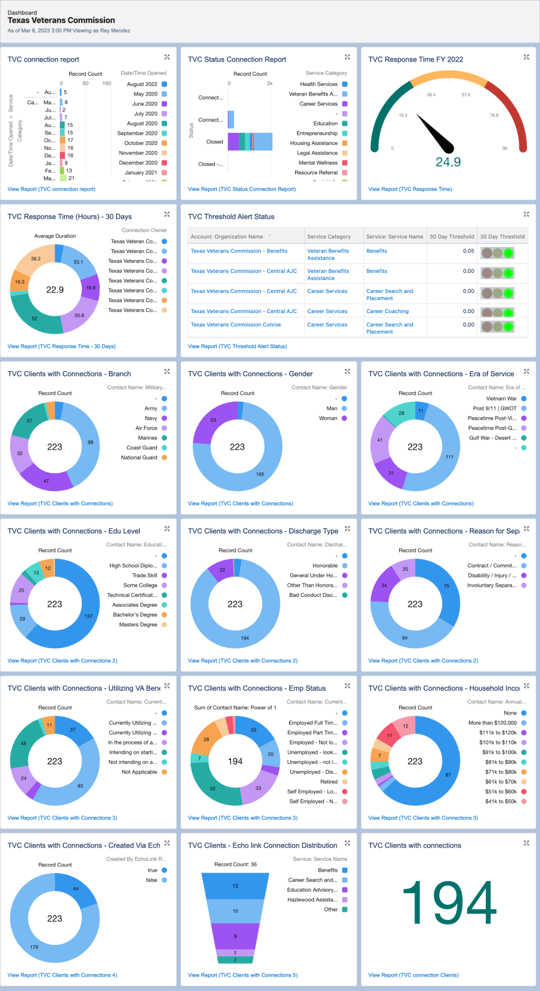
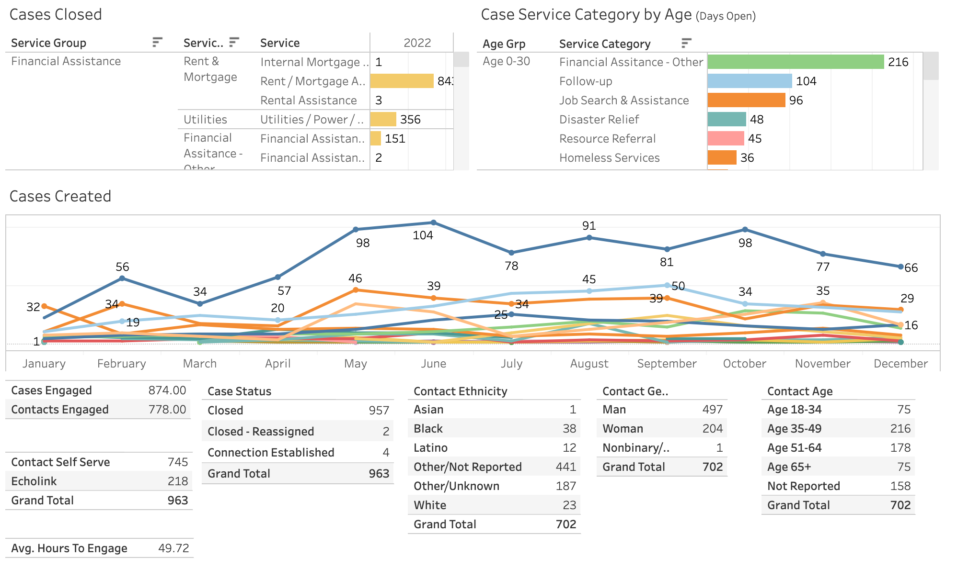
USING DATA TO DRIVE DECISIONS

Slide 11
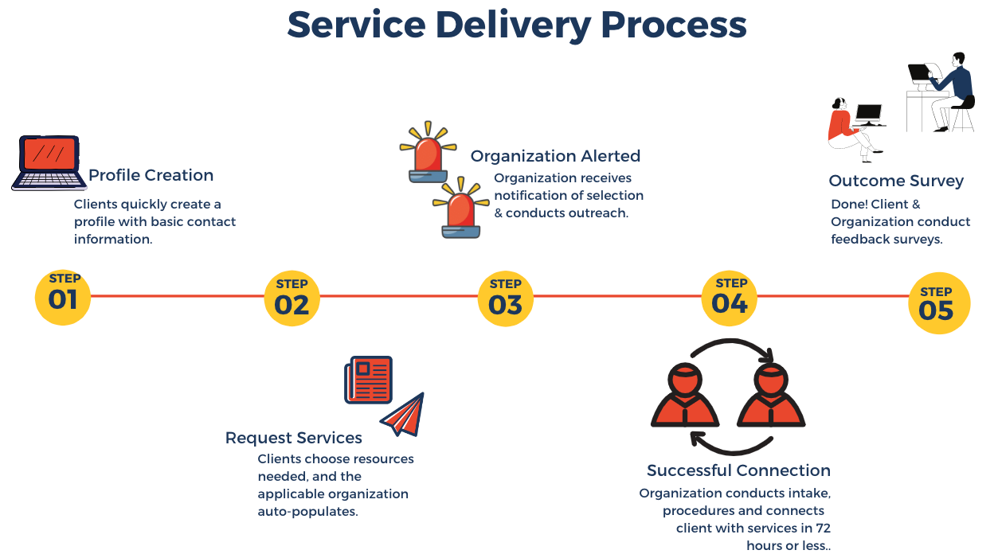
COMBINED ARMS TECHNOLOGY

Slide 12
What else do you need?

