Slide 1
Build a Better World: Veterans in the TAMU SoA
Interim Dean of the School of Architecture
Patrick C. Suermann, PhD, PE, LEED AP, F. ASCE, F.SAME
Lt Col, USAF, ret.

Slide 2
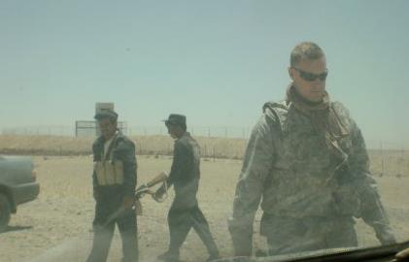
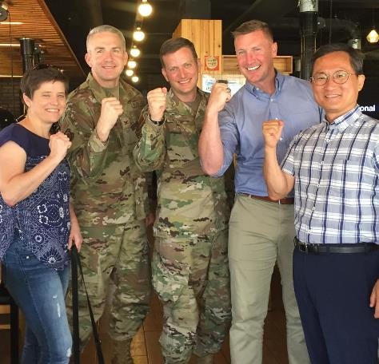
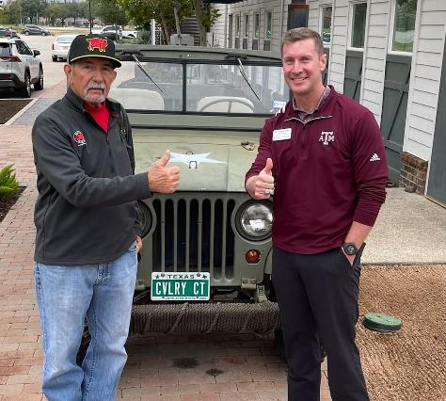
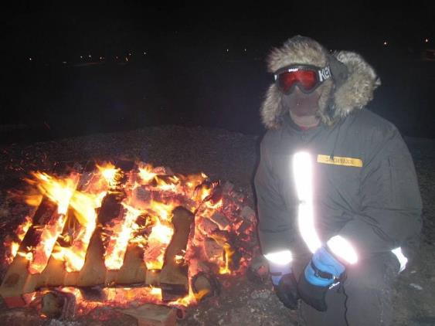
Overview
Introduction
Background
PLAN
DESIGN
DELIVER
Summary

Slide 3
“Very often, the successful scientist must simultaneously demonstrate traits of both the traditionalist and the iconoclast.” --Thomas Kuhn, 1962 The Structure of Scientific Revolutions
Notes:
Many of you probably already heard me reference this quote that is as salient today in 2023 as it was 60+ years ago. Applied to administrative leadership, I want to allay any fears you may have of immediate or drastic change. My goal in this time as the College of Architecture is to listen and learn so that, IF NEEDED, changes can be planned for a successful launch in FY23 on September 1, 2022. Much like the number 23 connotes, I think 23 will be the best year in TAMU’s history and certainly most revolutionary since General Earl Rudder was President in the 1960s. We’ve already begun a SOAR-based strategic planning process that will be led by Dr. Shannon Van Zandt that will help us navigate this transformative time and achieve the best version of ourselves.

Slide 4
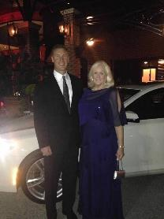
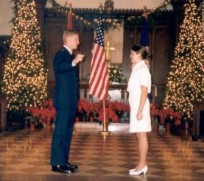
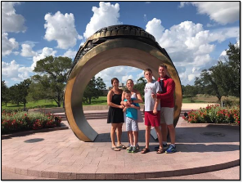
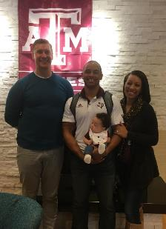
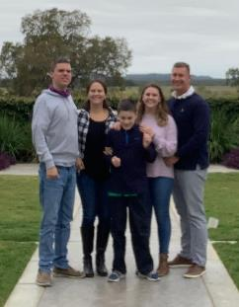
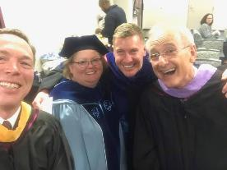
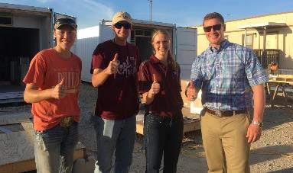
What’s Important?
Notes:
While I am an engineer, I am a very visual person. I will often choose to speak to you through pictures and I hope that I can relate to you through these photos of what’s important to me. While I may not always mention them, I really define myself by my family. They’ve had to find their own way for many months and years when I was deployed around the world in the Air Force on deployments building things in Saudi Arabia, Guam, across the Pacific, the U.S., and later in Afghanistan and Greenland.
But, my wife is also a veteran in her own right. She was the first female commissioned in the Navy from The Citadel, the military college of South Carolina, in 1998. While she went on to separate from active duty as an O-3, Lieutenant in the USN, when we found out our daughter would be joining us 14 months after our first child, Drew, she is still a registered L&D nurse and licensed Doula. When our third son, Jack, joined as a bonus gift in Gainesville, FL and we learned he also had autism like his older brother, Drew, Megan went back to school at Texas State while I was in Afghanistan and Greenland and earned her Master’s in Education and Psychology so she could go on to become a Board Certified Behavior Analyst (BCBA) and help our children as well as other military dependents where autism is raising to epidemic levels.
Looking ahead, now Drew is 19, Isabelle will be 18 in 11 days, and Jack will be 14 next month. After Megan and I both moved frequently as kids, we wanted to let our daughter make it through High School with her peers and help retain Drew and Jack’s autism services, so these last 4.5 years, they remained in New Braunfels while I gave it 100% here. Probably my happiest part of taking this new role is that my wife has committed to help Isabelle graduate and go on to her chosen college, but that Megan, Drew, and Jack will move here to College Station sometime this summer as Jack starts High School. <3
These other photos are all special to me because the represent moments in my life where the smiles were real: partnering with other caring leaders of the school, hosting former students for football games, seeing our students work at BUILD or other things near and dear to their hearts, tackling research and construction challenges with the NSF, or up in the top left corner, spending time with extended family.
One of the things that you will see about me is that I follow a saying I heard from a VMI grad, MG Bo Temple, “I’m not in a rush, but I am in hurry.” You see, my parents both passed away at relatively young ages in 2011 and 2019 due to variants of pancreatic cancer and I know that our time on this earth is limited. I am excited to “leave it all on the field” here at A&M and after a decade or so of doing all I can to support you, I look forward to a real retirement with my family as our boys, Drew and Jack, will live with us forever until we pass and someone else is charged with giving them the dignity and pursuit of happiness that should be afforded all people.

Slide 5
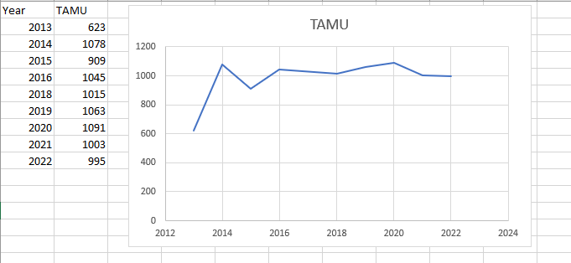
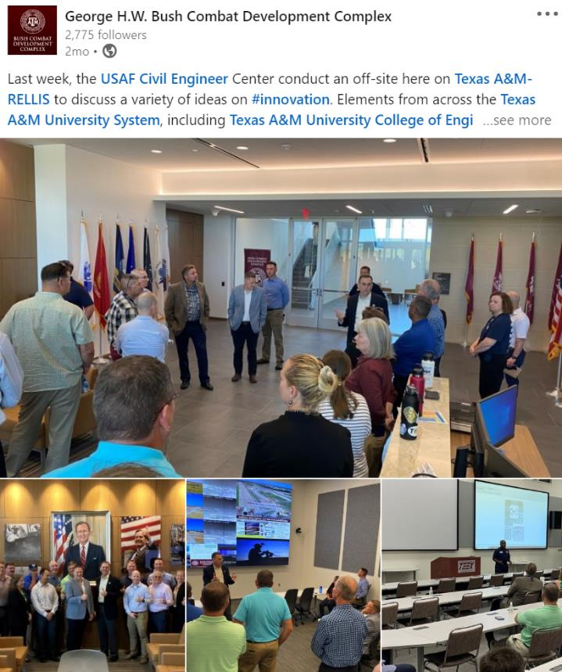
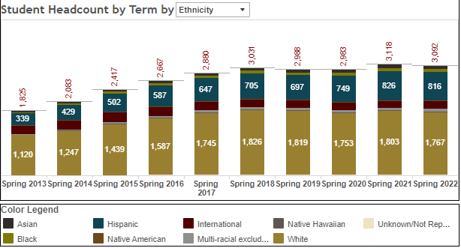
Background

Slide 6
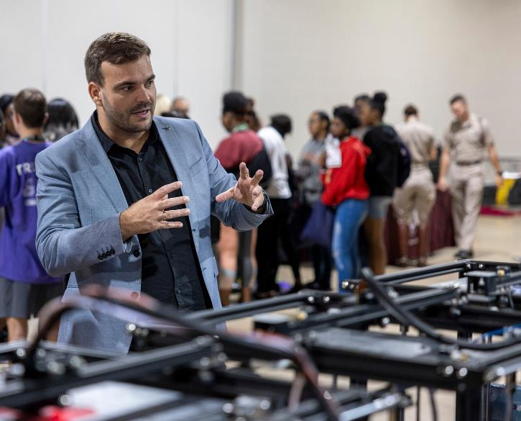
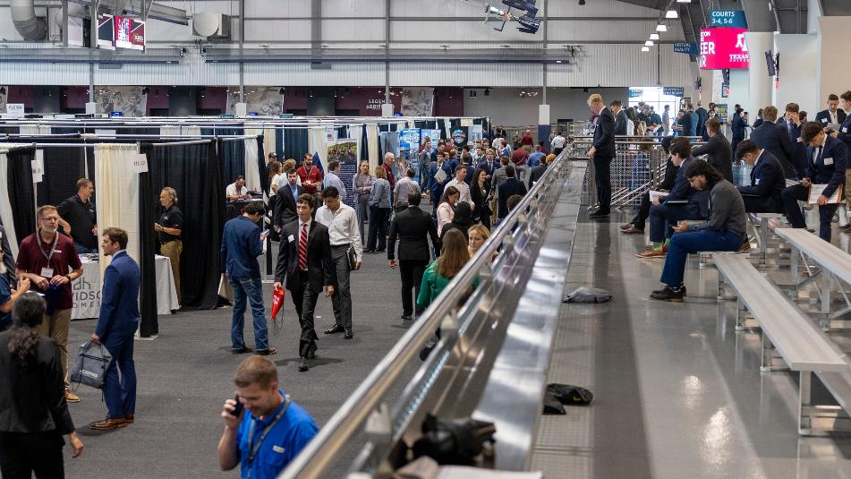
PLAN->DESIGN->DELIVER

Slide 7
PLAN: LAUP Rankings
#10 in 2021 Best Colleges with Landscape Architecture Degrees in America from niche.com
#4 in 2021 Highest Paid Landscape Architecture Graduates from collegefactual.com
#7 2021 Top Landscape Architecture Bachelors Degree Programs from collegeraptor.com
#12 Best Landscape Design Schools in the World (mentioned BLA program) from worldscholarshipforum.com
#6 for Most Popular Schools for Landscape Architecture from stateuniversity.com
#2 in 2021 Affordable Urban Planning Degrees from College affordability guide: collegeaffordabilityguide.org
#2 in 2021 Masters in Urban Community and Regional Planning Programs in Texas from niche.com
#10 2021 Best 15 Masters in Urban Planning in 2021 from Best Value Schools: bestvalueschools.org
#10 2021 Top City/Urban, Community and Regional Planning Bachelors degree Programs (mentioned BLA program) from collegeraptor.com

Slide 8
DESIGN: Arch. Growth Areas
Existing:
B. ENDS→ B.S. Architecture
M.S. Architecture→ STEM coded with research focus areas
New Programs:
Bachelor of Architecture (5-year professional program, NAAB Accredited at 150 credit hours)
Bachelor of Science in Interiors (4-year, CIDA Accredited program at 120 credit hours)
Bachelor of Science in Design Studies ((4-year, non-studio based, STEM-designated degree program at 120 credit hours)
Notes:
The Department of Architecture has two existing programs that are changing based upon the evolution of the undergraduate and graduate curriculum.
The Bachelor of Environmental Design (4-year pre-professional program at 120 credit hours) is being renamed Bachelor of Science in Architecture (4-year pre-professional program at 120 credit hours)
The Master of Science in Architecture (32 credit hours) is changing CIP Codes to be STEM and expanding its research focus areas from one to five areas to include: Health, Energy, Interiors, Robotics and Fabrication
The Department of Architecture has three new programs under development that capture the increasing diversity of our undergraduate student body and career opportunities.
Bachelor of Architecture (5-year professional program, NAAB Accredited at 150 credit hours) This program will be STEM designated and capture the large cohort of Integrated Pathway to Architecture Licensure (iPAL) students enrolled in our program. This program has unanimous support from the Architecture + Industry Advisory Council (A+IAC). This program directly responds to the MGT Report increase for more strengthening our degree programs and connecting students to professional programs and architecture licensure.
Bachelor of Science in Interiors (4-year, CIDA Accredited program at 120 credit hours) This program will capture the large cohort of students who want to pursue professional careers in Interiors. This program has unanimous support from the Architecture + Industry Advisory Council (A+IAC).
Bachelor of Science in Design Studies ((4-year, non-studio based, STEM-designated degree program at 120 credit hours). This program will largely capture the cohort of USAR students and intentionally connect them to our existing Career Change program. This program has unanimous support from the Architecture + Industry Advisory Council (A+IAC).

Slide 9
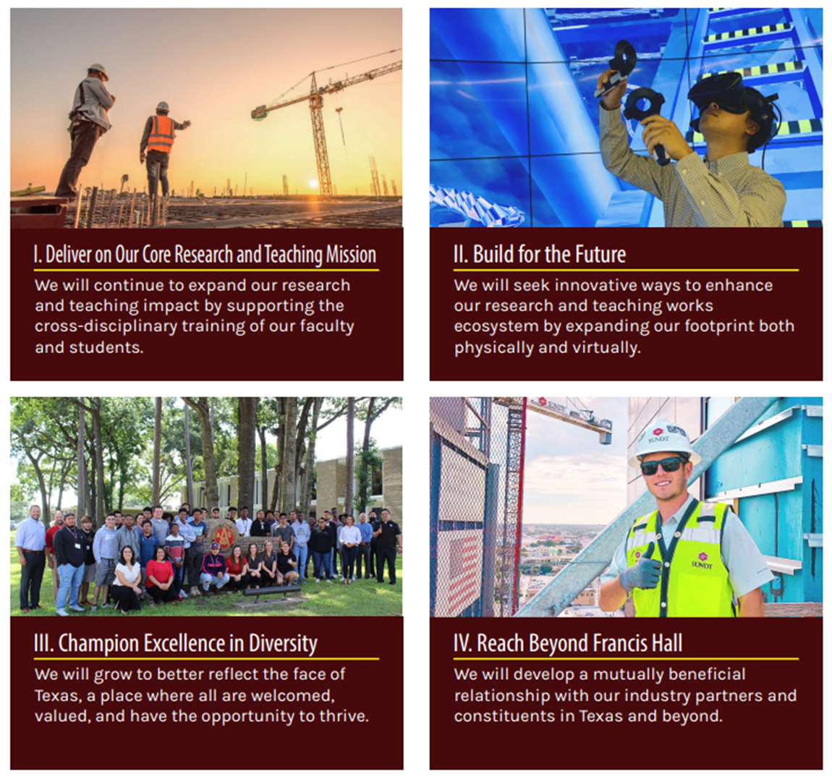
COSC Strategic Pillars

Slide 10
Summary

Slide 11
Summary
Introduction
PLAN
DESIGN
DELIVER
Summary
Notes:
Summary and then Q/A

