Slide 1
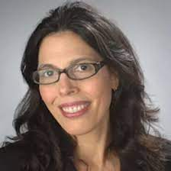
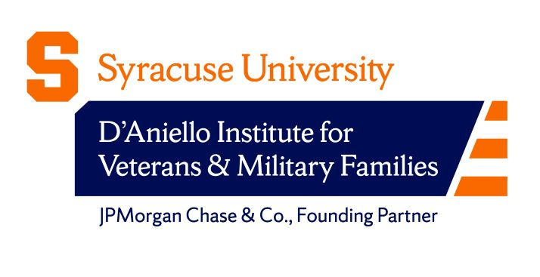
Advancing the Future of Veteran and Military Services:
Fostering Dialogue, Best Practices, and Post-Graduation Success
15th Annual Texas A&M University System Military-Affiliated Student Symposium, 23 Oct. 2023
Corri Zoli, Ph.D.
Forensic and National Security Sciences Institute (FNSSI)
Co-Investigator (Co-I), Syracuse University Intelligence Community Center of Excellence (ICCAE)
cbzoli@syr.edu
Linda R. Euto, Ph.D.
Associate Director | Research and Evaluation Institute for Veterans and Military Families
lmrougea@syr.edu
Your Name or Department
Suggested citation: C. Zoli & L. Euto, “Advancing the Future of Veteran and Military Services: Fostering Dialogue, Best Practices, and Post-Graduation Success,” 15th Annual Texas A&M University System Military-Affiliated Student Symposium, online presentation, 23 Oct. 2023.
.
Notes:
The Center – Is intended not only to help uncover the systemic issues contributing to the racial wealth gap, but also to discover and develop scalable solutions to reduce inequities, provide access to opportunity, and to enable historically marginalized communities to ultimately build better economic futures.
*Myths are contributing to ongoing and widening wealth gap.

Slide 2
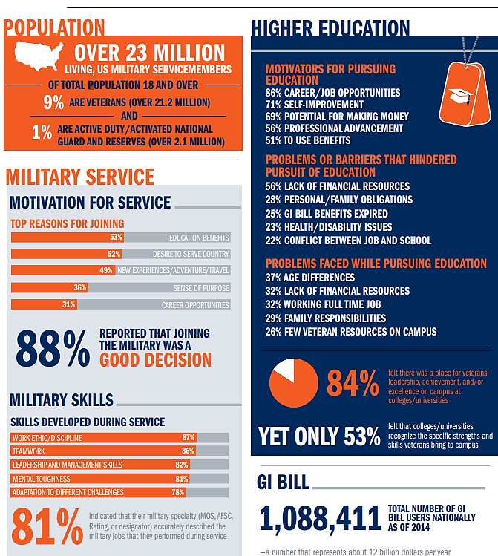
01. Part of a Broader Research Agenda
Basic research to understand distinctive Post-9/11 cohort of transitioning U.S. military servicemembers and veterans.
Prioritize veterans lived experiences across multiple roles & identities (i.e., warfighter, family member, student, professional, community leader…)
Why study military veterans?
Bridge the (increasing) civilian-military divide, including on college campuses.
Understand why student veterans go back to school after service, what they study, and what they do after school.
Answers led us to the problem of myths: the range and durability of myths about national service and servicemembers.
Notes:
Zoli, C., Maury, R., & Fay, D. (2015, November). Missing perspectives: Servicemembers’ transition from service to civilian life- data-driven research to enact the promise of the Post-9/11 GI Bill. Syracuse, NY: Institute for Veterans and Military Families, Syracuse University.

Slide 3
Table of Contents
01 Research Agenda
Larger research agenda: Post-9/11 cohort & myth-busting.
02 Role of research in veterans’ success on campus & beyond
03 Dialogue as Method
New voices; diversity in national service; overcoming barriers.
04 New stories & strategies.
05 Recommendations
06 Q&A
Objective: To create a lasting public good in fostering storytelling and dialogue by veterans to dispel myths that have social costs, including misrepresenting veterans’ contributions to college campuses and beyond.
Research question(s):
What role does research (and evidence-based thinking) play in improving veterans’ success on college campuses and in post-education and post-service careers?
What role do myths about military play in ignoring the contributions of veterans and military-connected communities on college campuses?
A subset of this question is the role of myths in homogenizing service and servicemembers, thus, ignoring diversity in the armed forces and minority communities’ service?
What is the role of dialogue and storytelling in dispelling myths about the military, addressing veterans' contributions, and tailoring campus programs and resources for veterans' concerns? How can we shift the conversation? (where do we go from here?)

Slide 4
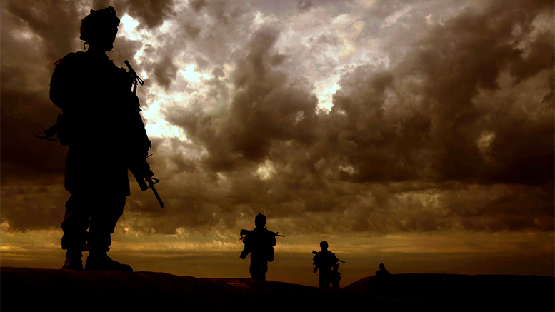
01. Myth-Busting: Common Myths about Veterans
SOME COMMON MYTHS
Need to debunk stubborn myths about today’s military veterans as the “broken hero.”
Ask veterans, instead, for more accurate representations of their historical and ongoing commitments to national and public service.
MYTH #1 Veterans and the military are a small subset of the population.
MYTH #2 Veterans join the military because they could not get into college; they are uneducated.
MYTH #3 The military is a homogeneous population; they are all the same.
MYTH #4 Veterans have limited skillsets and pursue careers similar to their military specialization.
MYTH #5 Veterans are broken heroes (all have PTSD or are prone to violence).

Slide 5
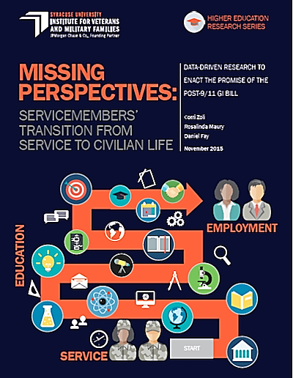
01. Lots to say about Post-9/11 Cohort…
See IVMF published, Missing Perspectives (2015) and other public federal data from VA, DoD, NCES
More educated; More married; More diverse
Women make up increasing share of veterans & leadership
More disabled
Working full/part time
1st generation students
Beyond demographics, Post-9/11 wars left lasting impressions:
Longest wars in US history, creating exhaustion even nihilism about war’s purpose.
Multiple deployments; Reserves fought.
Younger leaders, so-called strategic corporal, take a far greater role in decisionmaking in dire combat situations.
Do we understand these post-9/11 wars & their effects?
Notes:
Institute for Veterans and Military Families at Syracuse University, "Student Veterans: a Valuable Asset to Higher Education" (2019). Institute for Veterans and Military Families. 169. https://surface.syr.edu/ivmf/169
Zoli, C., Maury, R., & Fay, D. (2015, November). Missing perspectives: Servicemembers’ transition from service to civilian life- data-driven research to enact the promise of the Post-9/11 GI Bill. Syracuse, NY: Institute for Veterans and Military Families, Syracuse University.
https://www.va.gov/vetdata/veteran_population.asp
https://nces.ed.gov/pubs2020/2020488rev.pdf

Slide 6
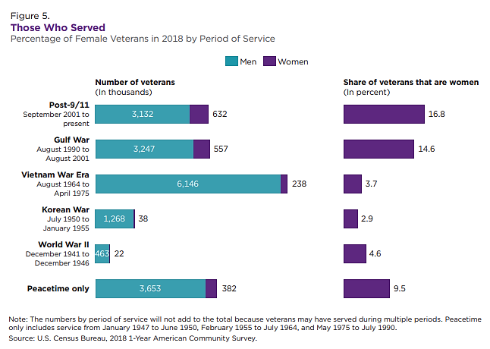
01. Diversity and Myth-Busting in the US Military
One durable myth about U.S. military service members is that veterans are demographically homogenous.
Not so. Active-duty and veteran military members, particularly Gulf War cohorts, exceed ethnic and racial representation of their national counterparts.
Notes:
Population Representation in the Military Services 2019, Appendix B-17
https://www.census.gov/content/dam/Census/library/publications/2020/demo/acs-43.pdf
For the active-duty force, African-Americans are 17% of the services (excluding the Coast Guard), and among Navy, Army, Air Force, and Marines, active-duty members report as racial minorities at 37%, 32%, 29%, and 20% of respective service branches (i.e., African American, Asian, Native American, Alaskan, Hawaiian, Pacific Islander, and/or multi-racial). See 2021 Demographics Report: Profile of the Military Community, Department of Defense (DoD), Office of the Deputy Assistant Secretary of Defense for Military Community and Family Policy (ODASD (MC&FP),: p. 3 and p. 8, https://download.militaryonesource.mil/12038/MOS/Reports/2021-demographics-report.pdf. See also, Katherine Schaeffer, The changing face of America’s veteran population (April 8, 2021), Pew Research Center, https://www.pewresearch.org/fact-tank/2021/04/05/the-changing-face-of-americas-veteran-population/

Slide 7
01. Why does diversity in the US military matter?
When we ignore the role of ethnic and racial minorities in national public service, we miss…
Specific contributions made by these communities
Active-duty: Total Department of Defense (DoD) 2021 personnel data (about 3.5 million people) show 31% self-report as racial minorities, and 18% identify as Hispanic/Latino.
Veterans: Also, diverse in age, disability status, marital status, and many are first-generation college students. Women represent nearly one-third of prior military undergraduates, a number expected to increase over time. Women and minorities are much more likely to attend school using the GI Bill.
Missing diversity “success stories” of a publicly-supported institution; useful model for other institutions.
Ethnic and racial diversity of All-Volunteer Force (AVF) exceeds all other public institutions: including universities.
Public support, even reverence for US military is too often based on a myth of “who serves” and “who veterans are.”
Myths about “who serves” may ignore minority communities’ motives to serve—what service means to them and what they do with their service.
AVF represents a very heterogeneous workforce across a myriad of dimensions: educational background, ethnicity, culture, values, and the goals/aspirations of organizational members.
It transforms the way in which we ask our public service questions: integrative vs. supplemental approach to diversity
Notes:
Haynie, J. Michael. (2012, March 5). The Business Case for Hiring a Veteran: Beyond the Clichés. Syracuse, NY: Institute for Veterans and Military Families, Syracuse University. Retrieved from https://ivmf.syracuse.edu/article/the-business-case-for-hiring-a-veteran-beyond-the-cliches/
Vaccaro, A. (2015). “It’s Not One Size Fits All”: Diversity Among Student Veterans. Journal of Student Affairs Research and Practice, 52, 347-358
Radford, A.W. (2009, July). Military service members and veterans in higher education: What the new GI Bill may mean for postsecondary institutions. American Council on Education, Washington, D.C. Retrieved from http://www.acenet.edu/news-room/Documents/Military-Service-Members-and-Veterans-in-Higher-Education.pdf
Kofoed, M.S. (2020, October). Where have all the GI Bill dollars gone? Veteran usage and expenditure of the Post-9/11 GI Bill. Brookings Institute, Washington, D.C. retrieved from: https://www.brookings.edu/wp-content/uploads/2020/10/ES-10.13.20-Kofoed-2.pdf

Slide 8
02. Research shows...
Student vets are strong in the classroom: achieved higher academic performance (GPA) as compared to traditional students (3.34 vs. 2.94), and complete college at rates comparable with the national average, and higher than other adult learners (53.6% vs. 39.2%).
Majority of student veterans (70%) attend public institutions, and 52% enrolled in four-year institutions, while 39% opt for two-year institutions ("Student Veterans of America," 2020). The SVA's data also indicates that student veterans are 22% more likely to complete their degrees within 4 years compared to their civilian peers ("Student Veterans of America," 2020).
However, veterans face challenges in recruitment, admissions, enrollment, career readiness, and post-graduate success.
Getting an education is a top reason (53%) to join the military, yet, according to VA, 57% of veterans consider pursuing higher education, only 49% enroll in a college or university ("U.S. Department of Veterans Affairs," 2020).
National Center for Education Statistics (NCES) reports that admissions can be a stumbling block, with a national average acceptance rate of 70% for veterans compared to 78% for the general population ("National Center for Education Statistics (NVEST)," 2020).
Notes:
Institute for Veterans and Military Families at Syracuse University, "Student Veterans: a Valuable Asset to Higher Education" (2019). Institute for Veterans and Military Families. 169. https://surface.syr.edu/ivmf/169
Zoli, C., Maury, R., & Fay, D. (2015, November). Missing perspectives: Servicemembers’ transition from service to civilian life- data-driven research to enact the promise of the Post-9/11 GI Bill. Syracuse, NY: Institute for Veterans and Military Families, Syracuse University.
https://www.va.gov/vetdata/veteran_population.asp
https://nces.ed.gov/pubs2020/2020488rev.pdf

Slide 9
02. Research shows...
Veterans encounter various significant transition challenges as they move from military service to civilian life:
navigating VA programs, benefits, and services, which was identified by 60% of respondents as a major obstacle.
Finding employment ranks closely behind, with 55% of veterans facing difficulties in securing jobs.
Adjusting to civilian culture (41%), addressing financial challenges (40%), and applying military-learned skills to civilian life (39%) are also substantial challenges in this transition.
66% of veterans reported that their military service prepared them for their civilian careers, a majority of them, 55%, express the desire to pursue a career different from their military specialty, also known as their MOS or AFSC.
47% of veterans indicate a preference for careers that differ from their actual military roles in practice. This data underscores the complex nature of veterans' post-service aspirations and the need for tailored support during their transition to civilian life.
Veterans encounter such challenges during their transition from military service- higher education-the workforce for several reasons:
Navigating VA benefits
Skills translations- transition is still the number one challenge from most student veterans/veterans
Cultural adjustment
Financial struggles
Emotional and psychological challenges
Notes:
Institute for Veterans and Military Families at Syracuse University, "Student Veterans: a Valuable Asset to Higher Education" (2019). Institute for Veterans and Military Families. 169. https://surface.syr.edu/ivmf/169
Zoli, C., Maury, R., & Fay, D. (2015, November). Missing perspectives: Servicemembers’ transition from service to civilian life- data-driven research to enact the promise of the Post-9/11 GI Bill. Syracuse, NY: Institute for Veterans and Military Families, Syracuse University.
https://www.va.gov/vetdata/veteran_population.asp
https://nces.ed.gov/pubs2020/2020488rev.pdf

Slide 10
02. Thesis and Approach: we argue…
These myths help to fuel lack of opportunities—the paths not taken—about veterans’ contributions, concerns, and future pathways on campus and beyond. Stories and dialogue help campus offices know these variables, provide resources and leverage veterans strengths.
These myths also narrow public and student understanding of national public service.
As an antidote we draw on fascinating studies of those who use military service to manage, even mitigate barriers and hurdles, including educational and employment disparities:
Case 1: Student Veterans: make an outsized impact through community involvement and civic engagement and through their interactions with other students, e nrich classroom discussions, enhance campus diversity overall, etc.
Case 2: African American and Native American veterans’ use of national public service to face stubborn structural socioeconomic barriers
We ask ourselves:
What role can universities play in confronting myths of service and shifting the conversation? (where do we go from here?)

Slide 11
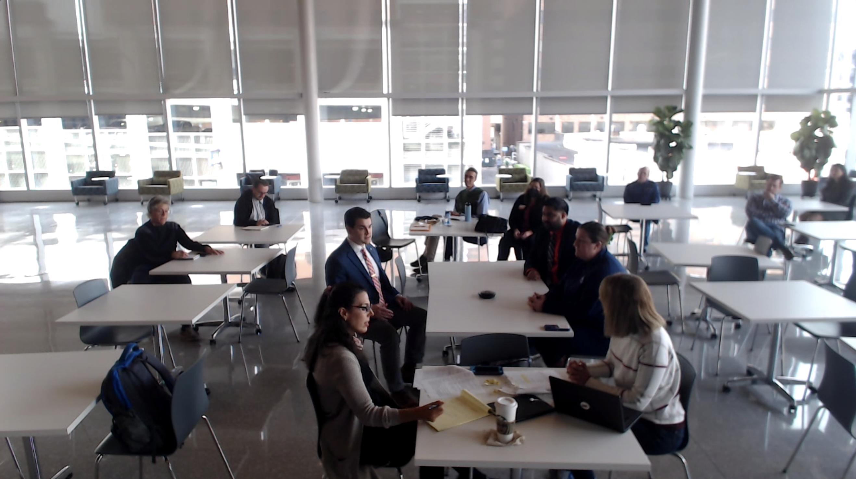
03. Dialogue as Method: Our Approach
We define “dialogue” as both a powerful humanist pedagogical method for collaborative communication and a historical genre, reflective of the longstanding role of multiple perspectives for knowledge, meaning making, and learning across differences.
“Dialogue”—not mere talk—a strategic approach. Verbal exchange between two parties, according to some kind of rules, conventions, or expectations.
Rooted in communication theory (Anderson, Cissna, 2008), “dialogue” is a genre and pedagogy to create tangible, self-organizing, charged “fields” of new meaning, in which profound, collective insight and reorientation appear, and out of which people can take aligned and effective action.
We draw on dialogue as communication strategy, pedagogy, and genre of meaning to reveal and dispel these ‘myths.’
Notes:
Walton, D. The Place of Dialogue Theory in Logic, Computer Science and Communication Studies. Synthese 123, 327–346 (2000). https://doi.org/10.1023/A:1005237527730
Communication Theory, Volume 18, Issue 1, February 2008, Pages 1–4, https://doi.org/10.1111/j.1468-2885.2007.00310.x
Isaacs, W. N. (1996). The Process and Potential of Dialogue in Social Change. Educational Technology, 36(1), 20–30. http://www.jstor.org/stable/44428974
Bowden, K.K., Lin, G.I., Reed, L.I., Fox Tree, J.E., Walker, M.A. (2016). M2D: Monolog to Dialog Generation for Conversational Story Telling. In: Nack, F., Gordon, A. (eds) Interactive Storytelling. ICIDS 2016. Lecture Notes in Computer Science(), vol 10045. Springer, Cham. https://doi.org/10.1007/978-3-319-48279-8_2

Slide 12
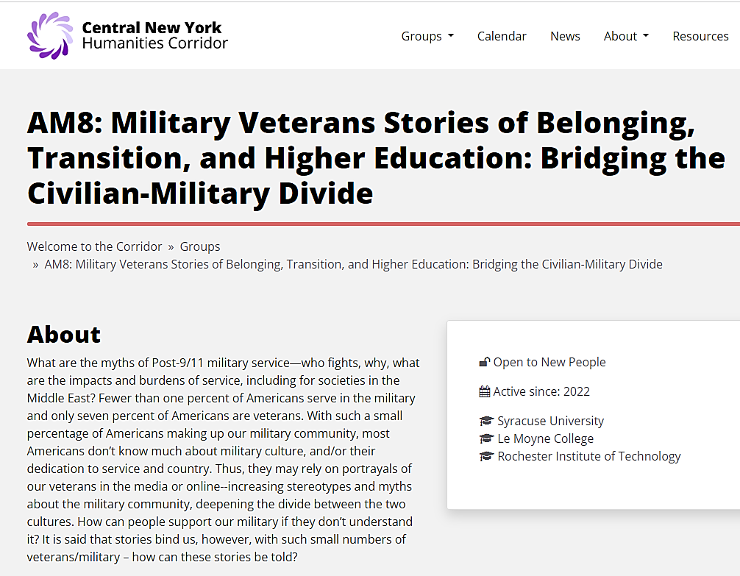
In the context of college campuses committed to veterans’ transition, education, and success, 2 sources informed our approach:
We designed the Dialogues series because our research indicated U.S. military veterans’ voices, particularly student veterans, were too rarely heard in public culture and on college campuses. Veterans are “seen, as in ROTC programs, but not often heard.”
I. Mellon-funded CNY Humanities Corridor “Working Group” creates on-campus spaces for dialogue—centering student veterans’ stories, voices, and experiences.
Military Veterans’ Stories of Belonging
Military Veterans’ Stories of Diverse Communities Serving
Military Veterans’ Transition from War and Service to Higher Education
II. Myths occupy the space of missing perspectives: Zoli, Rosy Maury & Danny Fay’s Missing Perspectives: Servicemembers’ Transition from Service to Civilian Life (2015) found a paradox: while Americans highly value US military & servicemembers—ironically, we know little about them: their struggles, veterans experiences in the long Post-9/11 wars, their transition from military life to college campuses, their post-service aspirations.
03. Dialogue as Method: Our Approach

Slide 13
03. Dialogue as Method: Our Approach
By fostering dialogue among veterans about their stories and experiences, we can promote a more nuanced understanding of the challenges they have encountered:
Our research initiatives were purpose-driven, seeking to establish a lasting public good by facilitating meaningful conversations. These dialogues were designed to encourage veterans to share their stories and experiences, fostering a more comprehensive understanding of the hurdles they face. This dialogue platform also serves to debunk misconceptions and advance fairness and inclusivity within military and veteran communities. Below are just some of the things said throughout our dialogue series:
“This was a great and important conversation. Thank you for the opportunity to speak.” (veteran)
“Veterans needs are different than civilians and conversations like these helps all of us understand those needs.” (veteran)
“The problem with transitioning from the military – and people don’t realize that it is a different form of stress.” When I had to transition out, it was difficult, it was very very difficult and it didn’t feel like the resources were there in the beginning, and so I had to dig deep to find a way to blend in with my civilian counterparts and begin to live life normally. I didn’t have any problems with diversity while I was in the military, but it was kind of worrisome to me how it would be when I got out and begin outside of the military. Resources and conversations like you guys are doing and just better assistance in general, its’ amazing and it does help out immensely. (student veteran).
Notes:
https://www.urban.org/urban-wire/evidence-shows-military-service-reduces-racial-homeownership-gap
https://www.prb.org/wp-content/uploads/2021/03/PopBulletin-59-4-2004-Military-ACF1396.pdf
Fitzgerald, K. G. (2016). The Effect of Military Service on Wealth Accumulation. Research on Aging. https://doi.org/10.1177/0164027505281574
Kofoed, M.S. (2020, October). Where have all the GI Bill dollars gone? Veteran usage and expenditure of the Post-9/11 GI Bill. Brookings Institute, Washington, D.C. retrieved from: https://www.brookings.edu/wp-content/uploads/2020/10/ES-10.13.20-Kofoed-2.pdf
Military service is linked to higher rates of ownership
Higher rates than general pop 78.2% vs. 64.0%
For diverse veterans-gap decreases from 30 to 19% for black households, 25 to 15% fpr Hispanic. Active-duty falls 30 to 12 % for black and 25 – 13% for Hispanic.
When we look at the homeownership rate by race and ethnicity, we find these differences between veterans and the total population are much larger for black and Hispanic households than for white households. In other words, military service for Hispanic and black households increases the likelihood of homeownership and higher income.
military status is associated with smaller gaps in homeownership and income between racial and ethnic groups. Although white veterans are slightly less likely to be homeowners than their nonmilitary counterparts, the opposite is true for black, Hispanic, and Asian households.

Slide 14
04. New Stories & Strategies. Veterans Socioeconomic Benefits Research across Differences: Literature
The American military is viewed as a form of national service, occupation, profession, workforce, calling, industry, set of internal labor markets (Segal & Segal 2004): it is also the largest government agency, the nation’s largest employer, and the most diverse public institution in the United States.
Several well-studied features of military service have the potential to reduce historical and systemic wealth gaps: Veterans compared with nonveteran counterparts have higher rates in 4 areas…
Wage Premium literature
Savings: individual personal
Higher education rates and GI Bill support (correlated to higher total earnings)
Homeownership rate
Social scientists find US military service influences wealth accumulation across demographics & racial dynamics:
Vick & Fontanella (2017) find women & Black veterans have a wage increase or premium (2% and 7% respectively) over comparable nonveterans.
Renna & Weinstein (2019) find the veterans wage premium for women and Black servicemembers—but the differential driven by education, occupation, industry, and location choice.
Military service for Hispanic and black households increases both likelihood of homeownership and higher income.
Military status is associated with smaller gaps in homeownership and income between racial and ethnic groups (White veterans slightly less likely to be homeowners than nonmilitary counterparts; the opposite is true for black, Hispanic, and Asian households).
If all else is held constant, homeownership rate for black veteran households is 8.3 percent higher than nonmilitary households—military service shrinks homeownership gap.
Notes:
https://www.urban.org/urban-wire/evidence-shows-military-service-reduces-racial-homeownership-gap
https://www.prb.org/wp-content/uploads/2021/03/PopBulletin-59-4-2004-Military-ACF1396.pdf
Fitzgerald, K. G. (2016). The Effect of Military Service on Wealth Accumulation. Research on Aging. https://doi.org/10.1177/0164027505281574
Kofoed, M.S. (2020, October). Where have all the GI Bill dollars gone? Veteran usage and expenditure of the Post-9/11 GI Bill. Brookings Institute, Washington, D.C. retrieved from: https://www.brookings.edu/wp-content/uploads/2020/10/ES-10.13.20-Kofoed-2.pdf
Military service is linked to higher rates of ownership
Higher rates than general pop 78.2% vs. 64.0%
For diverse veterans-gap decreases from 30 to 19% for black households, 25 to 15% fpr Hispanic. Active-duty falls 30 to 12 % for black and 25 – 13% for Hispanic.
When we look at the homeownership rate by race and ethnicity, we find these differences between veterans and the total population are much larger for black and Hispanic households than for white households. In other words, military service for Hispanic and black households increases the likelihood of homeownership and higher income.
military status is associated with smaller gaps in homeownership and income between racial and ethnic groups. Although white veterans are slightly less likely to be homeowners than their nonmilitary counterparts, the opposite is true for black, Hispanic, and Asian households.

Slide 15
04. New Stories & Strategies. Myth-busting Case Studies 1 & 2: Veterans Socioeconomic Benefits Research across Differences
Synthesizing Literature and Cases to Identify Solutions: How have the ‘myths’ about the military ignored student veterans contributions and minority communities’ service?
Case 1: African American and Native American veterans’ use of national public service to face stubborn structural socioeconomic barriers—at the individual, community, and public-policy levels.
Hidden histories
Different motives to serve
Case 2: Student Veterans represent 3-4% of the entire student population in U.S. higher education. Research shows student veterans make an outsized impact through community involvement and civic engagement and through their interactions with other students.
Enrich classroom discussions
Enhance campus diversity overall
Notes:
Kelley, B. C., Smith, J. M., & Fox, E. L. (2013). Preparing your campus for veterans’ success. Sterling, VA: Stylus.; U.S. Department of Education, National Center for Education Statistics. (2007-2008). National Postsecondary Student Aid Study (NPSAS: 08). Retrieved from https://nces.ed.gov/ pubs2016/2016435.pdf
Institute for Veterans and Military Families & Student Veterans of America. (2019), op-cit.
Institute for Veterans and Military Families & Student Veterans of America. (2019), op-cit.

Slide 16
05. Recommendations: Best practices & using dialogue and real concrete practices for campus environments.
Campus Culture - Keeping the conversation going. Foster a campus culture that encourages open dialogue and collaboration between veterans and non-veteran students, promoting mutual understanding and support.
Diversity- cultural competency Training
Mentorship Programs: (i.e.. PAVE)
Streamlined Admission Process: (give SU example)
Career Readiness Workshops: (OVMA)
Student Veteran Immersion – trips (OVMA)
Collaborative Partnerships: Establish partnerships with local military bases, veterans' organizations, and relevant government agencies to ensure a coordinated effort in supporting military-affiliated students.
Continuous Research: Continue conducting research to identify evolving needs and challenges faced by military-affiliated students, adapting policies and programs accordingly.
Notes:
https://www.urban.org/urban-wire/evidence-shows-military-service-reduces-racial-homeownership-gap
https://www.prb.org/wp-content/uploads/2021/03/PopBulletin-59-4-2004-Military-ACF1396.pdf

Slide 17
05. Conclusion: Challenges of Debunking Myths
Debunking misinformation is often more difficult than merely telling people that information is inaccurate. It means getting people to identify with the truth. Once someone has been introduced to false information, they often continue to believe it despite the correction.
Myths are persistent, stubborn, and memorable. To dislodge a myth, you need to counter it with an even more compelling, memorable fact.
Correction strategies, such as the myth-versus-fact article format, may backfire because they subtly reinforce the myths through repetition and may further increase the spread and acceptance of it, especially if the facts are not constantly reinforced.
The Internet, social media, and other digital technologies have only proven to intensify the speed and ease at which misinformation spreads.
Notes:
Dobson, K. S., & Rose, S. (2022). “Myths and facts” campaigns are at best ineffective and may increase mental illness stigma. Stigma and Health, 7(1), 27–34. https://doi.org/10.1037/sah0000323
Cook, John. The truth is out there—so how do you debunk a myth? The Conversation. Published: February 2014. Retrieved on August 2, 2022, on https://theconversation.com/the-truth-is-out-there-so-how-do-you-debunk-a-myth-22641
Schwarz, N., Newman, E., & Leach, W., Making the truth stick & the myths fade: Lessons from cognitive psychology. Behavioral Science & Policy, Brookings Institution Press. Volume 2, Issue1, 2016. Pp85-95. Project MUSE, Retrieved August 2022. https://muse.jhu.edu/article/634511/summary
Down the rabbit hole: Why people fall for conspiracy theories. News Literacy Project. Retrieved August 2022. https://newslit.org/

Slide 18
06. Q&A

