Slide 1
AREA COORDINATOR TRAINING

Slide 2
What Are We Going to Cover?
2023 SECC Contact Information
What is the SECC?
How is the SECC Managed?
How Do Employees Participate?
Guidance for Completing Pledge/Gifts
Leadership Givers
Fundraising
What is an Area Coordinator? What are Their Responsibilities?
What is a Unit Coordinator? What are Their Responsibilities?
Summary of Forms
2023 Important Dates
2023 Goals

Slide 3
2023 SECC Contact Information
UNITED WAY
PEGGI GOSS
President and CEO
1716 Briarcrest Dr Ste 155 Bryan TX 77802
979.696.4483 x 101 | pgoss@uwbv.org
LOCAL EMPLOYEE CAMPAIGN LIAISON
KIM FOX Manager
Economic Dev. & Community Impact, DASC
Pavilion, Room 211
1245 TAMU College Station TX 77843
979.845.8008 | kfox@tamu.edu

Slide 4
2023 SECC Contact Information
SYSTEM CAMPAIGN
Sheri Meyer Simone Hutchins Lewer
A&M System Campaign Chair A&M System Campaign Manager
System Benefits Administration System Benefits Administration
301 Tarrow Street, 5th Floor 301 Tarrow Street, 5th Floor
College Station, TX 77840 College Station, TX 77840
979-458-6175 | s-meyer@tamus.edu 979-458-6184 | hhutchinslewer@tamus.edu
Laura Fritsch
A&M System Campaign Manager
System Benefits Administration
301 Tarrow Street, 5th Floor
979-458-6171 | lfritsch@tamus.edu

Slide 5
2023 SECC Contact Information
CAMPUS CAMPAIGN
Susan Ballabina RebekkA Dudensing
A&M Campus Campaign Chair A&M Campus Campaign Manager
Division of Academic & DASC
Strategic Collaborations Pavilion, Ste. 209
Jack K. Williams Administration Bldg, 1245 TAMU
Ste. 112 College Station TX 77843
1246 TAMU 979-845-2731 | rmdudensing@tamu.edu
College Station, TX 77843
979-845-2217 | sg-ballabina@tamu.edu
Rebekah see-hruska mary gutierrez
A&M Campus Campaign Manager A&M Campus Campaign Manager
DASC DASC
Administration Bldg. Pavilion, Ste. 209
1246 TAMU 1245 TAMU
College Station, TX 77843 College Station, TX 77843
979-458-2524 | see-Hruska@tamu.edu 979-845-2731 | mgutierrez@tamu.edu

Slide 6
2023 SECC Websites
STATE OF TEXAS SECC WEBSITE
www.secctexas.org
TAMU & TAMUS SECC WEBSITE
www.tamus.edu/secc
TAMU & TAMUS SECC FACEBOOK PAGE
www.facebook.com/TAMUSECC

Slide 7
What is the SECC?
For 25+ years, state, higher education and retired employees have contributed through the SECC to provide support to food banks, homeless or domestic violence shelters, job training programs targeting veterans, and other community programs to help keep Texans healthy, safe, and strong.
Created by Legislation in 1993
First campaign conducted in 1994
Offered Texas state employees greater giving options with hundreds of charitable choices
The only workplace charitable campaign in which state employees can make a voluntary, tax-deductible contribution to charities through payroll deduction, cash, or check
Notes:
Choice!
There are over 400 approved organizations to choose from. You decide which organizations best address your concerns.
Confidence!
All agencies participating in the SECC must meet strict eligibility standards established by state law and are screened by the SECC State Policy Committee. Therefore, you can feel confident your gift is being used efficiently and effectively by your designated charities.
Convenience!
The SECC encourages you to take advantage of the online payroll deduction as a convenient method for giving. – monthly or one-time gift.

Slide 8
How is the SECC Managed?
Governing and Administrative Structure:
State Policy Committee
State Employee Committee
State Campaign manager
Local Employee Committee
Local Campaign Manager – United Way of the Brazos Valley
Charity Review Process:
Charity Application
Administrative Review
Local Employee Committee Review and Approval
Texas A&M University
Texas A&M University Chair
Texas A&M University System Chair
Texas A&M University
Area Coordinator
TAMUS
Area Coordinators
Texas A&M University Unit Coordinators
TAMUS
Unit Coordinators

Slide 9
Campaign Dates
Pledge Period: September 1 – October 31
Reports Due to LCM: November 17
Have all deposits and reports to GSC Accounting Services by November 9
Payroll Deductions: January 1 – December 31

Slide 10
How Do Employees Participate?
Donation Options
Single Sign-On Workday – Payroll deduction: sso.tamus.edu
Monthly payroll deductions (9 or 12 month based on employee status with a $2 per charity, per month minimum).
One-time donations to be deducted in January.
Paper Authorization Forms – One-time cash and check gifts only
Checks should be made payable to the SECC. Attach the check or cash to the form with a paperclip. DO NOT staple.
Credit Card – One-time gift
Donor registers and makes a donation at https://secctexasgiving.org/_brazosvalley/
Select appropriate Employer and fill out registration form
Activate account per email instructions, select charity and make your donation.
Participation in Fundraisers – numerous options for further support
Document donors name for fundraising donations of $24 or more on authorization form
Notes:
Employees paid monthly:
Payroll deductions start in December and will be reflected on January paycheck (of the new calendar year).
Employees paid bi-weekly:
Monthly deductions taken from the second paycheck each month, starting in January.
Payroll deductions are made after taxes have been withheld & can be stopped at any time by contacting payroll office.

Slide 11
Guidance for Completing Pledge/Gifts
Donor Designation Options
Employees may select the charities they wish to support from the SECC brochure or the SECC directory (available in hardcopy or on the SECC website).
https://www.secctexasgiving.org/
Employees may designate to a single charity or up to six different charities from any three charitable groups. The first 2 digits of the 6-digit agency number identify the charitable group.
Example: 250000 – United Way of the Brazos Valley
Example: 500000 – Adopt-A-Beach
Example: 415062 – Mission Road Ministries
PAPER AUTORHIZATION FORM -- The employee must sign and date the form and provide their UIN number to authorize payroll deduction.

Slide 12
LEADERSHIP GIVERS
Leadership Givers are donors who donate $1,000 or more.
Leadership Givers are recognized for their gift on the SECCTexas.org website and in the printed directory for the next campaign.
Donor can opt to not be acknowledged
Ensure donor’s prefix is listed on form (i.e. Dr., Mr., Mrs., Mr. & Mrs.) if they want it included in their acknowledgment.
Donations from two employees (spouses) can be combined to meet the Leadership Giving required donation of $1,000 or more.
The Unit Coordinator for each employee needs to email secc@uwbv.org to communicate that the employees wish to be recognized together.

Slide 13
FUNDRAISING
Fundraisers can be a fun way to bring in extra donations.
Check out the Best Practices handout for more great ideas and information.
Select a charity to receive the proceeds from the event.
An authorization form needs to be completed for each fundraiser and charity(ies) need to be selected for the designation.
Identify donors who contributed over $24 on a separate attached spreadsheet.

Slide 14
Area Coordinator
What is an Area Coordinator?
Manage the campaign activities for divisions of the System and University.
Provide the link between campaign leadership and the Unit Coordinators.
Have Financial Reporting responsibilities.
Administrative Responsibilities:
Work with Administration to set Goal(s) (% or $)
Provides leadership and direction for the campaign in your area.
Appoints unit coordinators to ensure all employees in your area are given the opportunity to participate.
Trains unit coordinators, as necessary.
Serves as a motivator, facilitator, and resource for your unit coordinators.
Delivers weekly deposits on Thursdays

Slide 15
Area Coordinator
Online Contribution REPORTING
Each week, Area Coordinators will receive the following reports on the activity of the campaign. They are welcome to share this information as they see fit.
Please make sure personal information is removed before distributing.
Weekly Reports:
SECC Names List By Area
SECC Summary By Area And Date
SECC Summary By Area, Type, And Date
SECC Employee Participation
SECC Credit Card donation report (from United Way)

Slide 16
Area Coordinator
Wednesday “To Do” List
Wednesday Mornings:
Collect and compile from Unit Coordinators:
Cash/Check donations, Form 2&4
Authorizations Forms (verify signature and UIN number, if needed)
Ensure all amounts match and forms are completed correctly
Fill out the Pledge Report Form, deposit slip and make copies.
Check-in with Unit Coordinators to share weekly reports and campaign reminders as well as seeing if they need support on their efforts.

Slide 17
Area Coordinator
Thursday “To Do” List
HAND DELIVER DEPOSIT BAG TO: Financial Management Services (FMS), 3rd Floor, Ste 3400 BEFORE 3:00 PM
INCLUDE:
Envelope:
Pledge Report Form
Yellow copies of Authorization form from individuals or fundraisers
Copy of deposit slip
Form 2 & 4
List of $24 or more fundraiser donors (if needed)
 Deposit Bag:
Deposit slip
All cash & checks
 Write amount and ‘SECC deposit’ on deposit bag label & on top tab
 Tear off and keep the completed deposit bag tab with your records
NOTE: Cash over $100 should be put in a locked safe until the Thursday deposit or make an early deposit to the GSC cashier by following the normal deposit guidelines. Deliveries over $5,000 should have a security escort.
KEEP A COPY OF EVERYTHING FOR YOUR RECORDS!

Slide 18
Unit Coordinators?
What is a Unit Coordinator?
The front line members of the SECC team.
Distribute materials to employees, fill out and deliver weekly reports
Answer questions to assist with understanding and participating in the SECC.
Share messages with employees on charities in the SECC.
Administrative Responsibilities:
Be familiar with the payroll donation on SSO, authorization form and credit card processes
Host Fundraisers – document names of fundraiser participants who donate $24 or more.
Deliver forms to the Area Coordinators Wednesday by 9 a.m.
Represent your unit at the training workshop and other meetings as scheduled.

Slide 19
Best Practices
Best Practices for a Successful Campaign
Set a Goal (% and/or $) & post signage around offices
Post on your personal social media
Set a face-to-face meeting with Unit Coordinators
Recruit a Team – Make use of your charity’s Ambassador
Get SECC on staff meeting agenda
Incorporate Leadership Giving
Rally the Troops and Make the Ask*
Use the I Gave Button on your email signature and share in your division
Distribute the We Give poster to donors to post in their office.
Report, Thank & Inform
*Goal of 100% ask!
Notes:
Find unique ways to make the “Ask” outside of sending emails which tend to get lost or overlooked.
We will give you a draft post to share on your social media on September 1.

Slide 20
SUMMARY OF FORMS

Slide 21
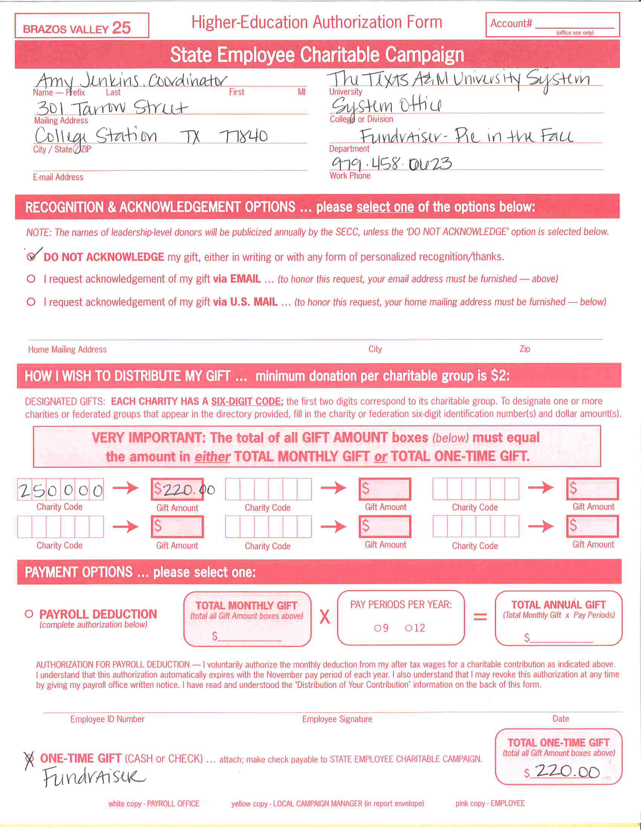
AUTHORIZATION FORM
Used by:
Employee: for one-time cash or check gifts only
Unit Coordinator: document fundraiser
Fundraisers: form must be completed for each fundraiser.
Coordinator should select charity(ies) to designate funds.
For “Name” list the unit and title of the fundraiser.
Identify donors who contributed over $24 on a separate attached spreadsheet.
This form is also available on the SECC website tamus.edu/secc for one-time cash and check donations should you run out.

Slide 22
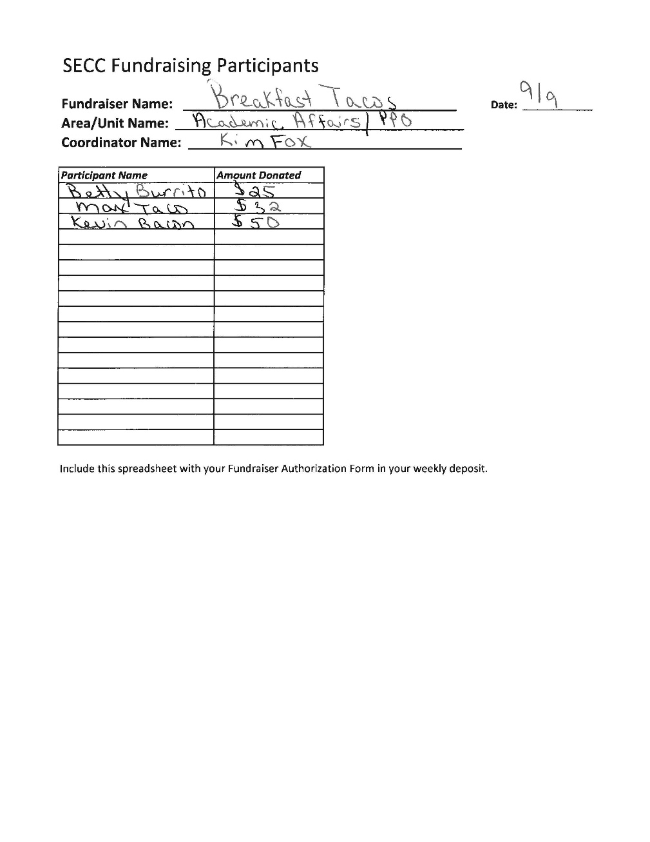
FUNDRAISER PARTICIPANTS
Used by:
Unit Coordinator: document fundraiser participants of $24 or more
Must be paperclipped to Authorization Form and turned in with weekly deposits.

Slide 23
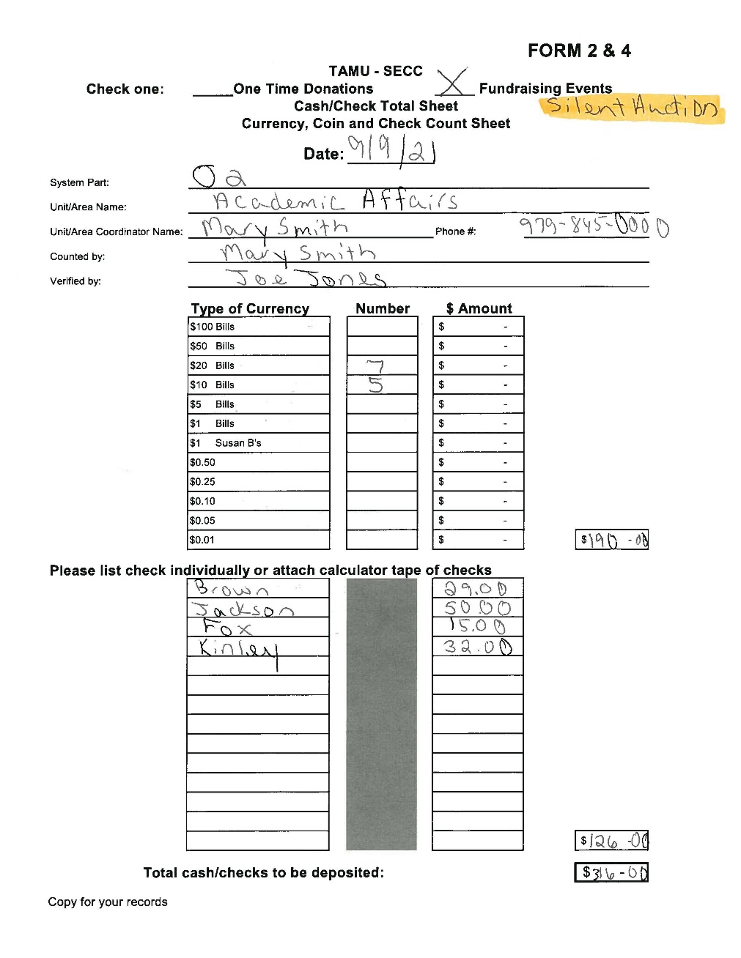
FORM 2&4
Completed by Unit Coordinators; reviewed by Area Coordinators
For all cash and check donations, whether one-time or fundraiser
Retain a copy for your records
Available for download on the SECC website tamus.edu/secc

Slide 24
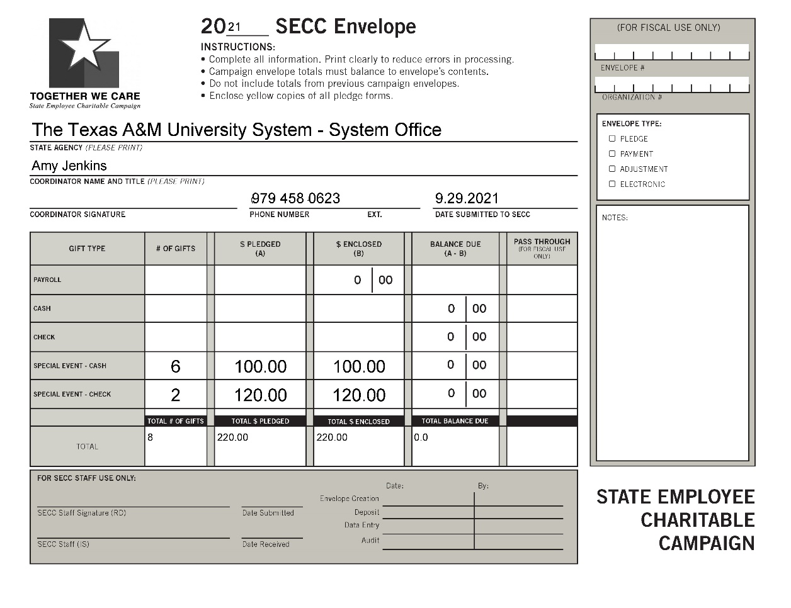
PLEDGE REPORT FORM ENVELOPE
Used by the Area Coordinator only
Complete anytime you are depositing funds / paper forms.
Instead of mailing/dropping off at United Way, drop off in the GSC Financial Management Services.

Slide 25
DEPOSIT SLIPS
Used by the Area Coordinators only
Bank: Truist
Complete for United Way of the Brazos Valley cash and check deposits. Place in plastic deposit bag with cash and check payments.

Slide 26
DEPOSIT BAG
Used by the Area Coordinators only.
Plastic envelopes used to place cash, checks and deposit slips in for weekly deposit delivery.
Complete information on the front of the bag along with the top tab noting “SECC deposit” on label and tab top. Tear off top tab and keep with your records.

Slide 27
Trends & Goals
2018
2021
2019
2020
2021
2022
2023 Campaign Goal: University- $300,000
System - $220,000
TOTAL - $520,000
2023 Participation Goal: University - 12%
System – 10%
Notes:
*** An important part of reaching our goals are FUNDRAISERS – Share Handout

Slide 28
SECC 2023 Important Dates
Week of August 21 – Distribute Materials
September 1 – Campaign kicks off; SSO and credit card giving sites LIVE
Wednesdays – Unit Coordinators deliver Forms, Cash and Pledges to Area Coordinators
Thursday – Area Coordinators prepare and deliver deposits to DAS
September 14 – Early Bird Deadlines
October 31 – Campaign ends
November 9 – Final Processing Deadline!

Slide 29
THANK YOU!!!
For your efforts in making the 2023
State Employee Charitable Campaign a success!
QUESTIONS?

Slide 30
FOR MORE INFORMATION, PLEASE VISIT TAMUS.EDU/SECC
Notes:
TURN IT BACK OVER TO CHAIRS FOR FINAL COMMENTS

