Slide 1


UNIT COORDINATOR TRAINING

Slide 2
WHAT ARE WE GOING TO COVER?
2022 SECC Contact Information
What is the SECC?
How is the SECC Managed?
How Do Employees Participate?
Guidance for Completing Pledge/Gifts
Leadership Givers
Fundraising
What is an Area Coordinator? What are Their Responsibilities?
What is a Unit Coordinator? What are Their Responsibilities?
Summary of Forms
2022 Important Dates
2022 Goals

Slide 3
2022 SECC CONTACT INFORMATION
UNITED WAY
ALISON PRINCE
President and CEO
1716 Briarcrest Dr Ste 155 Bryan TX 77802
979.696.4483 x 101 | aprince@uwbv.org
LOCAL EMPLOYEE CAMPAIGN LIASON
KIM FOX
Manager
Economic Dev. & Community Impact, DASC
Pavilion, Room 211
1245 TAMU College Station TX 77843
979.845.8008 | kfox@tamu.edu

Slide 4
2022 SECC CONTACT INFORMATION
SYSTEM CAMPAIGN
Bradley Blair Lori Hayes
A&M System Campaign Chair A&M System Campaign Manager
Office of Information Technology Office of Information Technology
700 University Drive, Suite 104 700 University Drive, Suite 104
College Station, TX 77840 College Station, TX 77840
979.862.6161 | bblair@tamus.edu 979.862.6100 | lhayes@tamus.edu
René quiroz deanna white
A&M System Campaign Manager A&M System Campaign Manager
Office of Information Technology Office of Information Technology
700 University Drive, Suite 104 700 University Drive, Suite 104
College Station, TX 77840 College Station, TX 77840
979.862.5922 | rquiroz@tamus.edu 979.862.6166 | deanna@tamus.edu

Slide 5
2022 SECC CONTACT INFORMATION
CAMPUS CAMPAIGN
Susan Ballabina RebekkA Dudensing
A&M Campus Campaign Chair A&M Campus Campaign Manager
Division of Academic & DASC
Strategic Collaborations Pavilion, Ste. 209
Jack K. Williams Administration Bldg, 1245 TAMU
Ste. 112 College Station TX 77843
1246 TAMU 979-845-2731 | rmdudensing@tamu.edu
College Station, TX 77843
979-845-2217 | sg-ballabina@tamu.edu
BRIAN Thigpin mary gutierrez
A&M Campus Campaign Manager A&M Campus Campaign Manager
DASC DASC
Pavilion, Room 225 Pavilion, Ste. 209
1245 TAMU 1245 TAMU
College Station, TX 77843 College Station, TX 77843
979-458-9820 | bthigpin@tamu.edu 979-845-2731 | mgutierrez@tamu.edu

Slide 6
2022 SECC WEBSITES
STATE OF TEXAS SECC WEBSITE
www.secctexas.org
TAMU & TAMUS SECC WEBSITE
www.tamus.edu/secc
TAMU & TAMUS SECC FACEBOOK PAGE
www.facebook.com/TAMUSECC

Slide 7
WHAT IS THE SECC?
For 25+ years, state, higher education and retired employees have contributed through the SECC to provide support to food banks, homeless or domestic violence shelters, job training programs targeting veterans, and other community programs to help keep Texans healthy, safe, and strong.
Created by Legislation in 1993
First campaign conducted in 1994
  Offered Texas state employees greater giving options with hundreds of charitable choices
The only workplace charitable campaign in which state employees can make a voluntary, tax-deductible contribution to charities through payroll deduction, cash, or check
Notes:
Choice!
There are over 400 approved organizations to choose from. You decide which organizations best address your concerns.
Confidence!
All agencies participating in the SECC must meet strict eligibility standards established by state law and are screened by the SECC State Policy Committee. Therefore, you can feel confident your gift is being used efficiently and effectively by your designated charities.
Convenience!
The SECC encourages you to take advantage of the online payroll deduction as a convenient method for giving.
For those who prefer, an additional option exists for employees to make a one-time donation online, to be made on the first payroll of the new calendar year.

Slide 8
HOW IS THE SECC MANAGED?
Governing and Administrative Structure:
State Policy Committee
State Employee Committee
  State Campaign manager
Local Employee Committee
  Local Campaign Manager – United Way of the Brazos Valley
Charity Review Process:
Charity Application
Administrative Review
Local Employee Committee Review and Approval
Texas A&M University
Texas A&M University Chair
Texas A&M University System Chair
Texas A&M University
Area Coordinator
TAMUS
Area Coordinators
Texas A&M University Unit Coordinators
TAMUS
Unit Coordinators

Slide 9
CAMPAIGN DATES
Pledge Period: September 1 – October 31
Reports Due to LCM: November 19
  Have all deposits and reports to GSC Accounting Services by November 11
Payroll Deductions: January 1 – December 31

Slide 10

HOW DO EMPLOYEES PARTICIPATE?
Donation Options
Single Sign-On Workday – Payroll deduction: sso.tamus.edu
  Monthly payroll deductions (9 or 12 month based on employee status with a $2 per charity, per month minimum).
  One-time donations to be deducted in January.
Paper Authorization Forms – One-time cash and check gifts only
  Checks should be made payable to the SECC. Attach the check or cash to the form with a paperclip. DO NOT staple.
Credit Card – One-time gift
  Donor registers and makes a donation at https://secctexasgiving.org/_brazosvalley/
  Select appropriate Employer and fill out registration form
  Activate account per email instructions, select charity and make your donation.
Participation in Fundraisers – numerous options for further support
  Document donors name for fundraising donations of $24 or more on authorization form

Slide 11
HOW DO EMPLOYEES PARTICIPATE?
Employees paid monthly:
  Payroll deductions start in December and will be reflected on January paycheck (of the new calendar year).
Employees paid bi-weekly:
  Monthly deductions taken from the second paycheck each month, starting in January.
Payroll deductions are made after taxes have been withheld.
Payroll deductions can be stopped at any time by contacting payroll office.
Notes:
A little more specifics on how and when the payroll deductions happen.

Slide 12
GUIDANCE FOR COMPLETING PLEDGE/GIFTS
Donor Designation Options
Employees may select the charities they wish to support from the SECC brochure or the SECC directory (available in hardcopy or on the SECC website).
  https://www.secctexasgiving.org/
Employees may designate to a single charity or up to six different charities from any three charitable groups. The first 2 digits of the 6-digit agency number identify the charitable group.
  Example: 250000 – United Way of the Brazos Valley
  Example: 500000 – Adopt-A-Beach
  Example: 415062 – Mission Road Ministries
PAPER AUTHORIZATION FORM -- The employee must sign and date the form and provide their UIN number to authorize payroll deduction.

Slide 13

LEADERSHIP GIVERS
Leadership Givers are donors who donate $1,000 or more.
Leadership Givers are recognized for their gift on the SECCTexas.org website and in the printed directory for the next campaign.
  Donor can opt to not be acknowledged
  Ensure donor’s prefix is listed on form (i.e. Dr., Mr., Mrs., Mr & Mrs) if they want it included in their acknowledgment.
Donations from two employees (spouses) can be combined to meet the Leadership Giving required donation of $1,000 or more.
  The Unit Coordinator for each employee needs to email secc@uwbv.org to communicate that the employees wish to be recognized together.

Slide 14

FUNDRAISING
Fundraisers can be a fun way to bring in extra donations.
Check out the Best Practices handout for more great ideas and information.
Select a charity to receive the proceeds from the event.
An authorization form needs to be completed for each fundraiser and charity(ies) need to be selected for the designation.
Document fundraising donations of $24 or more on a separate spreadsheet

Slide 15
AREA COORDINATOR
What is an Area Coordinator?
Manage the campaign activities for divisions of the System and University.
Provide the link between campaign leadership and the Unit Coordinators.
Have Financial Reporting responsibilities.
Administrative Responsibilities:
Work with Administration to set Goal(s) (% or $)
Provides leadership and direction for the campaign in your area.
Appoints unit coordinators to ensure all employees in your area are given the opportunity to participate.
Trains unit coordinators, as necessary.
Serves as a motivator, facilitator, and resource for your unit coordinators.
Deliver weekly deposits on Thursdays

Slide 16
UNIT COORDINATOR
What is a Unit Coordinator?
The front line members of the SECC team.
Distribute materials to employees, fill out and deliver weekly reports
Answer questions to assist with understanding and participating in the SECC.
Share messages with employees on charities in the SECC.
Administrative Responsibilities:
Be familiar with the payroll donation on SSO, authorization form and credit card processes
Host Fundraisers – document names of fundraiser participants who donate $24 or more.
Deliver forms to the Area Coordinators Wednesday by 9 a.m.
Represent your unit at the training workshop and other meetings as scheduled.

Slide 17
UNIT COORDINATOR
WEDNESDAY MORNING “TO DO” LIST
AUTHORIZATION FORMS
Copy to employees
Original to area coordinator
Fill out for Fundraisers
      Include spreadsheet with list of participants of $24+ donors
 Keep one copy for your files
FORM 2&4 – Cash/Check Donations
Balance cash & checks
Deliver to area coordinator by 9am on Wednesdays
** Keep a copy of everything for your records **

Slide 18
Best Practices
Best Practices for a Successful Campaign
Recruit a Team
Lock Down Logistics
Incorporate Leadership Giving
Rally the Troops and Make the Ask*
Report, Thank & Inform
*Goal of 100% ask!

Slide 19
SUMMARY OF FORMS

Slide 20
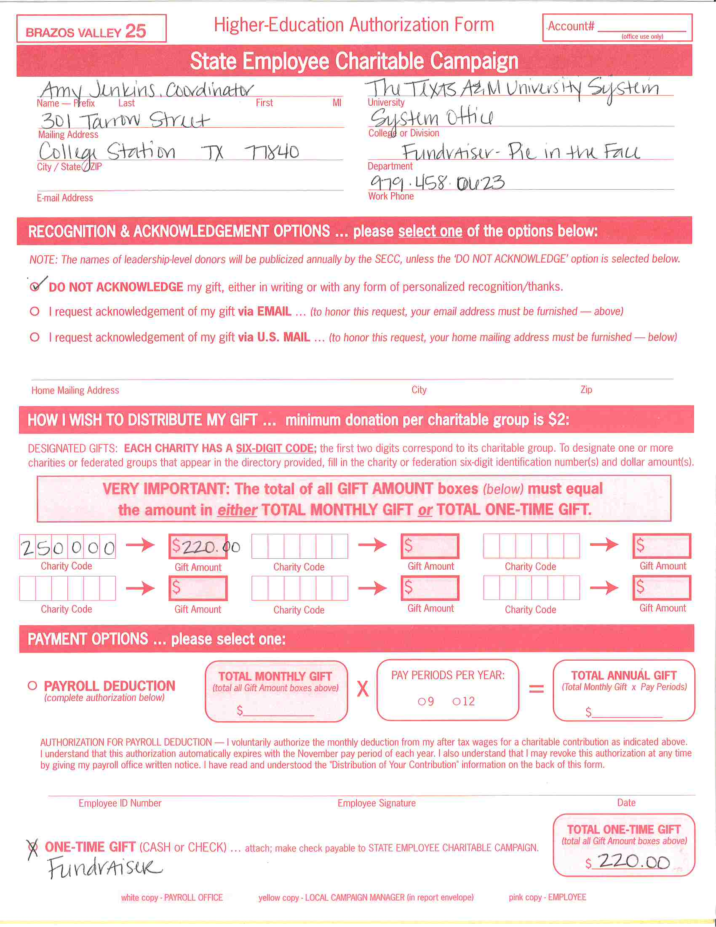

AUTHORIZATION FORM
Used by:
  Employee: for one-time cash or check gifts only
  Unit Coordinator: document fundraiser
Fundraisers: form must be completed for each fundraiser.
  Coordinator should select charity(ies) to designate funds.
  For “Name” list the unit and title of the fundraiser.
  Identify donors who contributed over $24 on a separate spreadsheet to be included with form.
This form is also available on the SECC website sso.tamus.edu for one-time cash and check donations should you run out.

Slide 21
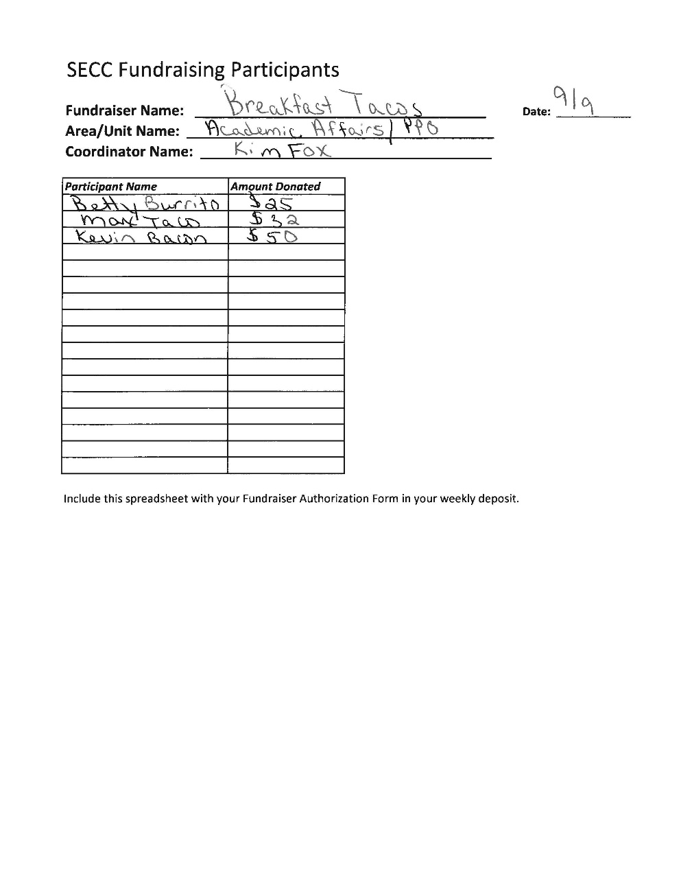
Fundraiser Participants
Used by:
  Unit Coordinator: document fundraiser participants of $24 or more
Must be paperclipped to Authorization Form and turned in with weekly deposits.

Slide 22
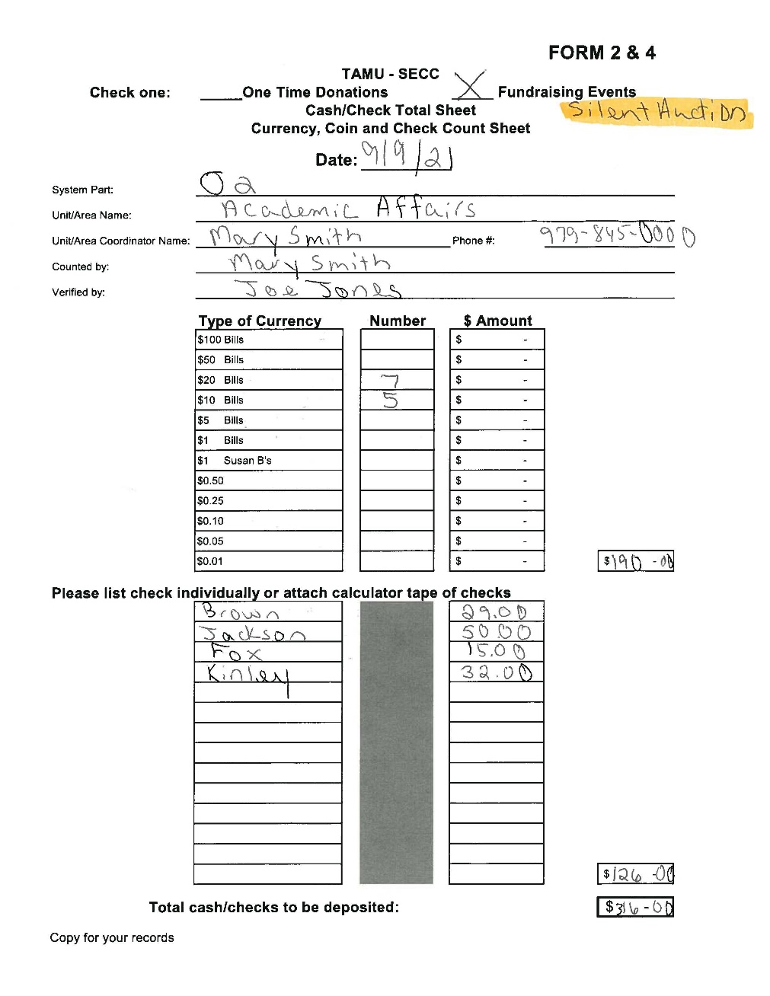
FORM 2&4
Completed by Unit Coordinators; reviewed by Area Coordinators
For all cash and check donations, whether one-time or fundraiser
Retain a copy for your records
Available for download on the SECC website sso.tamus.edu

Slide 23
Trends & Goals
2022 Campaign Goal: University - $300,000
System - $220,000
TOTAL - $585,000
2022 Participation Goal: University - 12%
System – 10%

Slide 24
SECC 2022 Important Dates
Week of August 22 – Distribute Materials
September 1 – Campaign kicks off; SSO and credit card giving sites LIVE
Wednesdays – Unit Coordinators deliver Forms, Cash and Pledges to Area Coordinators
Thursday – Area Coordinators prepare and deliver deposits to DAS
September 15 – Early Bird Deadlines
October 31 – Campaign ends
November 11 – Final Processing Deadline!

Slide 25
THANK YOU!!!
For your efforts in making the 2022
State Employee Charitable Campaign a success!
QUESTIONS?

Slide 26
FOR MORE INFORMATION, PLEASE VISIT
TAMUS.EDU/SECC
Notes:
TURN IT BACK OVER TO CHAIRS FOR FINAL COMMENTS

