Slide 1
The Design and Development of an Integrated Researcher Profile System at Texas A&M to Enrich Scholarly Identity of Faculty
Chief Research Officer’s Meeting
Texas A&M University System, August 30, 2016
Dr. Bruce Herbert | Michael Bolton | Doug Hahn | Dong Joon Lee

Slide 2
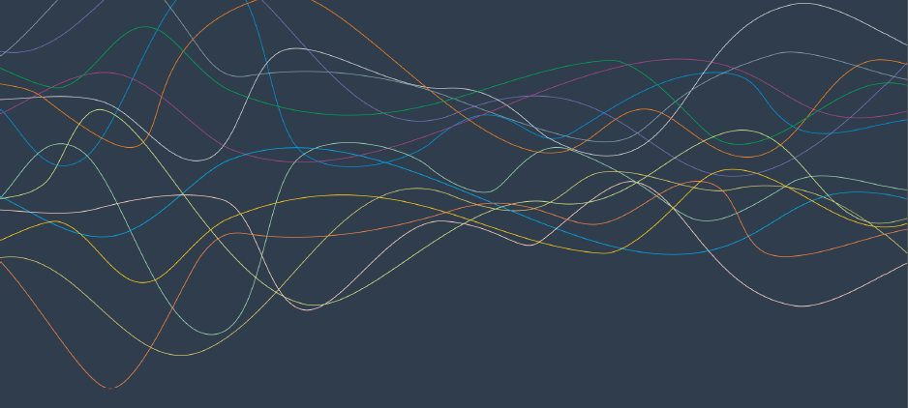
Shifting Research Landscape

Slide 3
Impact of Team Collaboration
Wuchty et al. (2007). Science 316(5827): 1036-1039.
Notes:
The model assumes that each lead author forms a core team through a Poisson process.
Extended teams arise from core teams by adding new members in proportion to the productivity of the team.
This process of cumulative advantage leads to the appearance of the power-law component of large teams at later times.

Slide 4
Collaboration Across Institutions
Jones et al. (2008). Science 322: 1259-1262.
Notes:
The model assumes that each lead author forms a core team through a Poisson process.
Extended teams arise from core teams by adding new members in proportion to the productivity of the team.
This process of cumulative advantage leads to the appearance of the power-law component of large teams at later times.

Slide 5
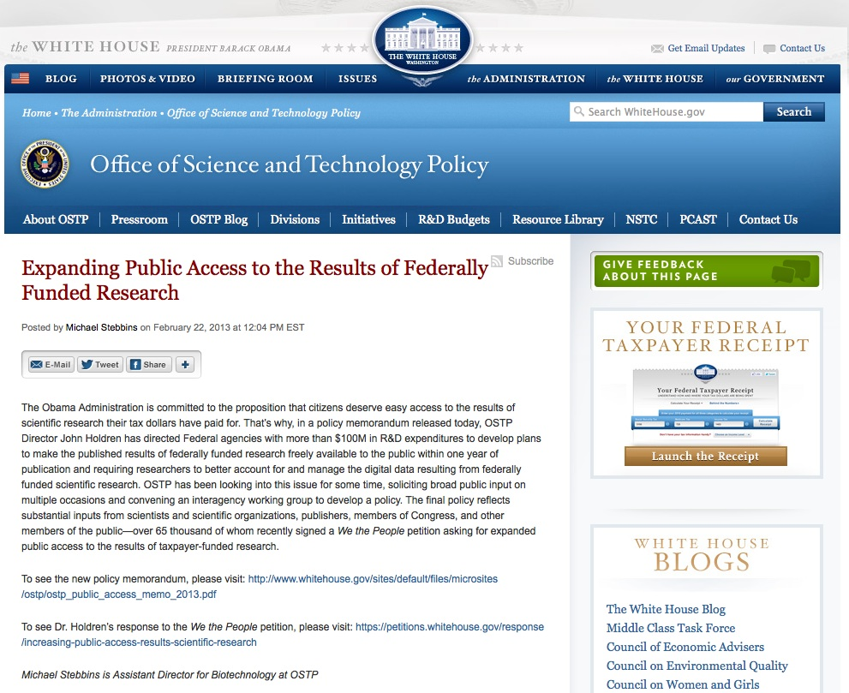
Emerging Issue: Open Access Federal Mandates For Public Access to Research
The Library Supports:
Publication repositories
Tools to create data management plans
Data repositories (soon)
http://guides.library.tamu.edu/DataManagement
http://www.whitehouse.gov/blog/2013/02/22/expanding-public-access-results-federally-funded-research

Slide 6
Users of Citation Data in Research Evaluation
What are the trends of disciplinary scholarship?
What are the characteristics of interdisciplinary scholarship?
What are departmental strengths?
What is the level of research activity and its impact?

Slide 7
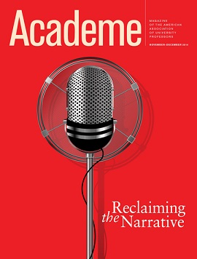
(Re)Claiming Faculty Narrative
“The personal statement … is your opportunity to make your own case. The statement communicates a quick sense of whether you know who you are, where you’ve been, and where you’re going in your career.
http://www.aaup.org/reports-and-publications/academe

Slide 8
Researcher Profile System

Slide 9
Scholars @ Texas A&M
People plus information on the research they do
Publicly-visible information, across disciplines
An open, shared platform for connecting scholars, research communities, campuses, and the world using Linked Open Data (LOD)

Slide 10
Integrates Institutional Data
Websites
Organizations
Expert
Finding
Scholars
VIVO
Grants/
Projects
Portfolio/
Vitae
Network
Analysis
Publications/
Scholarly
Works
Teaching/
Engagement
Reports
Adhoc
Queries

Slide 11
PEOPLE
Notes:
Abawi slide (small) +
predicated on information emerging from what people are doing – outputs, yes, but other activities including grants, teaching, and talks

Slide 12
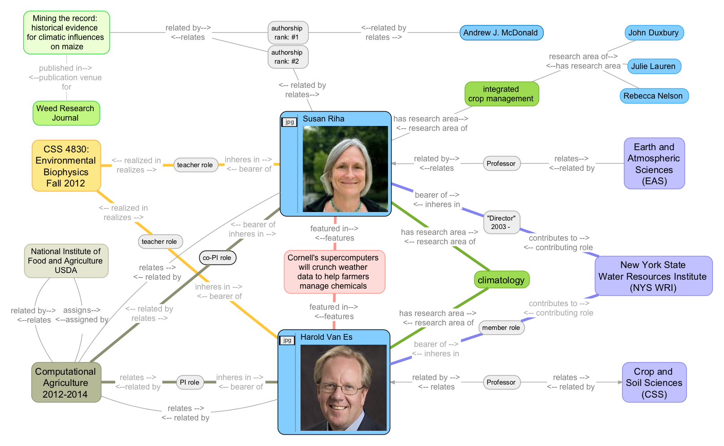
And How They Connect
Notes:
predicated on information emerging from what people are doing – outputs, yes, but other activities including grants, teaching, and talks

Slide 13
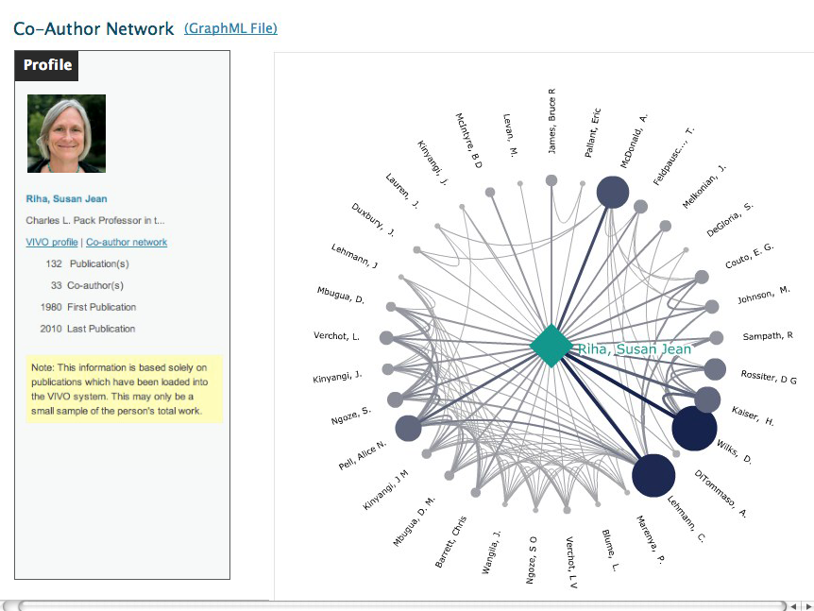
Structured Data for Visualizations

Slide 14
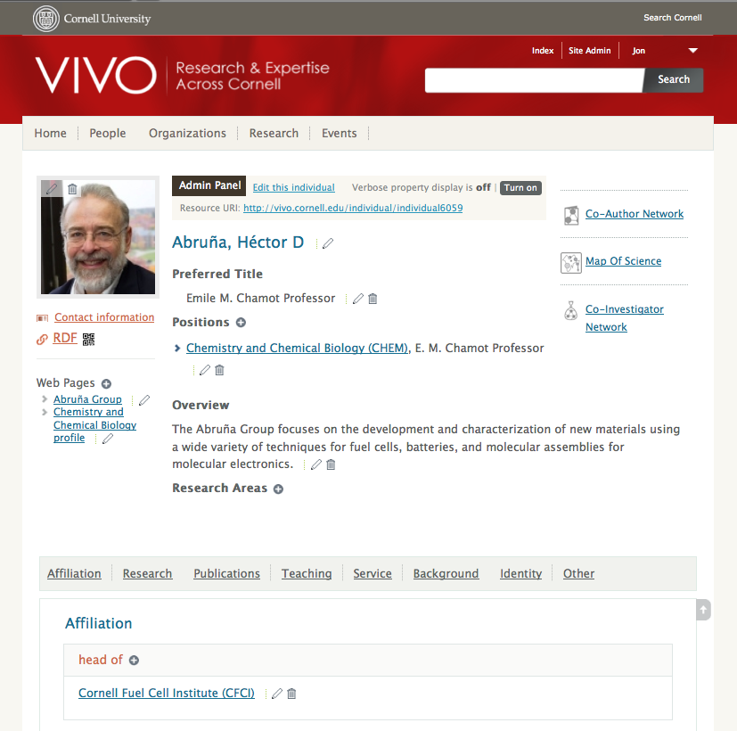
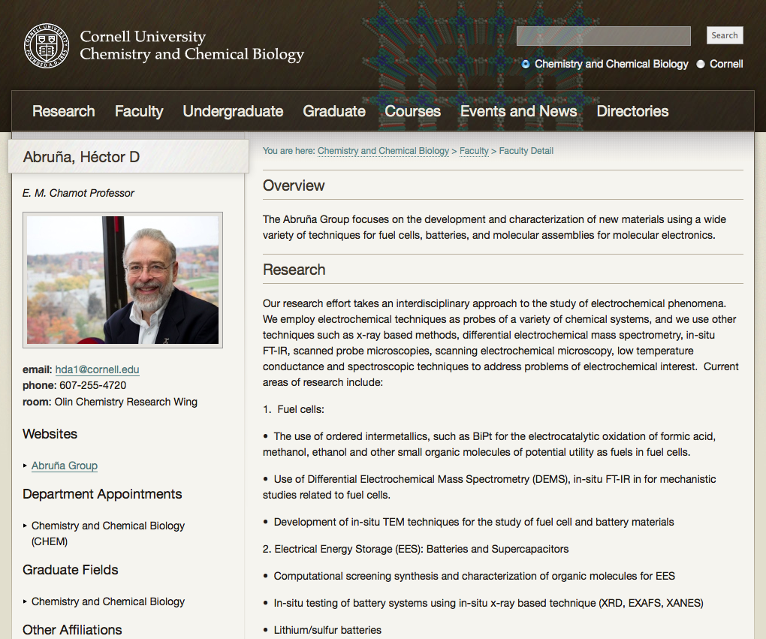
Enter Data Once, Use Many Times
Notes:
Our philosophy is you can save time and improve currency and accuracy if you only have to input information one time. This is a feature that is very appealing to faculty. [Cornell intends to participate in the Economic Development Portal being developed by NY????? Having data in VIVO means we can pipe the data to the Portal, faculty don’t have to fill out yet form.]
The College of Arts and Sciences is using VIVO to feed core data into departmental websites.

Slide 15
TAMU Use Cases
Discovery of expertise when building collaborative teams
Organizational practices for faculty, departments and colleges
VPR and TEES Proposal development
Research funding compliance
Informing Society

Slide 16
Implementation at Texas A&M Dr. Bruce Herbert & Michael Bolton

Slide 17
Data Sources
HR: people and their positions
Symplectic Elements Harvester: Faculty Publications
Registrar: courses
Faculty reporting: awards, professional service, education, research areas, research blurb
Institutional Repository: ETDs, publications, grey literature
Events calendar
MARCOMM: internal and external news
Extension: outreach, technology transfer
Research administration: grants & contracts

Slide 18
Data Stewardship
Manage data at its appropriate source with appropriate privacy
HR, grants management, registrar, graduate school, colleges and schools, research centers, extension
Department/agency/division/geographic location/research unit
Consciously derive public data for exchange
Engage stakeholders and build relationships
Recruit power users for training and local knowledge
Data that are visible get corrected!
Notes:
VIVO projects stimulate an ecosystem approach. Repurposing data is cost efficient. (Leads in to next slide)

Slide 19
Policy Issues
Representing faculty reputations
Dirty data
Lack of common definitions of organizational structure or who’s “faculty”
Data ownership
Many dimensions of privacy beyond simple “opt-in vs. opt-out”
Short-term “go it alone” vs. common good
Institutional risk
Notes:
See all or see nothing across colleges. Opt-in
Information in aggregate has been known to reveal unintended identifiable data

Slide 20
Researcher Profile Information Ecosystem
Profile Editor
Faculty Data
TAMU Data
Manual Input
Curator
QC
Widgets
Harvest
SQL Database
Crosswalk
Widgets
Harvest
Harvest
Harvest
Reports
Notes:
Value Proposition
Disambiguation
Discoverability
Business Practices

Slide 21
Scaling Up the Project
scholars.library.tamu.edu

