Slide 1
Making STEM URM Funding Work for TAMUS Universities
Dr. Luis Cifuentes | VP Research, Commercialization and Outreach
Dr. Amanda Garcia | Associate Professor, Department of Art, Office of Community Outreach Faculty Fellow
Dr. JoAnn Canales | Dean, College of Graduate Studies
August 30, 2016

Slide 2
TAMUS Opportunity
In 2009, for the first time in Texas’ history, Latino children represented the majority of Texas first-graders.
The Texas Hispanic population has grown significantly in recent years such that in 2014 the approximate percentage share of Latino children in Texas are
50% 5-9 year olds;
47% 10-15 year olds and
46% 15-19 year olds (Saenz, 2016).
Now almost college age, many will attend TAMUS universities creating a strong group of prospective URM students to recruit for STEM programs.

Slide 3
TAMU-CC Recruitment of URM
STEM funding for URM: TAMU-CC Example
Recruitment of URM
Retention of URM
Keeping $$ in the System: NIFA Grant Example
Leveraging RCN CE³SAR

Slide 4
TAMU-CC STEM URM funding
Total | STEM+URM | All sponsored projects | Percentage of STEM+URM Sponsored projects
Total dollar amount awarded to ongoing sponsored projects | $ 16,419,650 | $ 60,897,786 | 27%
Total dollar amount requested for sponsored projects in the pipeline | $ 24,414,453 | $ 91,172,083 | 27%
Total | $ 40,834,103 | $ 152,069,869 | 27%
Project criteria used STEM, Student related, URM, Hispanic. Pending projects May 2015- to date in Maestro-type: in-development, submitted to sponsor, preproposal

Slide 5
TAMU-CC STEM URM funding
PI Name | Title | Sponsor | Total Amount Awarded
Open Projects
Spaniol-Mathews Patricia | TAMUCC McNair Scholars Program | U.S. Department of Education | $ 1,097,575
Cifuentes Luis | RCN-SEES: Climate, Energy, Environment, and Engagement in Semi-Arid Regions | National Science Foundation | $ 745,817
Mahdy Ahmed | BPC-AE: Computing Alliance of Hispanic-Serving Institutions | University of Texas El Paso/National Science Foundation | $ 291,210
Canales Joann | The Cultivar Project: Connecting Underrepresented Latinos to Integrate Values and Academic Resources | USDA-National Institute of Food and Agriculture | $ 336,968
Schauer Leslee | Project GRAD: Graduation and Retention through Academic Diversity | Department of Education | $ 524,876
Pending Projects
Lea Der Chen | The CREST Center for Innovations in Geospatial Computing Science and Autonomous Systems (iGEO COMPASS) | National Science Foundation | ~ $ 5,000,000
Leslee Schauer | Project TRAC: Transfer Resources for Academic Completion | Department of Education | $ 4,936,502
Jennifer Pollack | Connecting Youth to Coastal Habitat Restoration in Texas | National Fish and Wildlife Foundation | $ 249,293.
Richard Mcglaughlin | CAREER: Broadening Participation in STEM: A Qualitative Analysis of Retention Experiences and Retention Strategies of Latina STEM Majors in Higher Education | National Oceanic and Atmospheric Administration | $ 3,500,000
Joe Fox | Experiential Training In Use Of Unmanned Aerial Systems (UAS) Technology For Agriculture Applications | USDA-National Institute of Food And Agriculture | $ 995,829

Slide 6
Recruitment of URM
OVERVIEW

Slide 7
Recruitment of URM
Family members, peers and trustworthy external guidance are key to reach and sustain positive attitude toward college.
Social capital ranks among the top three factors in recruitment determination for 4-year colleges. Lack of reliable and trustworthy social capital can make or break a student getting out of the gate.

Slide 8
Recruitment of URM
Parents and students have consistently reported difficulty locating proper and accurate information in a direct and easily accessible way.
Misconceptions about what this means for URM students and their parents often create additional barriers unintentionally.

Slide 9
Recruitment of URM
Maternal support is shown as key factor in student attitude and follow through during college enrollment.
Parental involvement—especially from the mother— is very important early on in order to motivate, encourage, and support students throughout the recruitment process.

Slide 10
Recruitment of URM
Addressing inaccurate perceptions of return on investment, financial resources, pipeline procedures, academic undermatch, among others, is crucial via one-on-one interaction with URMs.
Without the social capital in place, parents and students will fall short of enrolling in a 4-year institution without frequent and intentional one-on-one follow up.

Slide 11
Recruitment of URM
Optimism, grit, gratitude, passion, sense of purpose, motivation,
and creativity are identified as leading to overall life satisfaction URMs. Investment in life satisfaction and communication of what these will mean to the student and parent is integral to buy in of campus life and culture as being an environment that will mimic home.
Campus activities which provide the above seven key tenants will address specifically what potential students will want.

Slide 12
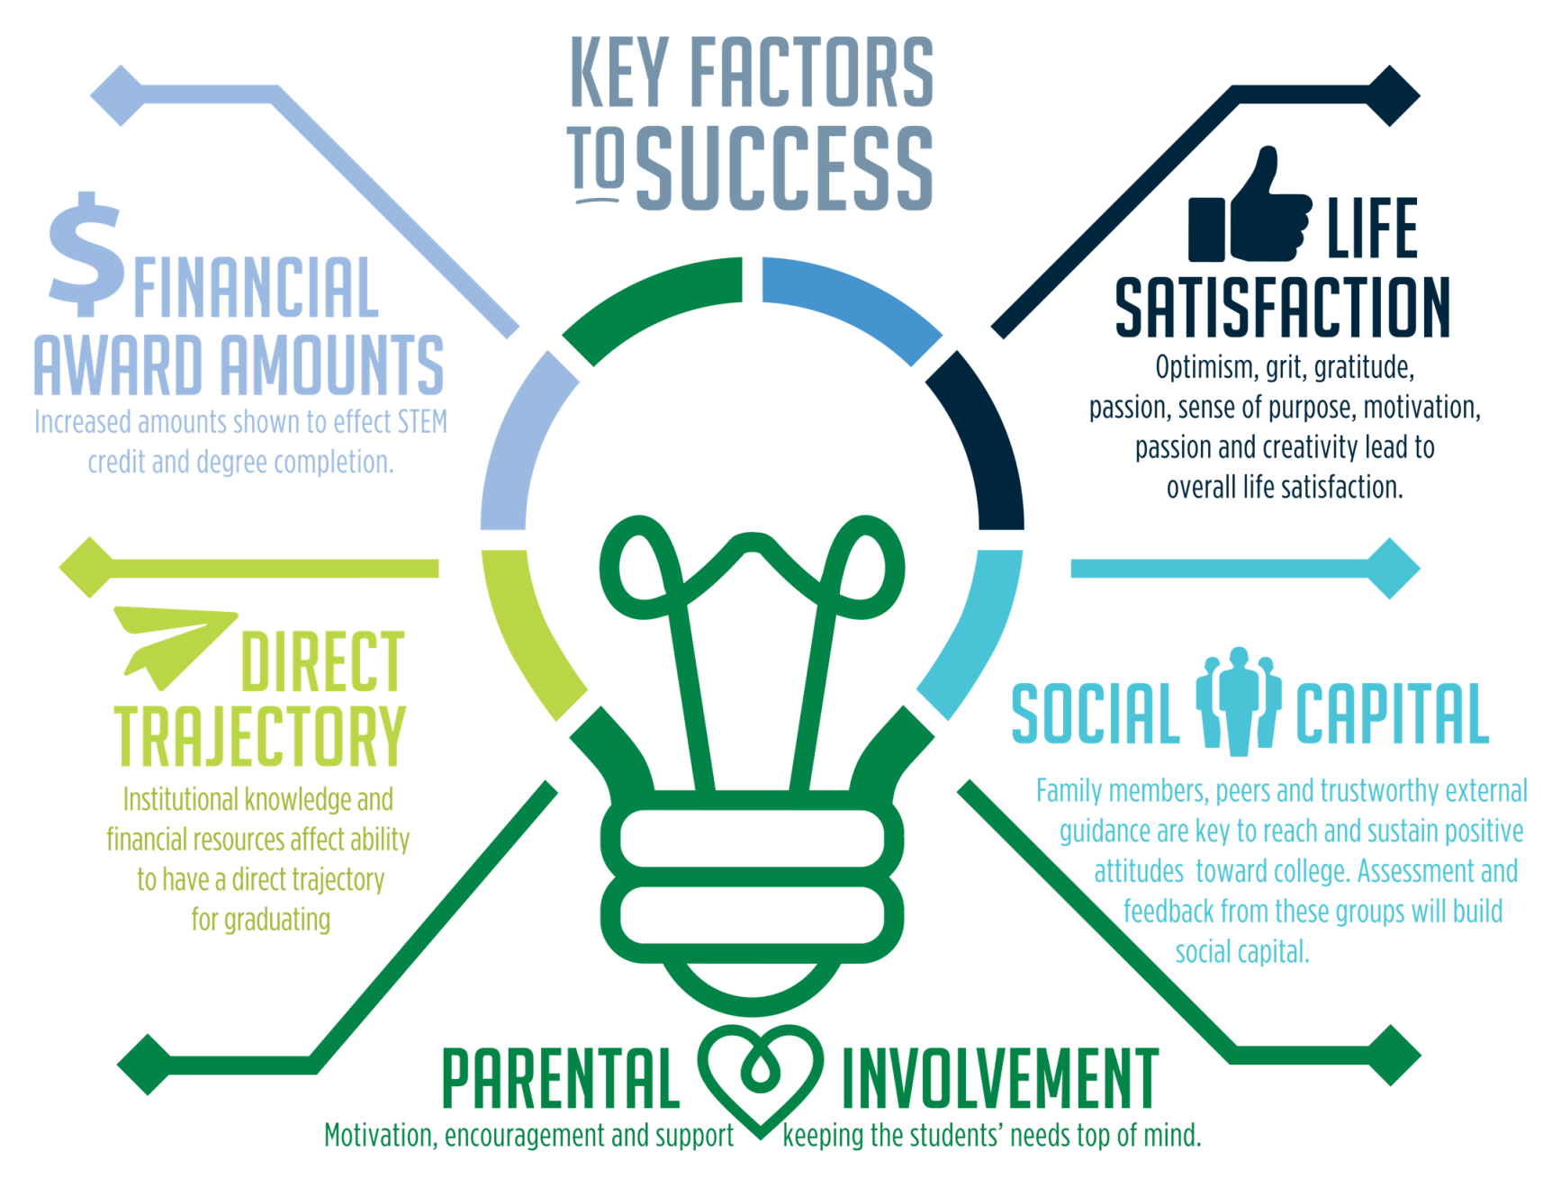
Retention of URM

Slide 13
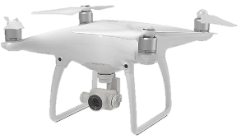
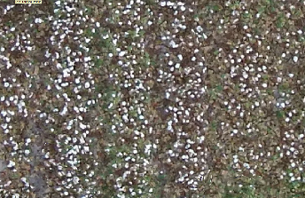
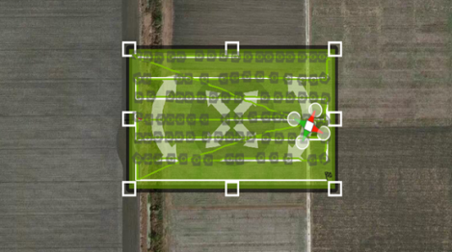
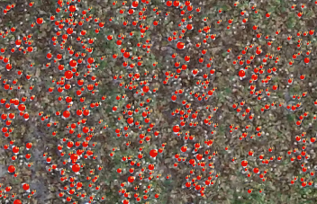
Keeping $$ in the System: NIFA Grant Example

Slide 14
Keep $$ in the System: Flow Chart
PI requests potential UG/G for NIFA grant
Mine student database
1. By level currently enrolled – [freshmen, sophomore, junior, senior, 1st year (newly enrolled) master’s]
2. Contact info – email and phone number
3. Residency
4. GPA (whatever it is)
Filter data to identify best
candidates meeting criteria
5. Race/ethnicity
6. Majors:
a. Atmospheric Science (BS)
b. Biology
c. FAMA (MS)
d. Marine Biology (MS)
e. Chemistry
f. Environmental Science
g. Computer Science (BS & MS)
h. GIS (BS)
i. GSEN
Excluded freshman - Only Sophomores to masters
Excluded certificate, non-degreed
Excluded foreign students
Selected only URMs - Black, Hispanic, multi-racial (Native American/Asian/White)
Sort each level of student by GPA (highest to lowest)
[Narrowing prospects from 2689 to 137 prospects]
Identified prospects with a GPA =/> 3.25
[Narrowing prospects from 137 to 28]
6 sophomore, 8 juniors, 9 seniors, 5 graduate (masters)

Slide 15
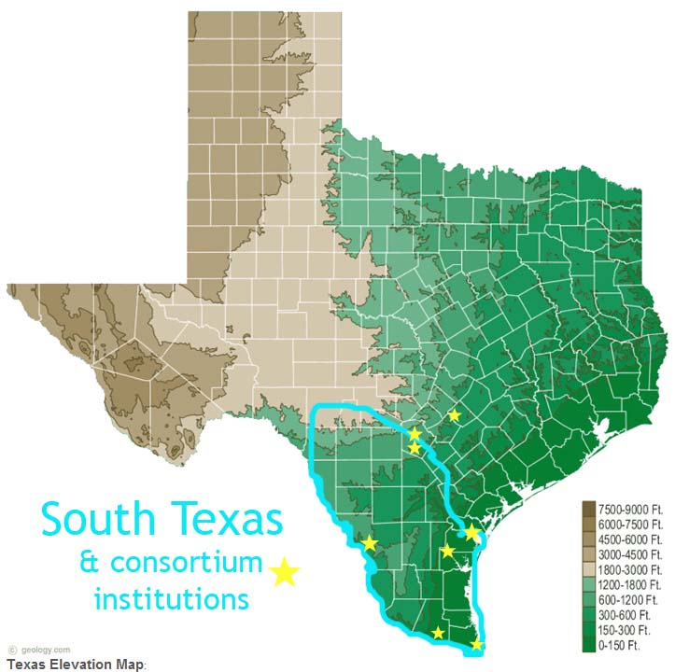
Leverage RCN CE³SAR
Overarching goals of the CE³SAR network:
A robust research, educational and engagement network of regional universities and research centers and institutes
Focus has been on the use of sustainability science in South Texas.
Transition to pilot a STEM URM recruiting network.

