Slide 1

Working with the Texas A&M System
The Texas A&M University System HUB Program
in collaboration with the TAMIU SBDC
Notes:
When adding in your logo to the placeholder, you may need to adjust the crop to best fit your logo’s dimensions.

Slide 2
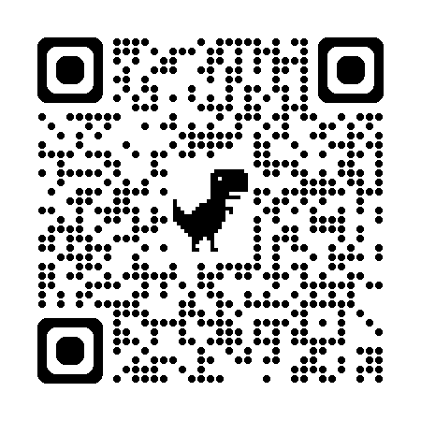
A&M System Weekly HUB Newsletter
Scan to subscribe.
Notes:
When adding in your logo to the placeholder, you may need to adjust the crop to best fit your logo’s dimensions.

Slide 3
About the Texas A&M University System (A&M System)
Public institution of higher education
Created in 1948 by the Texas Legislature
Governed by the Texas Administrative Code & Texas Government Code standard regarding the Historically Underutilized Business (HUB) Program
Sets HUB goals in six procurement categories, reviewed annually
Reports HUB expenditures semi-annually
Notes:
When adding in your logo to the placeholder, you may need to adjust the crop to best fit your logo’s dimensions.

Slide 4
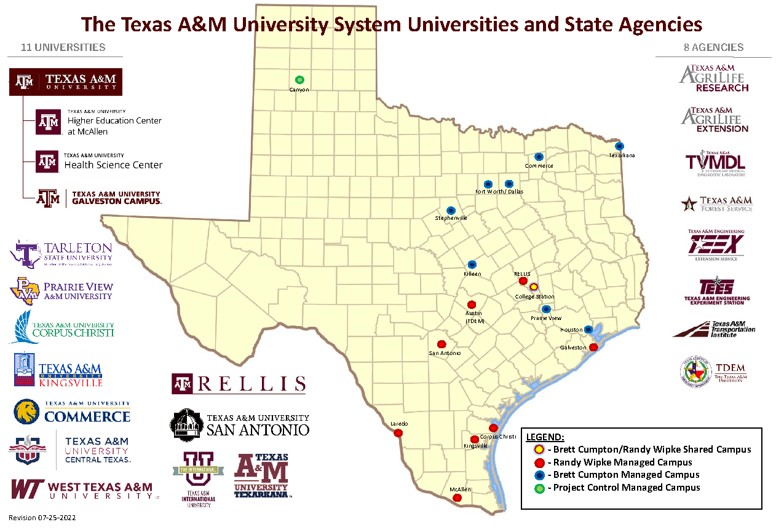
A&M System Map
Includes:
11 universities (soon to be 12),
A comprehensive health science center,
Eight state agencies, and
Texas A&M-RELLIS.
Notes:
When adding in your logo to the placeholder, you may need to adjust the crop to best fit your logo’s dimensions.

Slide 5
HUB Goals & Expenditures
FY25 HUB Goals|
HEAVY CONSTRUCTION: 10%
BUILDING CONSRUCTION: 30%
PROFESSIONAL SERVICES: 35%
COMMODITY PURCHASING: 45%
SPECIAL TRADE: 10%
OTHER SERVICES: 11%
HUB Expenditure Over Time |
Spent over $183 million with HUBs in FY24
Spent over $544 million with HUBs in the past five fiscal years
Majority of expenditure is through capital projects
Notes:
When adding in your logo to the placeholder, you may need to adjust the crop to best fit your logo’s dimensions.

Slide 6
Construction Opportunities
| Capital Projects
Notes:
When adding in your logo to the placeholder, you may need to adjust the crop to best fit your logo’s dimensions.

Slide 7
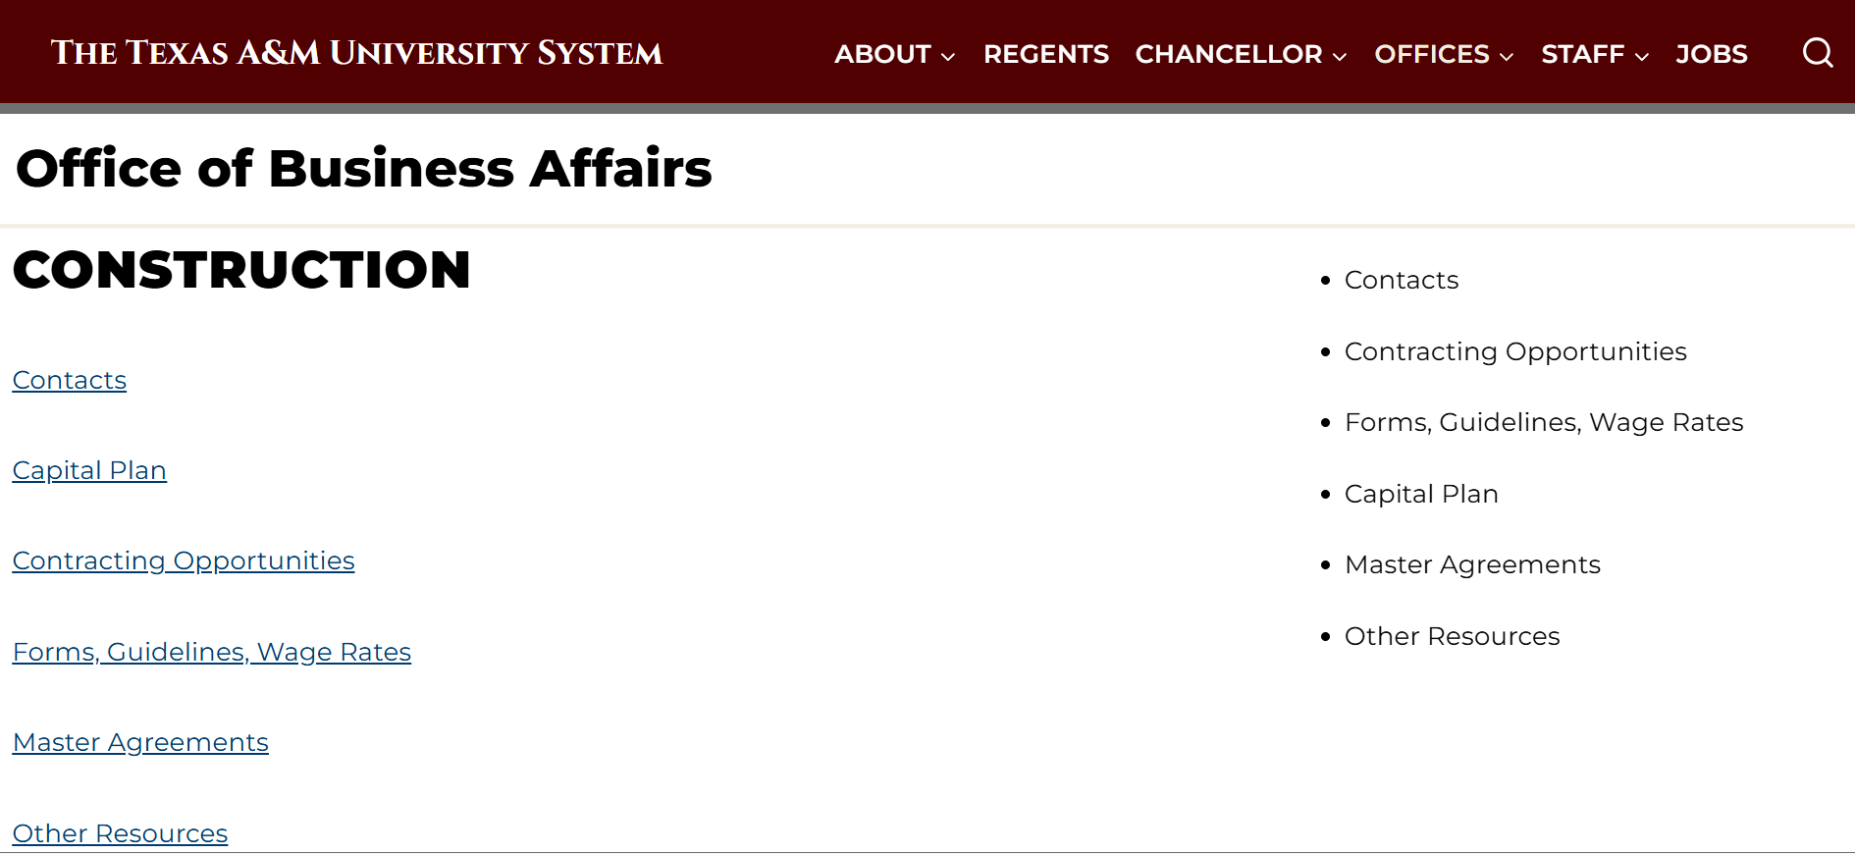
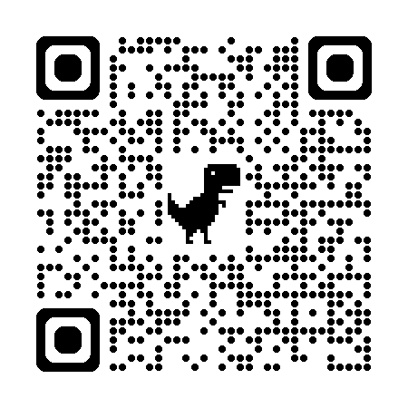
Construction Opportunities | FP&C
Scan to View Webpage.
https://www.tamus.edu/business/facilities-planning-construction/
Notes:
When adding in your logo to the placeholder, you may need to adjust the crop to best fit your logo’s dimensions.

Slide 8
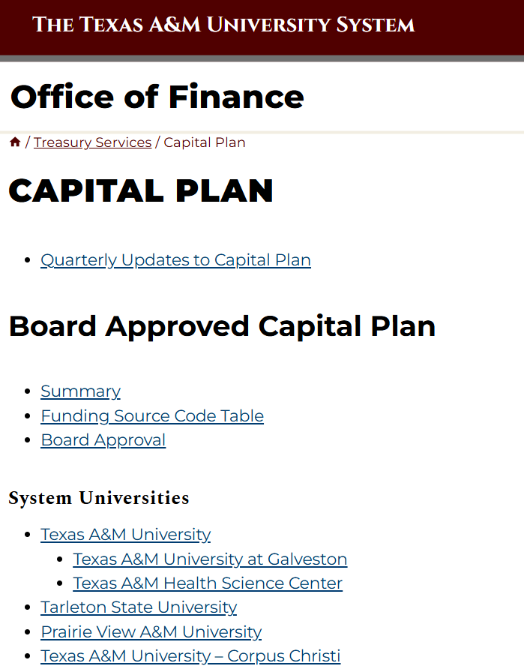
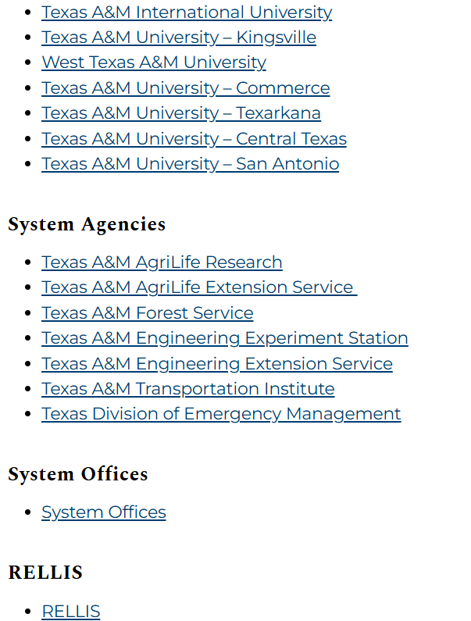
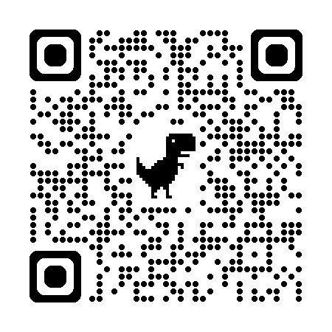
Construction Opportunities | Capital Plan
Scan to View Webpage.
https://www.tamus.edu/finance/treasury-services/capital-plan/
Notes:
When adding in your logo to the placeholder, you may need to adjust the crop to best fit your logo’s dimensions.

Slide 9
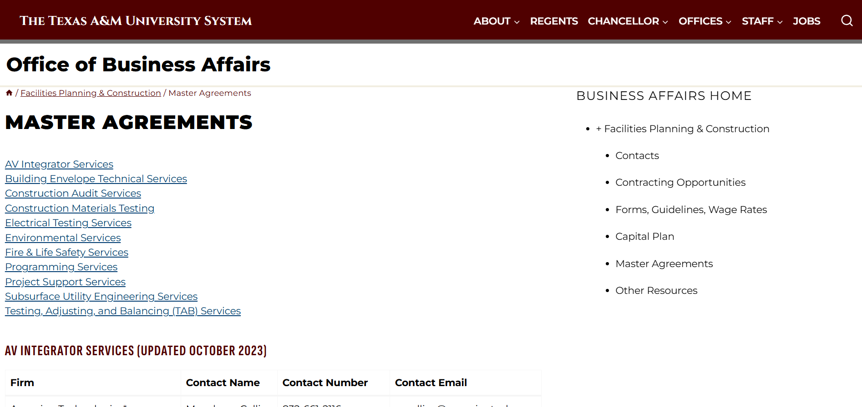
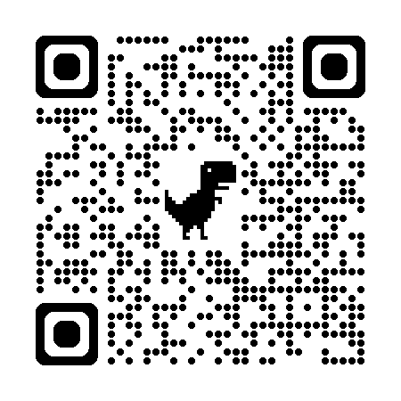
Construction Opportunities | Construction MSAs
Scan to View Webpage.
https://www.tamus.edu/business/facilities-planning-construction/
master-agreements/
Notes:
When adding in your logo to the placeholder, you may need to adjust the crop to best fit your logo’s dimensions.

Slide 10
Building & Grounds Maintenance, Custodial Services
| Construction Under $10M
Notes:
When adding in your logo to the placeholder, you may need to adjust the crop to best fit your logo’s dimensions.

Slide 11
Current Opportunities | Under $10M
SSC - A/E Indefinite Delivery Indefinite Quantity Agreement Pool
Email Lisa Gray to get added to the email distribution list for information on future opportunities.
Lisa Gray | lisa.gray@sscserv.com
Notes:
When adding in your logo to the placeholder, you may need to adjust the crop to best fit your logo’s dimensions.

Slide 12
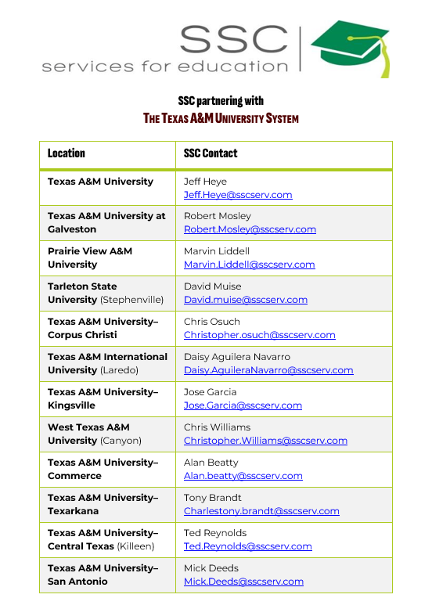
Building & Grounds Maintenance, Custodial Services| Contacts
Notes:
When adding in your logo to the placeholder, you may need to adjust the crop to best fit your logo’s dimensions.

Slide 13
Other Procurement Opportunities
Notes:
When adding in your logo to the placeholder, you may need to adjust the crop to best fit your logo’s dimensions.

Slide 14
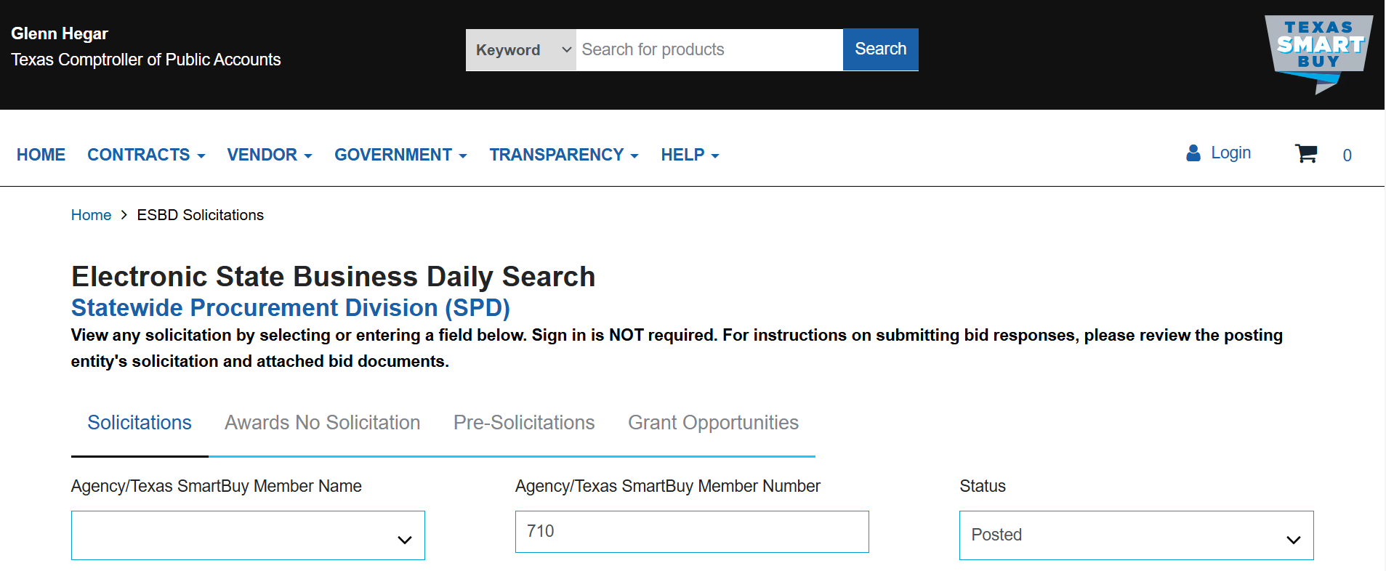
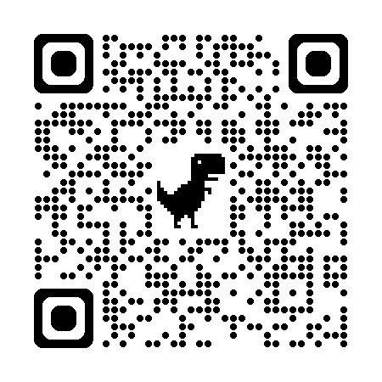
Procurement Opportunities | ESBD
Scan to View Webpage.
https://www.txsmartbuy.gov/esbd
Notes:
When adding in your logo to the placeholder, you may need to adjust the crop to best fit your logo’s dimensions.

Slide 15
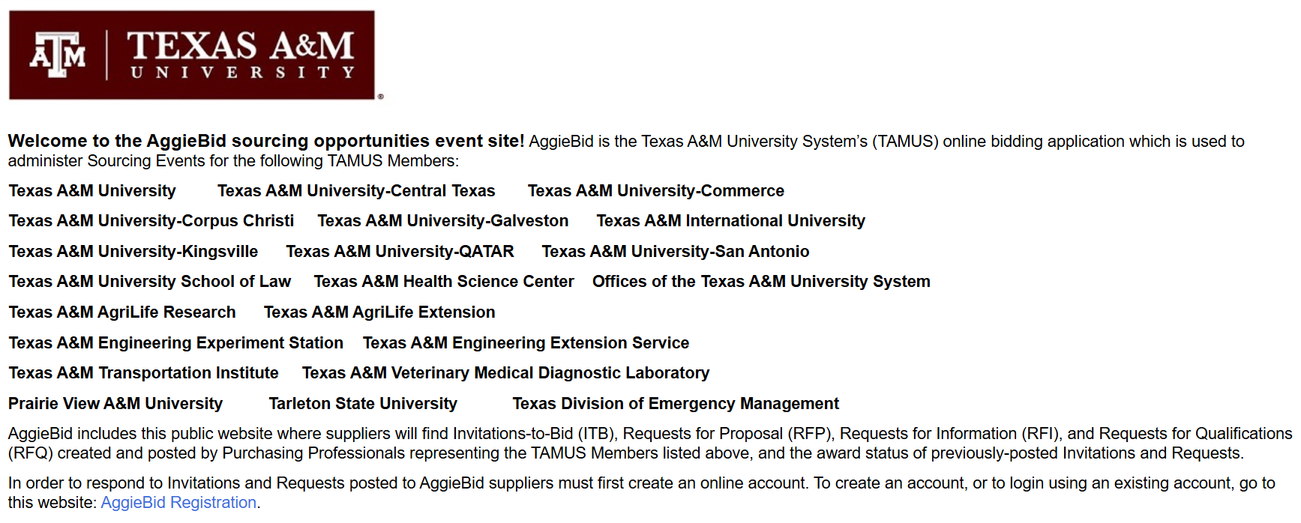
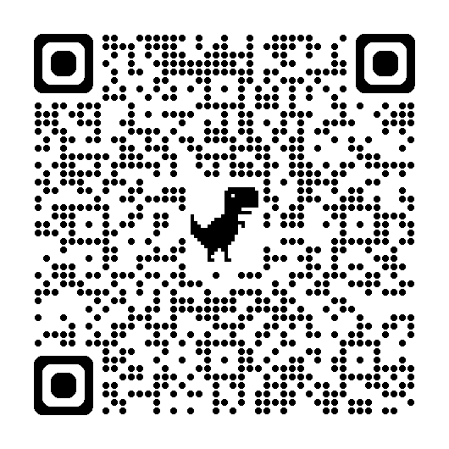
Procurement Opportunities| AggieBid
Scan to View Webpage.
https://solutions.sciquest.com/apps/Router/SupplierLogin?CustOrg=TAMU
Notes:
When adding in your logo to the placeholder, you may need to adjust the crop to best fit your logo’s dimensions.

Slide 16
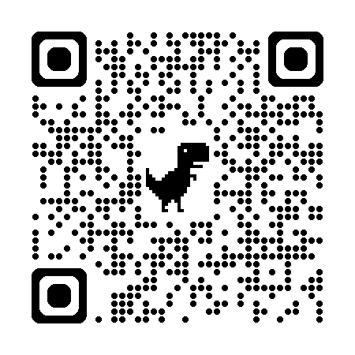
Resources on our Webpage
| HUB Certification Portal Training
| Vendor Lists
| Current HUB Goals & Documents
https://www.tamus.edu/business/hub-procurement/hub-programs-3/
Scan to View Webpage.
Notes:
When adding in your logo to the placeholder, you may need to adjust the crop to best fit your logo’s dimensions.

Slide 17
Thank you, TAMIU SBDC!
Email us: SO-HUBProgram@tamus.edu
Scan to subscribe to the HUB Newsletter.
Notes:
When adding in your logo to the placeholder, you may need to adjust the crop to best fit your logo’s dimensions.

