Slide 1
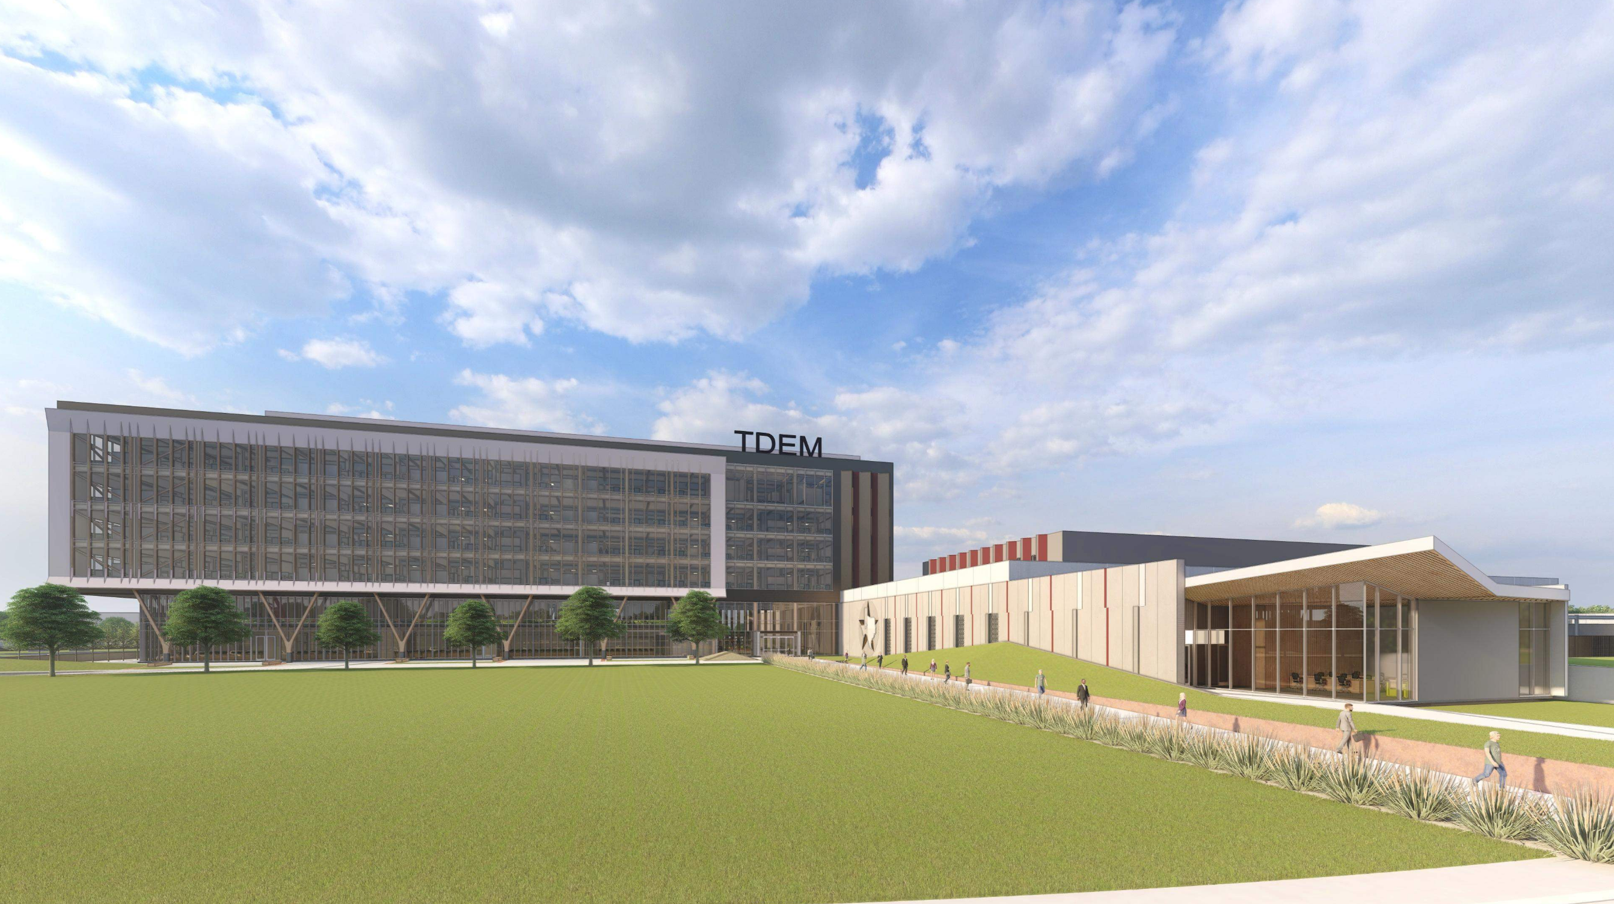
TDEM Headquarters & SEOC
Bid Package #1 – Site Capture, Utilities, and Piers
Notes:
Colby

Slide 2
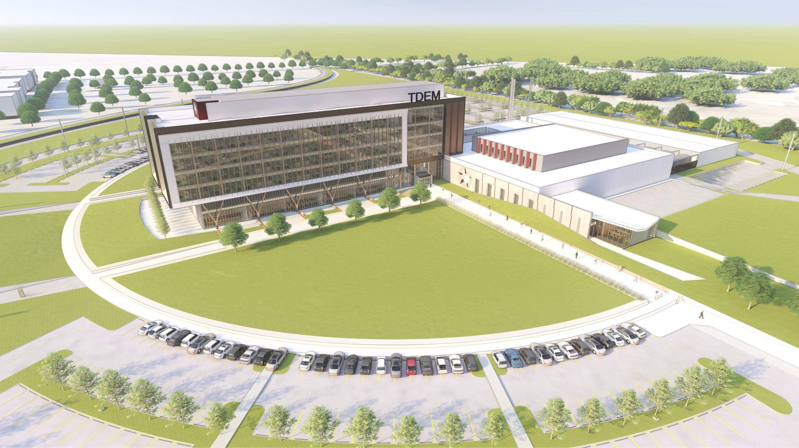
Project Team
Owner: TAMUS FP&C
Owner/User: Texas Division of Emergency Management
CMAR: Vaughn Construction
Architect: Energy Architecture & BGK
Structural & Geotech Engineer: Gessner Engineering
Civil Engineer: Garza EMC
MEP Engineer: Gonzalez Shah Smith
Telecomm Engineer: DataCom Design Group
Landscape Architect: Coleman & Associates
Notes:
Colby

Slide 3
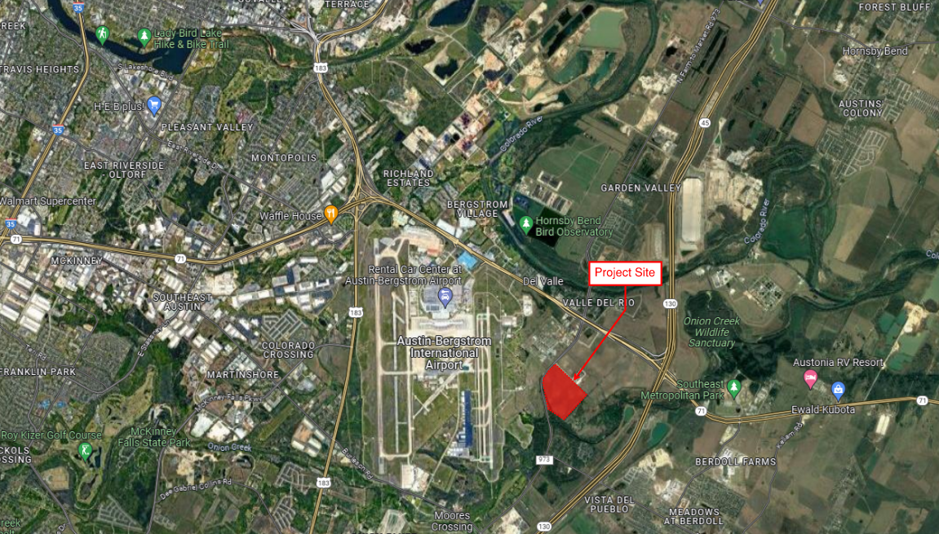
Overall Project Site Location
Notes:
Colby

Slide 4
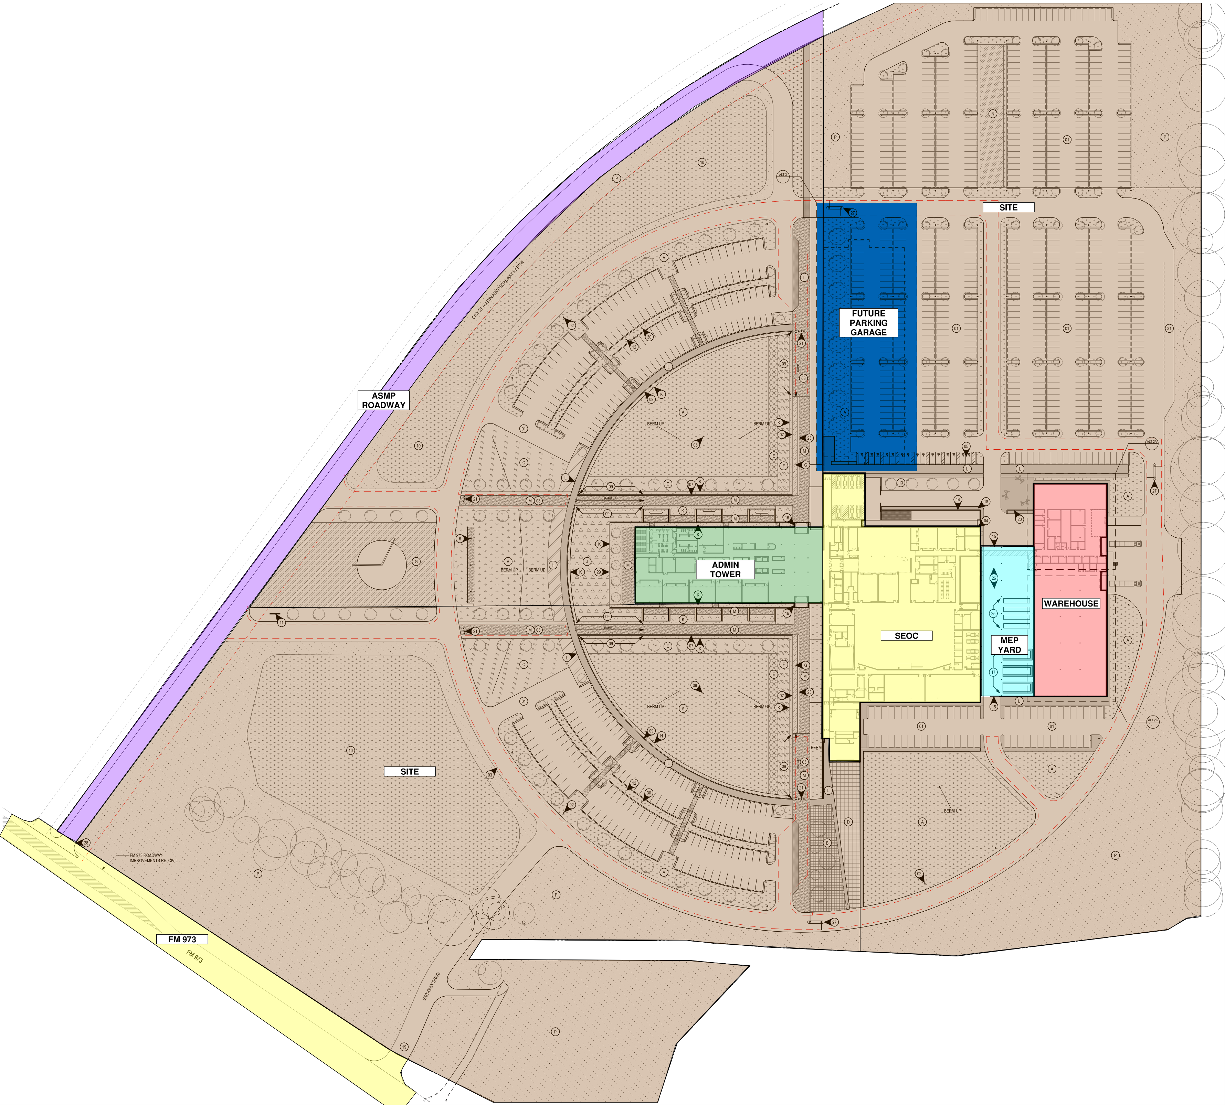
Overall Project Description
TDEM Headquarters & SEOC
The Texas Department of Emergency Management (TDEM) Headquarters and State Emergency Operations Center (SEOC) projected is located on roughly 50 acres at 4125 S FM 973 Austin, TX 78719.
The new campus will include:
Office Building
- ~240,000 SF
- 5 Story, Mass Timber & Steel Hybrid structure
- Metal Panel, Masonry, and Curtain Wall envelope
- Traction Elevators
- Mechanical Penthouse
State Emergency Operations Center (SEOC)
- ~92,000 SF
- 2 Story, Tilt-up panels and Steel Framed structure
- Precast wall features
- Hardened roof with a concrete ballas roof
- Mechanical yard with steel cover structure
Parking Garage (Alternate #7)
- 450 Spaces
- Cast-in-place/Precast Concrete Structure
- Final Design and Inclusion of Alternate TBD
Warehouse (Alternate #1 & #4)
- ~45,000 SF
- 1 Story (TDEM & FEMA spaces)
- Tilt-up panels and Steel framed structure
- Loading Dock and Overhead Doors
Site Development & Offsite Improvements
- 48 acres
- New turn lane and traffic signal at FM 973
- Utilities: Storm, W, RW, and WW
- Drainage/Civil features: 2 ponds, full site grading plan
- ASMP Road
- Surface Parking Lots
- Concrete retaining walls, head walls, sidewalks, banding
- Landscaping
Notes:
Colby

Slide 5
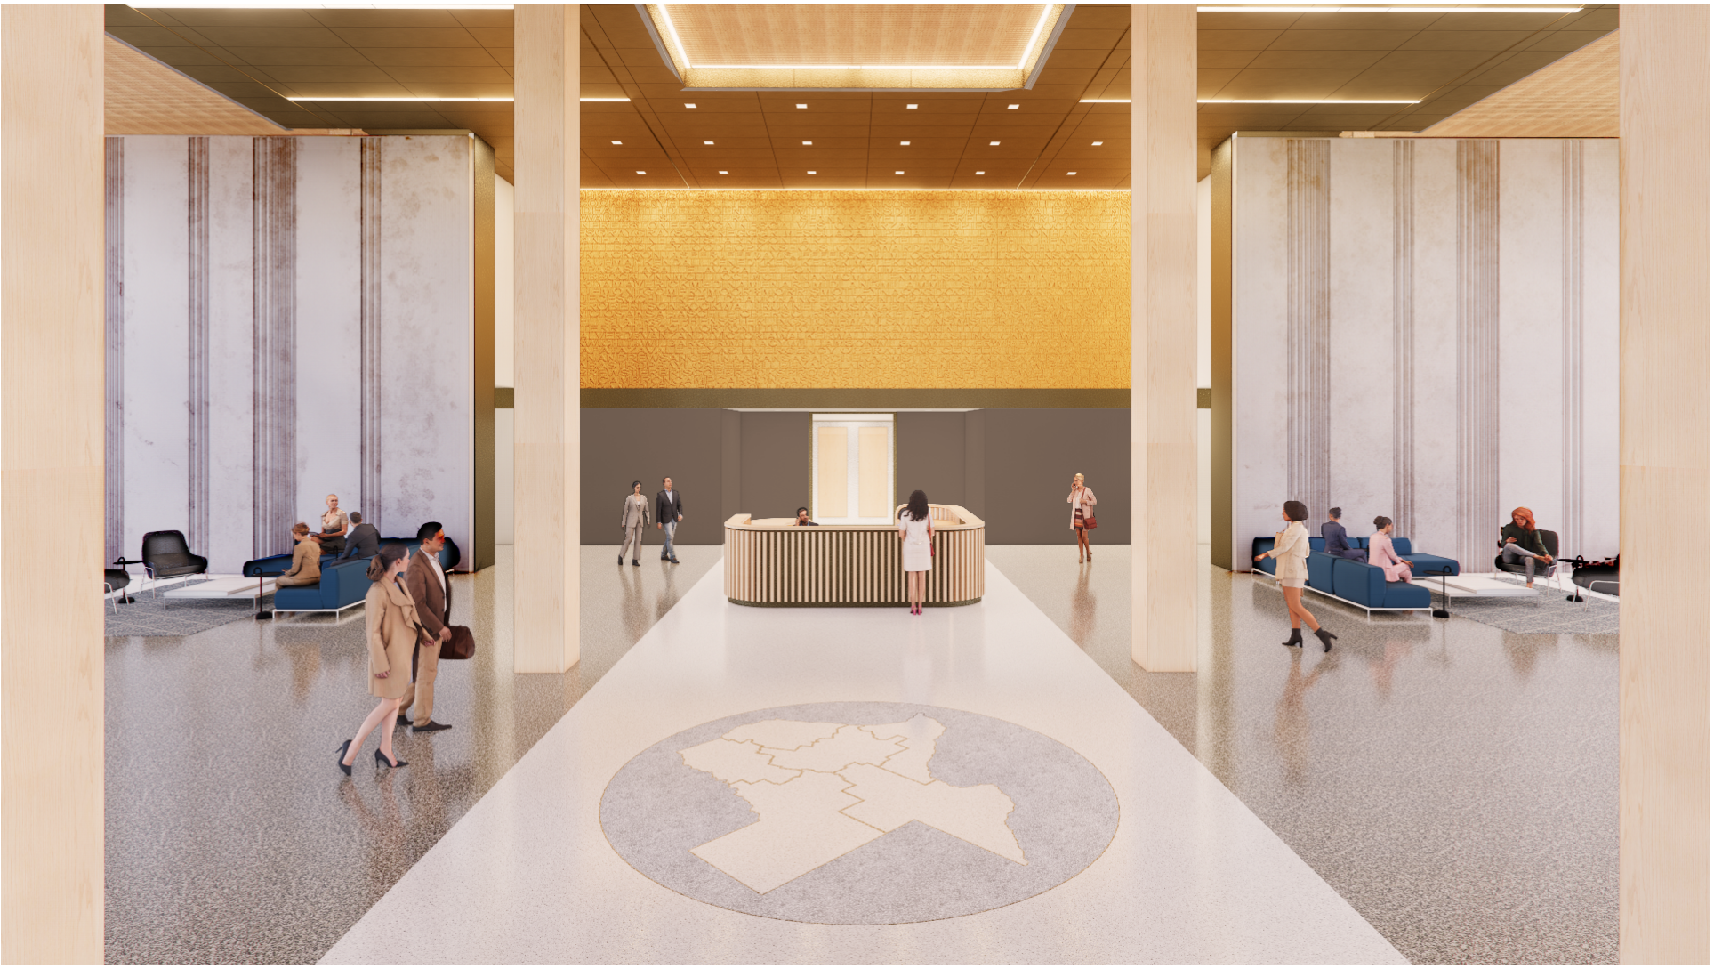
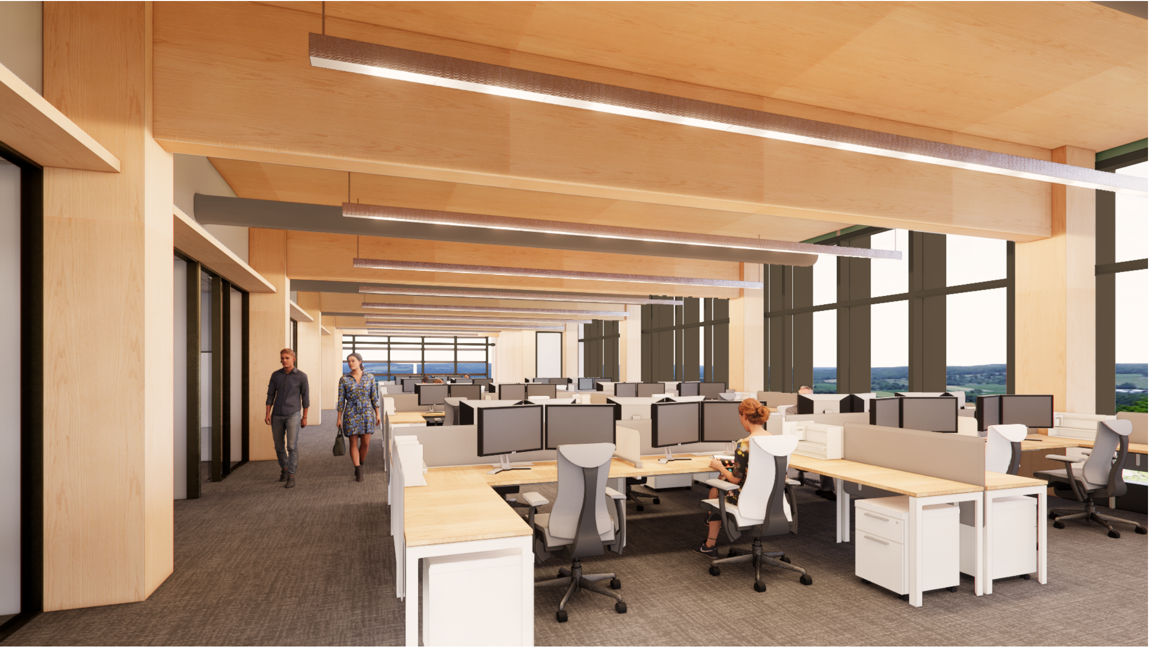
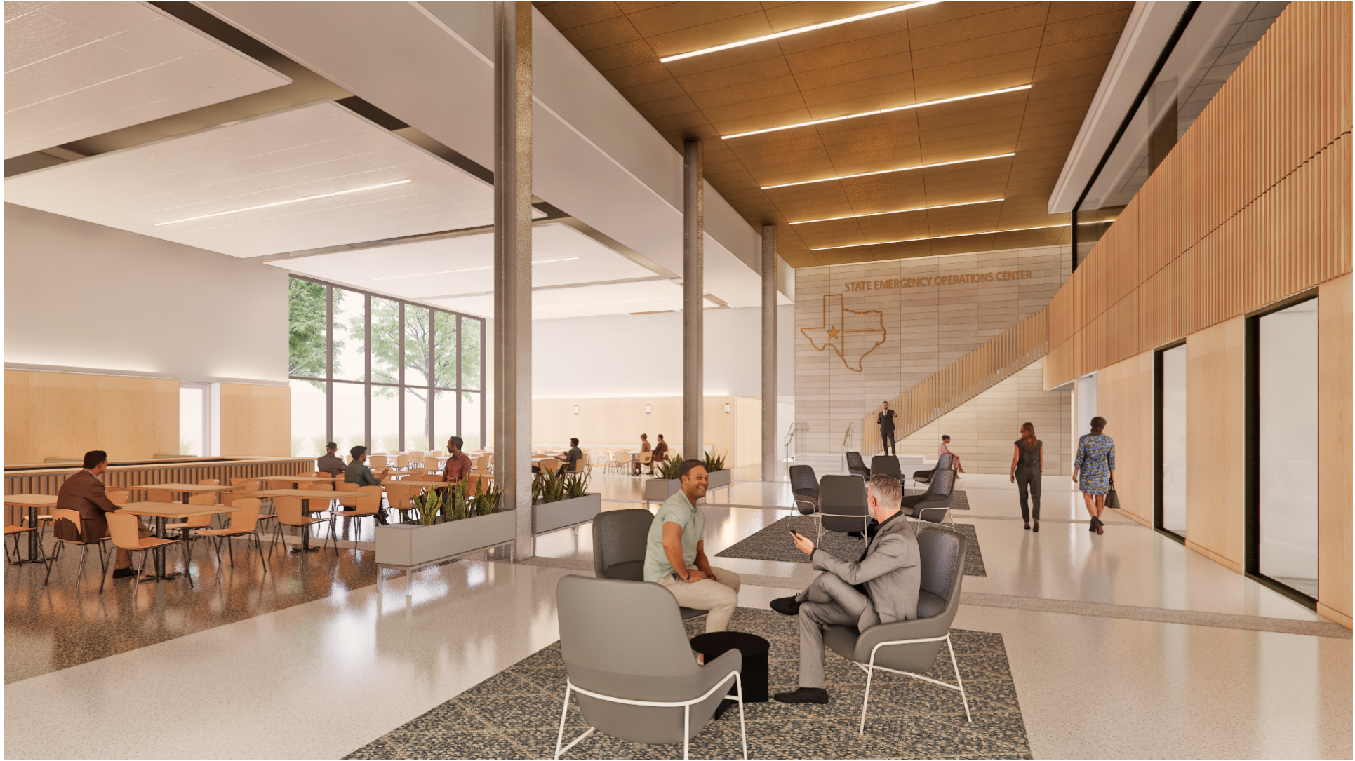
Renderings – Admin Tower & SEOC
Notes:
Colby

Slide 6
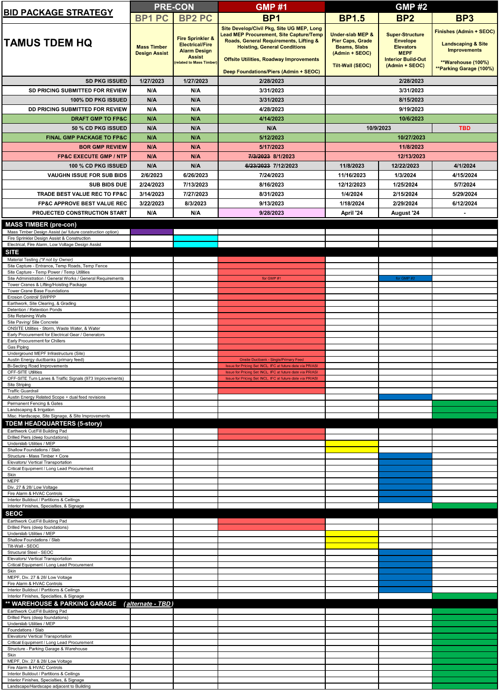
Project Bid Package Strategy
Previously Bid – Awarded or Post-Bid Evaluation Ongoing
Precon Bid Package #1: Mass Timber Design Assist
Precon Bid Package #2: Fire Protection & Electrical Design Assist
Current Bid Opportunity
Bid Package #1: Site Capture, Utilities, Piers
Future Upcoming Bid Opportunities
Bid Package #1A: Chiller & Generator Procurement
Bid Package #1.5: Shallow Foundations, U/S MEP, Tilt Wall
Bid Package #2: Super-Structure, Skin, MEPF, Elevators, & Interior Buildout
Bid Package #3: Finishes / Landscaping & Site Improvements, **Garage & Warehouse ALTERNATES

Slide 7
Schedule – BP1 Pre-Construction Milestones
Bidding Milestone Dates (Bid Package #1)
Bid Package #1 – Issue to Bid July 24, 2023
Pre-Proposal Conference August 1, 2023
Pre-Bid Questions/RFI’s Due By August 4, 2023 by 2:00PM
Addendum #1 Issued August 2, 2023 (Pre-Bid PowerPoint / Sign-In)
Addendum #2 Issued August 10 or 11, 2023 (tentative; for RFI responses)
Cost Proposal Deadline August 16, 2023 by 2:00PM
Technical Proposal Deadline August 17, 2023 by 2:00PM

Slide 8
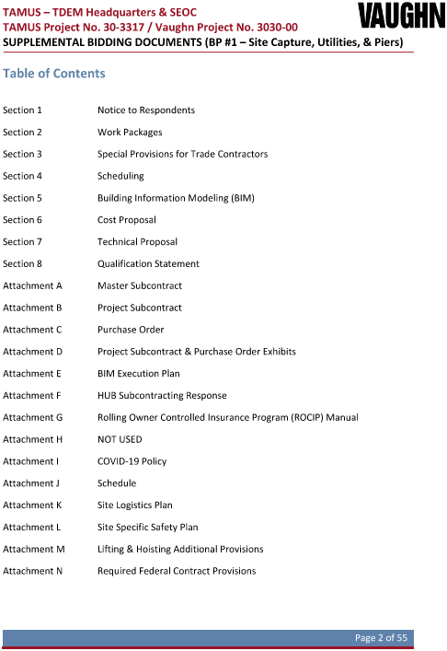
Supplemental Bidding Documents (CM Front Ends)
Notes:
Switch to Clayton

Slide 9
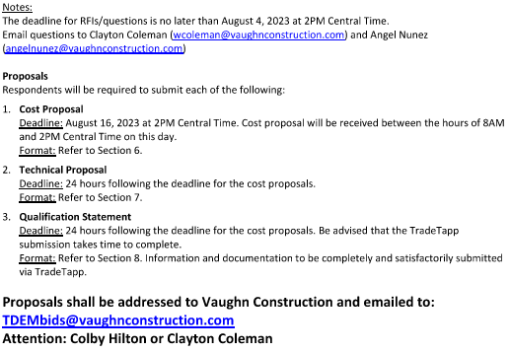
Notice to Respondents: Proposals / Dates
Proposals may be submitted on respondent’s letterhead in the required format (Section 6).
Proposals that include conditional clauses, alterations, or items not called for, or contain other irregularities which in Vaughn Construction’s opinion constitutes a material qualification of the proposal, may be rejected.

Slide 10
Work Packages (BP1 – Site Capture, Utilities, and Piers)
Expected Trade Contracts (Work Packages) and detailed scope breakdowns for each work package are outlined in Section 2 of the CM Supplemental Bidding Documents
BP1 Work Packages
01.03 – SITE ADMINISTRATION
01.04 – PROJECT SUPPORT
01.59 – PHOTO DOCUMENTATION
01.70 – LIFTING AND HOISTING
03.00 – CONCRETE DRILLED PIERS
22.01 – PLUMBING
26.01 – ELECTRICAL
31.01 – EARTHWORK
31.04 – SWPPP
32.02 – SITE CONCRETE & ASPHALT PAVING
32.13 - LANDSCAPE & IRRIGATION
32.14 - STRIPING & SIGNS
32.97 – FM 973 IMPROVEMENTS / TRAFFIC SIGNAL
33.01 - SITE UTILITIES
33.02 – OFFSITE WASTEWATER(Turnkey)

Slide 11
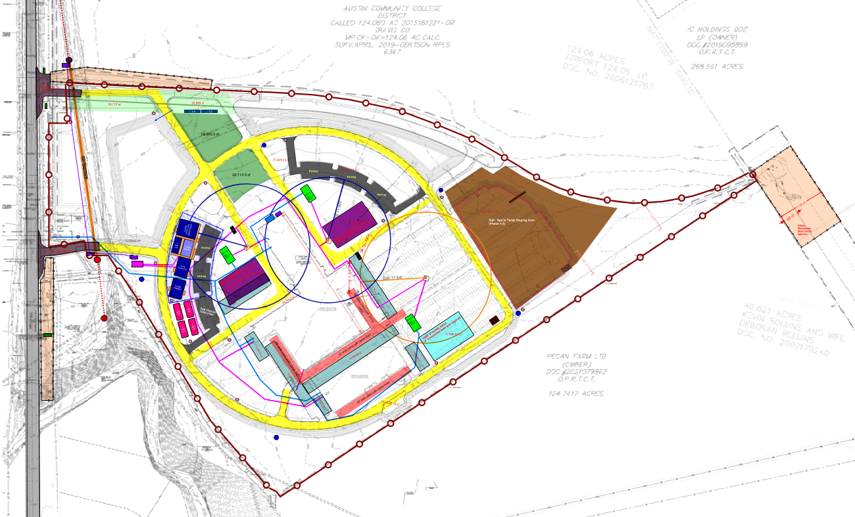
Overall Project Site Logistics
2 Tower Cranes. 3rd Crane is Add Alt
3 Break Areas
Offsite Wastewater
Parking Area.
Laydown/Staging next to Building
Temp Entrances
Temp Water and Temp Electric into Site
Full Perimeter
Fencing
Office Trailer Compound
Spoils Staging
Temp Asphalt Roads (Yellow)
Casting Beds and Crane Paths

Slide 12
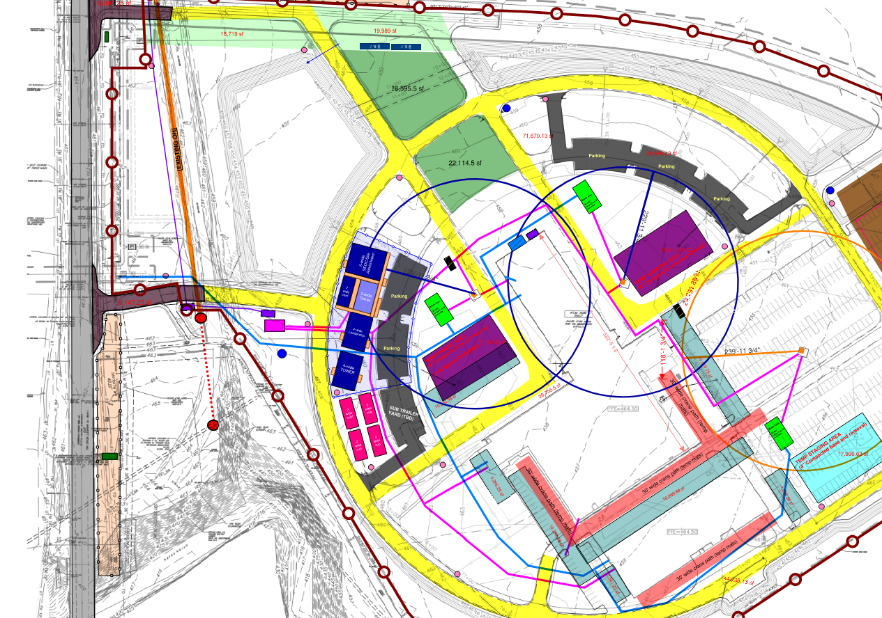
Overall Project Site Logistics

Slide 13
Work Packages (NOT Part of BP1)
Please note the following Work Packages are NOT currently available for bidding at this time. These work packages will be part of Future Bid Solicitations.
10.22 – Knox Box
10.23 – Marquee Sign
11.07 – Food Service Equipment
11.52 – Window Washing Equipment
12.05 – Blinds and Shades
14.01 – Elevators
22.01 – Plumbing
23.03 – Controls
26.01 – Electrical
26.03 – Fire Alarm
27.01 –Telecom/Data
27.07 – Das System
27.97 – Other Special Systems
28.01 – Security
32.02 – Site Concrete
32.04 – Unit Pavers
32.07 – Fences & Gates
32.11 – Site Furnishing
32.13 – Landscape & Irrigation
33.01 – Site Utilities
01.74 – Final Clean
03.00 – Concrete Turnkey (Slabs)
03.11 – Architectural Precast
03.13 – Tilt Up Panels
03.15 – Topping/Underlayment/Floor Prep
04.01 – Masonry
05.01 – Steel Fabrications
05.02 – Steel Erection
05.04 – Stair Treads & Nosings
05.50 – Ornamental Metal
06.02 – Architectural Woodworks/Millwork/Trim
07.01 – Waterproof/Dampproof/Joint Sealants
07.03 – Roofing
07.06 – Composite Panels
07.08 – Fireproofing
07.09 – Firesafe
07.10 – Fire Caulking
08.00 – Doors, Frames, Hardware
08.10 – Overhead Doors/Coiling Grills
08.12 – Fire Smoke Curtain
08.28 – Glass & Glazing
09.02 – Drywall
09.03 – Tile
09.04 – Terrazzo
09.07 – Carpet, Vinyl Flooring, Base
09.09 – Specialty Flooring
09.12 – Painting
09.16 – Concrete Sealer
10.01 – Visual Display Boards
10.03 – Toilet Compartments
10.05 – Wall Protection
10.06 – Access Flooring
10.07 – Flagpoles
10.08 – Signage
10.09 – Lockers
10.10 – Fire Protection
10.11 – Aluminum Covers & Awnings
10.14 – Operable Partitions
10.15 – Other Partitions
10.17 – Toilet Accessories

Slide 14
Schedule – BP1 Pre-Construction Milestones
Bidding Milestone Dates (Bid Package #1)
Bid Package #1 – Issue to Bid July 24, 2023
Pre-Proposal Conference August 1, 2023
Pre-Bid Questions/RFI’s Due By August 4, 2023 by 2:00PM
Addendum #1 Issued TBD
Addendum #2 Issued TBD (If Necessary)
Cost Proposal Deadline August 16, 2023 by 2:00PM
Technical Proposal/HUB Deadline August 17, 2023 by 2:00PM
Notes:
ANGEL

Slide 15
Pre-Proposal Questions
All proposal and scope related questions must be submitted by August 4th, no later than 3:00 PM.
Answers to pre-proposal questions will be included in a future addendum.
Send questions to wcoleman@vaughnconstruction.com and/or angelnunez@vaughnconstruction.com

Slide 16
Schedule – BP1 Construction Milestones
Construction Milestone Dates (Bid Package #1)
Bid Package #1 – Contract Awards September 14, 2023
Project Mobilization September 21, 2023
Earthwork Activities Begin October 5, 2023
Utilities Activities Begin December 18, 2023
Piers Activities Begin February 9, 2024
Tower Crane 1 Erection March 13, 2024

Slide 17
Bid Documents (BP1)
BP1 Bidding Files / Contract Documents
Bid Package 1 (BP1) Drawings and Specifications issued by Energy Architecture, dated July 12, 2023, 100% Issued for Construction
BP1 CM Supplemental Bidding Documents (Front Ends) and related attachments / referenced files
Bidding Addenda issued during BP1 bid advertisement period (2 Addendum expected to be issued. Refer to pre-construction milestone schedule)

Slide 18
Plans & Specs – Availability / Access Info
PLANS & SPECS:
Current Bid Opportunities List (vaughnconstruction.com)
Building Connected will be utilized to facilitate this solicitation. All pertinent information will be included
within the online platform and can be accessed via bid invitation emailed to each firm.
WOMEN AND MINORITY ORGANIZATIONS FOR HUB ASSISTANCE:
Organization | Email | Phone
Regional Hispanic Contractors Association of DFW | bids@regionalhca.org | +1 972-786-0909
Southwest Minority Supplier Development Center | smsdc@smsdc.org | +1 512-386-8766
Asian Contractors Association | asiancontractor@gmail.com | +1 512-926-5400
HCA De SA | admin@hcadesa.org | +1 210-444-1100
Tx Assoc. of Mexican American Chambers of Commerce | panton@tamacc.org | +1 512-444-5727
Womens Business Enterprise Alliance | bids@wbea-texas.org | +1 713-681-9232
Austin Black Contractors Assn. | brc-pro@att.net | (512) 467-6894
Texas Association of African American Chambers of Commerce | info@taaacc.org | +1 512-535-5610
Womens Business Council | asteele@wbcsouthwest.org | +1 817-299-0566
City of Austin - DSMBR Plan Room | juaquin.gonzalez@austintexas.gov | +1 512-974-7745
U.S. Hispanic Contractors Association De Austin | ushcadeaustin@gmail.com
Bexar County | rwatson@bexar.org | +1 210-335-2478
CAL LLC | scohen1089@gmail.com

Slide 19
HUB Goals
Participation by Historically Underutilized Business (HUB)
Actively seek involvement of HUBs
Total Project HUB Goal: 30%
HSP required from all successful bidders
HUB Subcontracting Response (Attachment F – 2 Parts)
** HUB Note: If your company does not include at least 21% HUB participation with your BP1 bid proposal, the project risks not meeting its HUB goal. Please make your good faith effort. There are many 2nd/3rd tier HUB opportunities available for consideration.
Project HUB Consultant: Regina Adams, Smith & Associates
Notes:
Clayton

Slide 20
Lower Tier HUB Participation Opportunities (EXAMPLES)
01.03 Site Administration
Dumpster supplier/vendor
Misc. materials (lumber, small tools, tool storage, fasteners, etc.)
Equipment purchase/rental
Misc. safety materials (eyewash, fire extinguishers, first aid supplies, etc.)
Temporary toilets
Layout equipment purchase/rental
Outrigger purchase/rental
Signage materials
03.00 Concrete Turnkey (Drilled Piers)
Equipment Purchase /Rentals
Pot-Holing/Hydro-Excavation Services
Concrete Purchase/Suppliers
Concrete Place and Finish
Concrete Pumping
Reinforcing Purchase/Suppliers + Installation
Formwork Purchase/Supplies + Installation
22.01 – Plumbing Systems
Misc. materials (small tools, tool storage, etc.)
Equipment purchase/rental
Plumbing materials (pipe, valves, fittings) supplier/vendor
Misc. safety materials (PPE, fire extinguishers, first aid supplies, etc.)
26.01 – Electrical
Misc. materials (small tools, tool storage, etc.)
Equipment purchase/rental
Electrical materials (conduit, raceways, fittings) supplier/vendor
Misc. safety materials (PPE, fire extinguishers, first aid supplies, etc.)
32.01 – Earthwork
Misc. materials (small tools, tool storage, etc.)
Equipment purchase/rental

Slide 21
Identifying HUB Suppliers/Vendors/Subs
Centralized Master Bidder List (CMBL) – HUB Search
URL: https://mycpa.cpa.state.tx.us/tpasscmblsearch/tpasscmblsearch.do
Search for Active HUB Vendors/Suppliers/Contractors
HUBs ONLY Search - Search results will consist of active vendors who are a Texas certified HUB, regardless of whether they are registered on the CMBL.

Slide 22
Register as HUB
Encourage businesses you work with that qualify to register as HUB.
Who Qualifies?
Must be a U.S. citizen.
a for-profit entity that has not exceeded the size standard prescribed by 34 TAC §20.294, and has its principal place of business in Texas, and Is at least 51 percent owned by an Asian Pacific American, Black American, Hispanic American, Native American, American woman and /or Service Disabled Veteran with a Service related disability of 20% or greater, who reside in Texas and actively participate in the control, operations and management of the entity's affairs.

Slide 23
Additional HUB Information
HUB Toll Free Line: 1-888-863-5881 HUB Local Line: 512-463-5872 HUB Fax Number: 512-936-2482 Email StatewideHUBProgram@cpa.texas.gov
HUB Frequently Asked Questions
URL: https://comptroller.texas.gov/purchasing/vendor/cmbl/faq.php

Slide 24
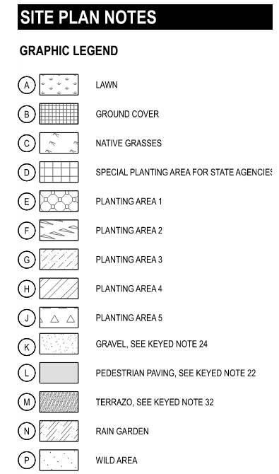
Special Provisions / Project Requirements
Refer to Section 3 of CM Front Ends for Complete Rqmts
Safety
Formal documentation to support training
PPE including: hard hats, safety glasses, reflective vests
Fall prevention/protection required at 6ft or greater
Fall protection, retractable lifelines, required at 12ft or greater
Subcontractor Safety Representative (SSR)
Onsite Full Time During Work / SSR can have additional duties
OSHA 30 HR certificate; dated within 4 years of start date
New Worker Orientation
COVID-19
Silica Standard
Pre-Install Meetings and Weekly Meetings (safety, sub, daily)
Prevailing Wages, Certified Payroll, & Wage Rate Forms
Submittals & RFIs (ACC Build)
Monthly CP / CO Log
Parking + Temp Construction Staging Onsite, & Temp Services (refer to Vaughn Site Logistics)
Site Access / Entrances & Deliveries
Layout / Field Engineering
Traffic Control and Flagmen
Permitting
Lifting, Hoisting, & Scaffolding
Cleanup / Jobsite Maintenance
BIM / 3D Coordination
QAQC + Commissioning
Closeout
Federal Compliance – 2 CFR 200 (E-Verify NOT required)

Slide 25
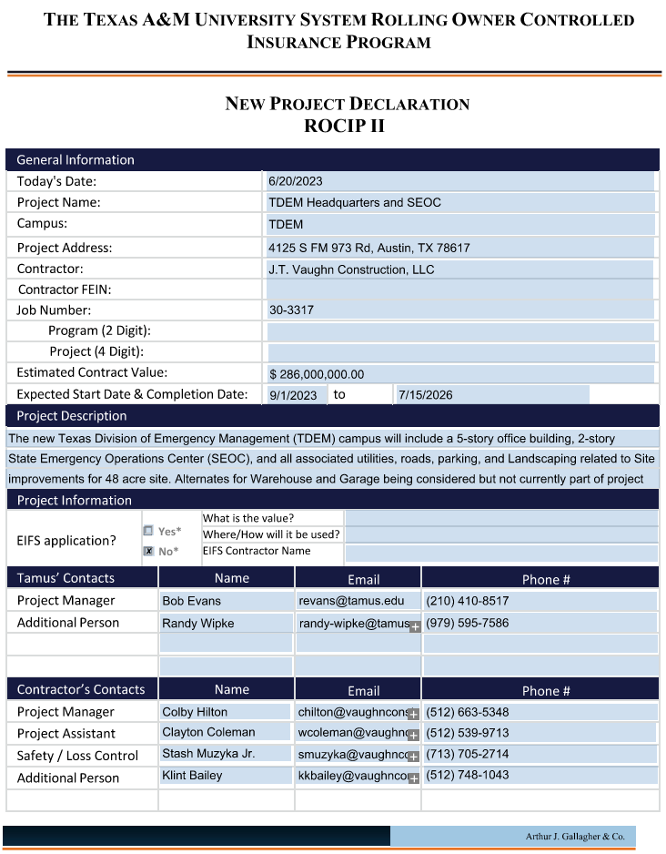
ROCIP Insurance
Rolling Owner Controlled Insurance Program (ROCIP) Manual - Reference Attachment G
Onsite GL, Excess/Umbrella, & WC Insurance
Subcontractor to provide:
Onsite Auto and Offsite GL, WC, Excess/Umbrella Insurance

Slide 26
Scheduling
Primavera (P6)
Initial schedule with proposal
Final Baseline Schedule within 14 days request
Schedule of Values to be included
Monthly Updates
Refer to Section 4 (CM Front Ends)

Slide 27
Building Information Modeling (BIM)
Refer to Section 5 (CM Front Ends)
Required for MEPF trades in BP1
Lead for Coordination = Vaughn
BIM Web-based
licenses provided by Vaughn
Weekly Coordination Meeting (conf. call / Teams)

Slide 28
Bid Deliverables / Contract Award Process
Proposals will be evaluated on the following criteria to determine best value:
Cost Proposal (Section 6)
Technical Proposal (Section 7)
Qualification Statement / TradeTapp (Section 8)
Other Required Bid Deliverables
HUB Subcontracting Response + good faith effort (attachment F)
Post-Bid Questionnaire (PBQ) Response - distributed to all respondents post bid
Project Team (Vaughn, Owner, Owner Representative) will jointly select the Trade Contractor that is most advantageous to the project. Failure to respond and/or provide any of the above requirements could put respondent at a significant disadvantage during the review process.
Bids must be submitted to TDEMbids@vaughnconstruction.com by August 16th @ 2:00 PM
Notes:
CLAYTON

Slide 29
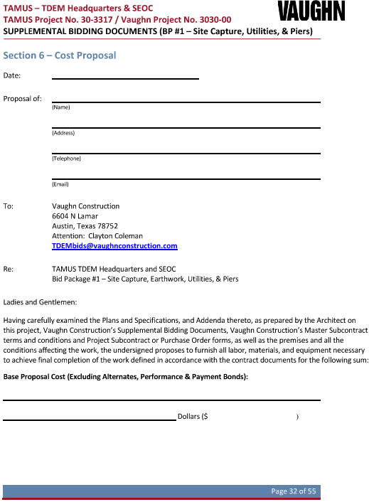
Cost Proposal
USE SECTION 6 BID FORM
Contact Vaughn team in advance of any questions regarding the submission of the proposals
Note work package being submitted on, along with any other scope clarifications and exclusions. Respondents may include additional proposal details as necessary on company’s letterhead
Include total proposed price
Acknowledge applicable addendum
SIGN THE PROPOSAL

Slide 30
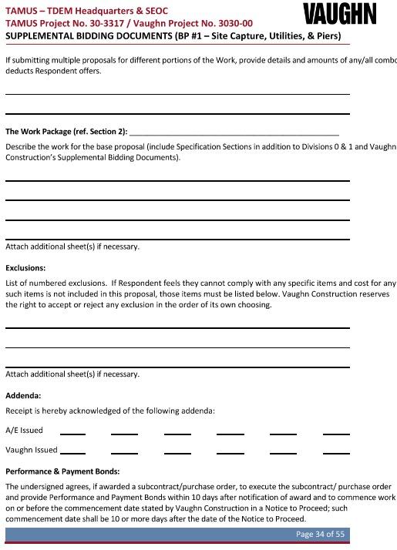
Cost Proposal – Bid Splits
USE SECTION 6 BID FORM
All trades will have the opportunity to bid on multiple work packages. Provide a cost in the proposal for EACH complete work package.
Credit/Deduct if awarded multiple packages
Combo Bid Total, including and credit/deduct amounts
Pricing for each alternate as applicable.
DO NOT INCLUDE ALTERNATE PRICING IN BASE PROPOSAL

Slide 31
Bonds & Tax & Prevailing Wages
Performance and Payment Bonds:
All proposals should NOT include P&P bonds. P&P bond rates should be provided in respondents proposal in the form of a percentage (%), NOT a dollar ($) value.
Tax:
State project. Tax status: Exempt.
Prevailing Wage Rates:
Texas Prevailing Rate Schedule – Travis County Building Construction Prevailing Wage Rates (ref. attachment H of CM Front Ends)
Wage Rate Notification Forms required prior to starting work (Vaughn Commitment Exhibit H – Work Wage Rate Notification Form)
Certified Payroll – Submitted monthly in electronic format.

Slide 32
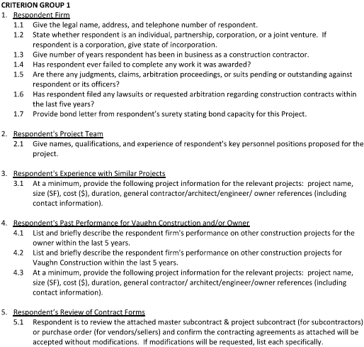
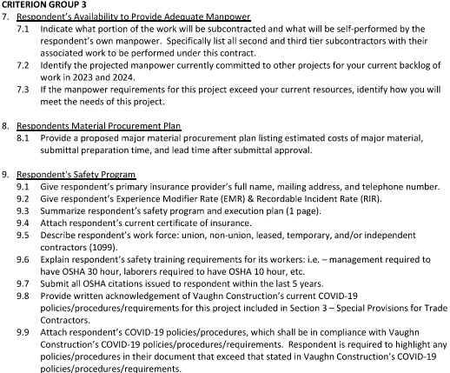
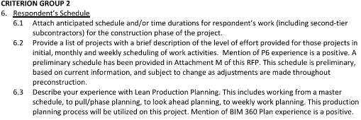
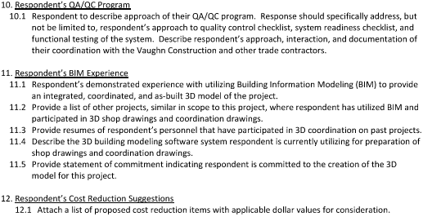
Technical Proposal
Submitted in format noted in Section 7
Provide complete responses to all questions
Important factor in determining best value award
Failure to respond = Disadvantage

Slide 33
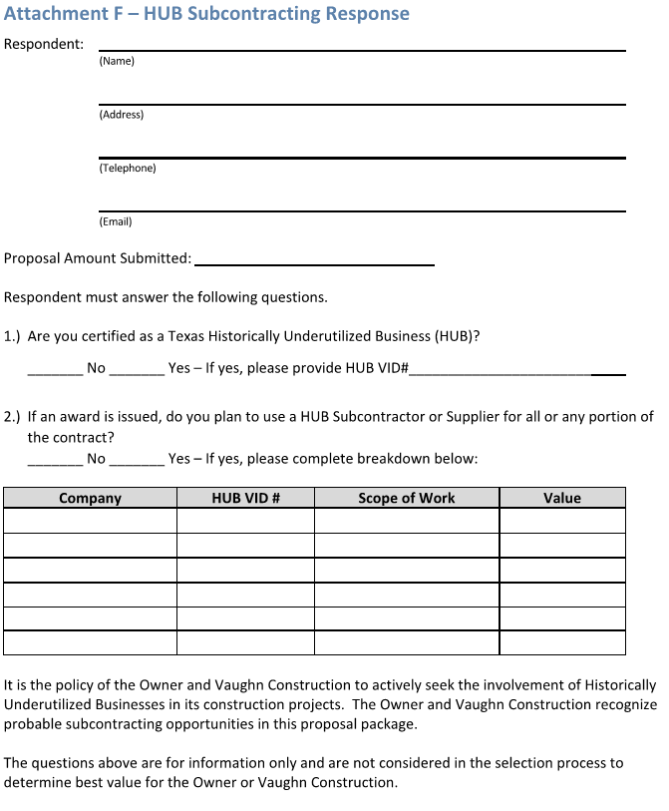
HUB Subcontracting Response (Part 1 of 2)
Actively seek involvement of HUBs
Total Project HUB Goal: 30%
Submitted in format noted in Attachment F
Provide accurate responses
Formal HSP Submitted after contract

Slide 34
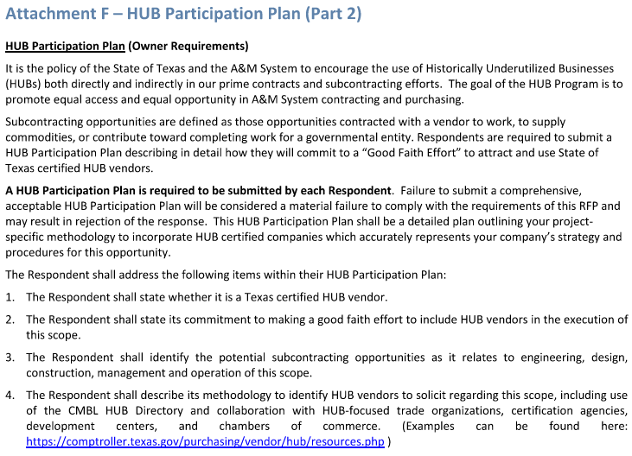
HUB Subcontracting Response (Part 2 of 2)
TAMUS HUB Plan

Slide 35
Qualification Statement / TradeTapp
Submitted in format noted in Section 8
Respondent is to submit a qualification statement as part of its proposal. Vaughn Construction is now utilizing an online platform, TradeTapp, for its trade contractor qualifications. Once submitted and approved, qualifications will remain on file for 12 months.
Respondents with an approved qualification on file are NOT required to submit a qualification statement with their proposal.
To begin the process, please email bid-subqual@vaughnconstruction.com and request an invite from TradeTapp.
Provide complete responses to all questions
Important factor in determining best value award
Failure to respond = Disadvantage

Slide 36
Proposals Due / Dates

Slide 37
Questions

Slide 38
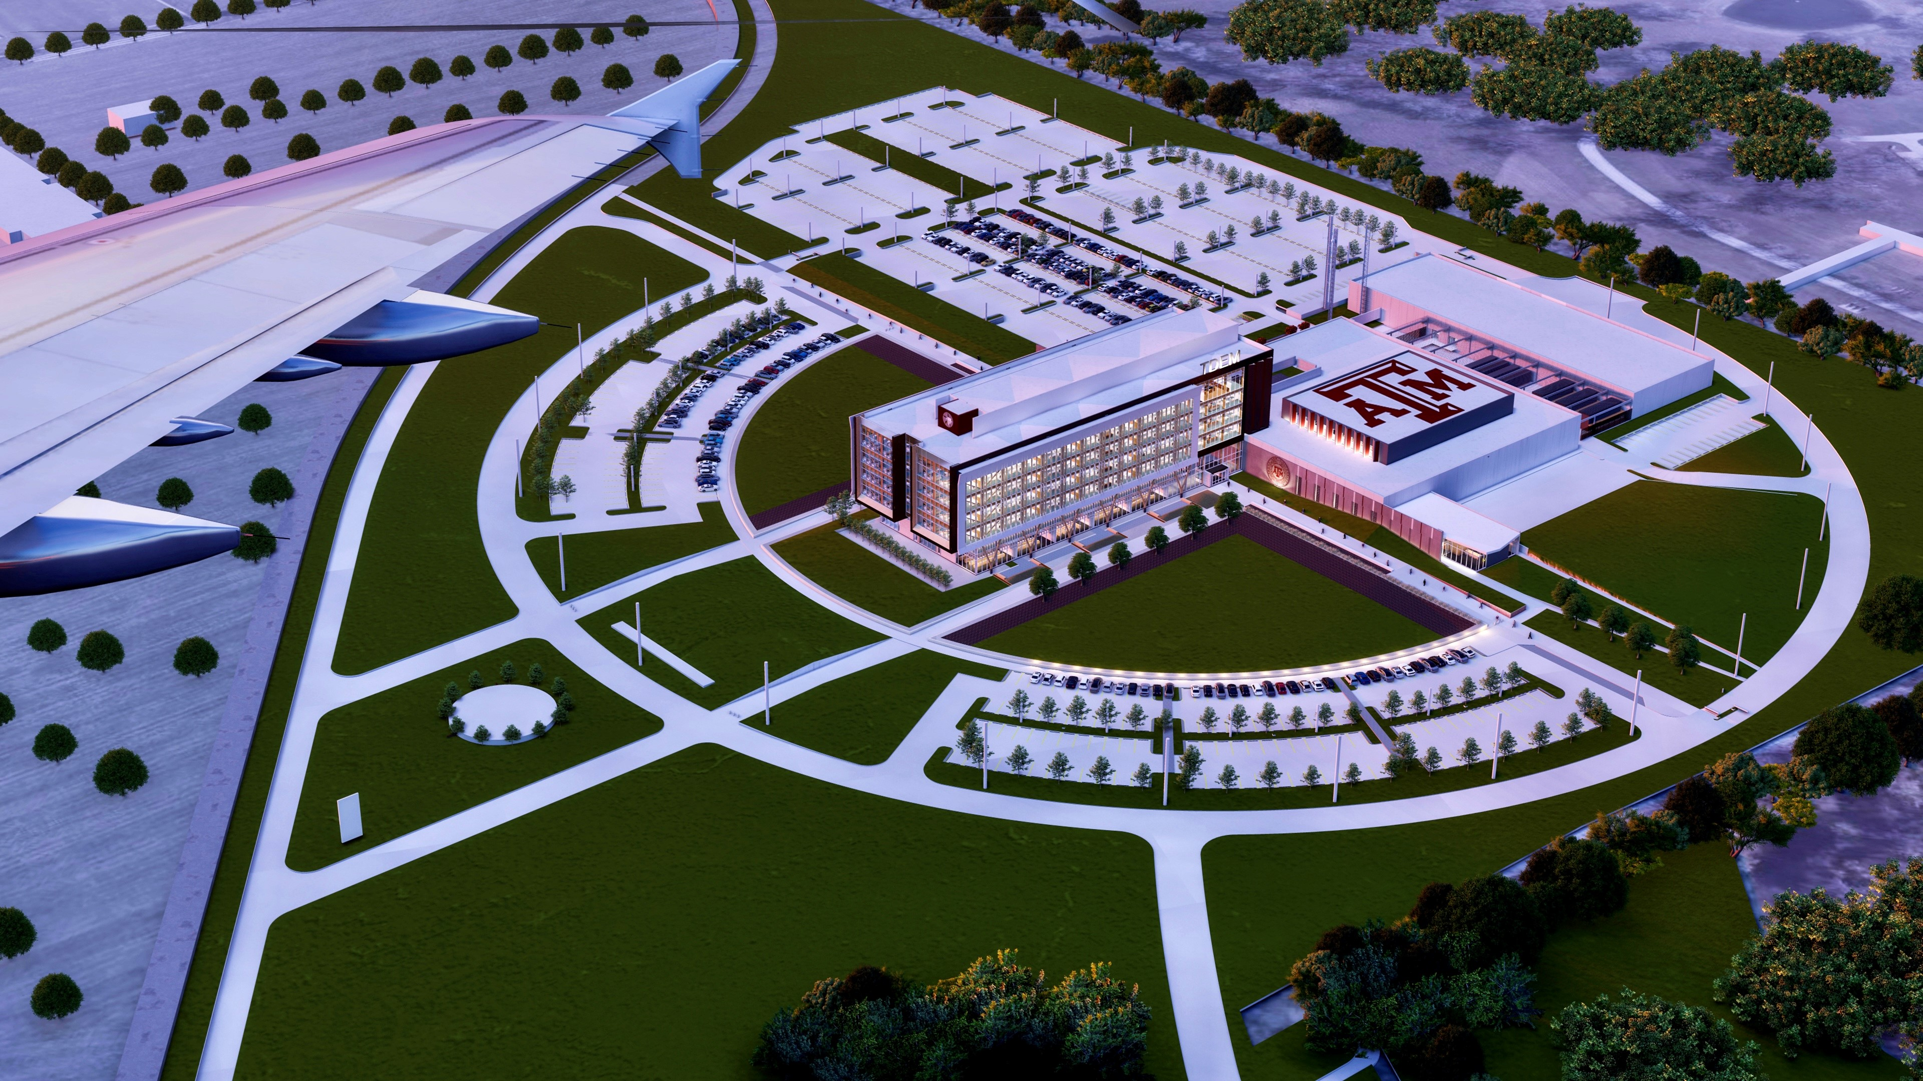
TDEM Campus Consolidation
Bid Package #1 – Site Capture, Utilities, and Piers

