Slide 1



A Strategic Opportunity
for Texas A&M-Corpus Christi
and Texas A&M-Kingsville
November 10, 2016

Slide 2
Historical Perspective
University System of South Texas (1977-1989)
  Upper-level campuses in Corpus Christi and Laredo
  Flagship/headquarters in Kingsville
USST officials recognized the need to unify
  Efforts were made to add schools & strengthen USST’s presence in the Coastal Bend
  Officials saw Pan American College and others as future competition
Since joining the Texas A&M University System in 1989, all three USST schools have flourished
Notes:
Modifier order fixed…changes in ALL CAPS

Slide 3
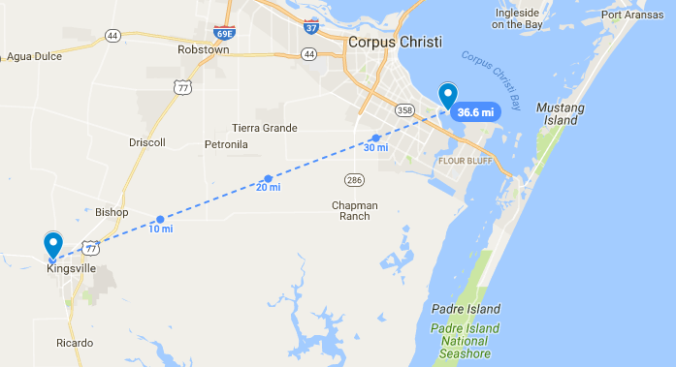
Why Consider Consolidation?
Two Campuses, One Mission

Slide 4
Why Could Consolidation Make Sense?
+
One large university to serve South Texas
The most university research activity south of San Antonio
Texas A&M University System’s first “emerging research university”
Increased opportunities for students and faculty
Cost savings over time
A wealth of natural resources on land, at sea, and in the air

Slide 5
Is the Time Right?
The issue hinges on local and System interest, and there are reasons for that interest now . . .
Presidential vacancy at TAMUCC provides opportunity
Legislative climate requires efficiencies
Coastal Bend Region primed for economic development
Competition is increasing from UT-RGV, Texas State University, UT-San Antonio, Texas A&M-San Antonio
Timing is crucial to get ahead of competitors
  Enrollment
  Student Success
  Research

Slide 6
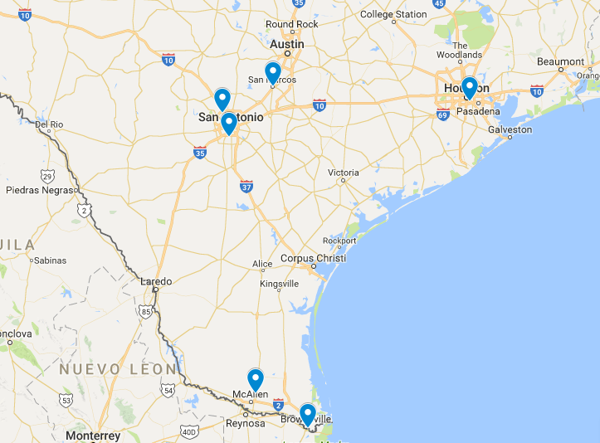
Academic Competition in South Texas
Texas State
UH
UT-San Antonio
A&M-San Antonio
UT-Rio Grande Valley

Slide 7
Enrollment & Demographics
Fall 2016 | TAMUK | TAMUCC | COMBINED
Preliminary 20th Class Day Enrollment | 9,290 | 12,174 | 21,464
White/Non-Hispanic | 14% | 38% | 28%
African American | 5% | 6% | 5%
Hispanic | 60% | 46% | 52%
Asian | 1% | 3% | 2%
American Indian/Alaskan Native | 0% | 0% | 0%
Non-Resident Aliens/Foreign Nat’ls | 19% | 4% | 10%
Not Reported | 0% | 2% | 1%
Native Hawaiian/Pacific Islander | 0% | 0% | 0%
Multiracial | 0% | 2% | 1%
Notes:
Modifier order fixed…changes in ALL CAPS

Slide 8
Metrics
Degrees Awarded*
Fiscal Year 2015 | TAMUK | TAMUCC | COMBINED
Total Degrees Awarded | 1,903 | 1,997 | 3,900
Undergraduate | 937 | 1,461 | 2,398
Masters | 945 | 512 | 1,457
Doctoral | 21 | 24 | 45
Research Expenditures**
Fiscal Year 2015 | TAMUK | TAMUCC | COMBINED
Total Research Expenditures | $19,052,550 | $23,206,229 | $42,258,779
Restricted Research Expenditures | $12,723,245 | $14,693,004 | $27,416,249
Endowments
Fiscal Year 2015 | TAMUK | TAMUCC | COMBINED
System Endowment Fund | $20,728,327 | $14,357,846 | $35,086,173
Affiliated Foundations Endowment Fund | $62,189,013 | $83,270,301 | $145,459,314
Data Sources: * THECB Prep Online ** THECB Accountability System

Slide 9
Among Public Universities in Texas
 | A&M-Corpus Christi | A&M-Kingsville | Combined
Total Enrollment | 19th | 21st | 12th
Hispanic Enrollment | 14th | 13th | 7th
Degrees Awarded | 20th | 23rd | 13th
Data source: THECB Accountability System, FY 2015

Slide 10
State Funds for “Emerging Research”
Texas Research Incentive Program (TRIP)
  Current biennium funding: $138,097,074
  Eligible institutions: Emerging research universities
Core Research Support Fund (CRS)
  Current biennium funding: $117,111,410
  Eligible institutions: Emerging research universities
National Research University Fund (NRUF)
  Current biennium funding: $37,817,288
  Eligible institutions: Emerging research universities that have expenditures of at least $45 million in restricted research and meet other criteria

Slide 11
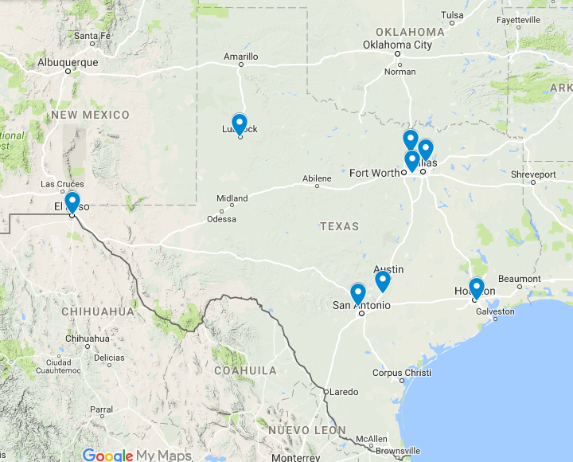
Current Emerging Research Universities
Texas Tech
UNT
UT-Dallas
UT-Arlington
UT-El Paso
Texas State
UT-San Antonio
UH
?

Slide 12
To Qualify for “Emerging Research”
Emerging Research Universities are expected to meet the following criteria for two consecutive years…
  Offer a comprehensive range of excellent undergraduate and graduate programs
  Award at least 30 PhD degrees annually
  Generate at least 20% of the research universities’ criteria for restricted research expenditures (20% of $150 million, adjusted for inflation)
Notes:
Modifier order fixed…changes in ALL CAPS

Slide 13
Comprehensive Range of Programs

Slide 14
PhDs & Restricted Research
Institution | Restricted Research Expenditures* | PhD Award Count**
University of Houston | $64,394,171 | 236
Texas Tech University | $48,774,414 | 283
UT-Dallas | $45,111,033 | 178
UT-El Paso | $46,821,190 | 108
UT-Arlington | $31,614,826 | 219
Emerging Research Criteria | $30,000,000+ | 30
TAMUCC & TAMUK | $27,416,249 | 22
UT-San Antonio | $25,026,676 | 92
Texas State University | $27,244,557 | 42
University of North Texas | $16,097,336 | 227
*Texas Higher Education Coordinating Board, FY 2015
** Texas Higher Education Coordinating Board, FY 2014

Slide 15
Advantages for Students
Access to broader, more diverse programs of study for all students—increased access to academic courses and majors.
Potential administrative cost savings that could be channeled into education and research.
Access to grants & student activities at both campuses will support and engage students.

Slide 16
Advantages for Teaching and Research
Access to laboratory equipment and lab space at both campus
Access to classroom technology and distance learning at both campuses
Greater ability to recruit professionals to the region
Provides a fast path to Emerging Research Institution designation and additional research funding (matching or formula)

Slide 17
Advantages for South Texas
Stronger competitiveness in the expanded higher education market against larger, emerging research universities
Enhanced image—making it easier to recruit and retain top scholars and professors
Enhanced economic development: Leading the way in work force development, public service & local spending.
In FY13, the two campuses combined produced $751 million in economic benefits to the Coastal Bend region.* This will be increase with unification and Emerging Research Institution funding.
*EMSI Study Commissioned by CPUPC

Slide 18
Challenges
Blending of two campus cultures/identities. It takes time to build trust and to identify with a new brand.
Short-term costs (advertising, signage, technology, etc.)
Resolving and combining administrative functions.
Decisions about athletic programs.
Providing an enhanced educational mix at both campuses.

Slide 19
Concerns
How to address local concerns about future direction of the University
How to engage and encourage alumni support
How to establish a process to communicate effectively with faculty, staff and students and solicit their input
How to resolve back office issues involving financial operations, student records, fund raising and other issues
Branding issues
How to build on and enhance the University’s identity over time

Slide 20
Other Considerations & Questions
    Academics
    How would academic programs be allocated between sites to successfully reflect a two-campus/one-university approach?
    How would program offerings be consolidated and distributed to meet student needs?
    How would consolidation affect any current academic programs?
    How would consolidation affect any current research activity?
    How would consolidation be used to benefit in faculty recruitment?
    Athletics
    How will athletic programs be coordinated?
    Would changes in conference affiliation affect any sport?
    Would construction of new facilities be required?

Slide 21


Athletics
TAMUCC is in the Southland Conference, NCAA Division I
  Men: Baseball, Basketball, Cross Country, Track & Field, Tennis
  Women: Basketball, Beach Volleyball, Cross Country, Golf, Soccer, Softball, Tennis, Track & Field, Volleyball
TAMUK is in the Lone Star Conference, NCAA Division II
  Men: Baseball, Basketball, Cross Country, Track & Field, Football
  Women: Basketball, Beach Volleyball, Cross Country, Golf, Softball, Tennis, Track & Field, Volleyball

Slide 22
Communication Would Be First Priority
  Forums to explain the idea and allay concerns will be necessary
Will require input & acceptance from:
  Public
  Faculty
  Current Students
  Alumni

Slide 23
Necessary Steps for Legislation
If the Board approved consolidation, it would be a 3-5 year process requiring legislative approval . . .
Texas A&M University System Board of Regents approval
Submission of higher education impact statement by THECB to Legislative Budget Board, laying out pros, cons, and estimated costs
Passage of Senate or House Bill

Slide 24
Necessary Steps with SACSCOC
Southern Association of Colleges and Schools Commission on Colleges approval is necessary for regional accreditation.
CEOs must provide written notice of the change 6 months in advance of date of review of the change by SACSCOC Board.
Review and approval process requires a minimum of 2-3 years before accreditation is granted.

Slide 25
Other Accreditations
Both institutions will need to research the requirements and implications for specific program accreditations:
  ABET (Engineering)
  AACSB (Business)
  NASM (Music)
  CACREP (Counseling)
  CCNE (Nursing)
  Other

Slide 26
Questions?

