Slide 1
Performance Reviews
May, 2019
Dr. René E. Quiroz, Workday Services

Slide 2
Today’s Agenda
Process Details
Employee Details
Manager Details
Demo: Employee and Manager
Timeline for Completion

Slide 3
Process Details

Slide 4




Employee & Manager Tasks
Performance review period launched in Workday
May 20, 2019
*If the Manager would like to skip these steps, skip task must be selected to continue with the Performance Review
Employee Submits Self-Evaluation / Manager Adds Additional Manager*
Manager Adds Additional Reviewers*
Manager Drafts Evaluation
Employee receives an Inbox task to complete the Self-evaluation
Manager receives an Inbox task to Add Additional Managers
Manager receives an Inbox task to Add Additional Reviewers to Employee’s evaluation
.
Manager receives an Inbox task to complete the Employee evaluation
IMPORTANT:
Complete the Evaluation. But do NOT submit. You will first meet with your Employee
  IMPORTANT: Employees must submit the Self-Evaluation in order to initiate remaining tasks

Slide 5
Additional What?
Additional Reviewers and Additional Managers are any Employee that has worked with or supervised the Employee over the course of the past year and the manager feels the individual may have valuable input for the performance review
  Additional Managers can add only comments but to ALL sections
  Additional Reviewers can add ratings and comments but ONLY to competencies section
Remember: Both of these tasks can be skipped by the Employee’s manager. They are optional

Slide 6



Employee & Manager Tasks
Outside of Workday
Return to Workday
July 3, 2019
Manager & Employee Discuss Evaluation
Manager Submits Evaluation
Employee Acknowledges Evaluation
Supervisor Acknowledges
Manager meets with Employee to discuss evaluation
Manager can make changes to evaluation draft or send back to Employee to make changes as needed
Manager submits Employee evaluation
Employee receives an Inbox task to acknowledge evaluation and affirm they have reviewed the positions restrictions
Manager receives an Inbox task to acknowledge the evaluation and position restrictions
Note: Manager and Employee should discuss position restrictions and the need for an update prior to Employee Acknowledgment

Slide 7
Employee Details

Slide 8

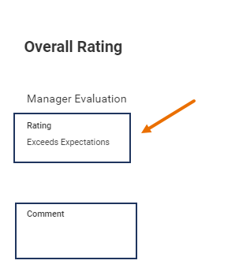
Employee Information
Discuss with your Manager any additional information about the review
  Managers can still make changes at this point
Discuss with your Manager updates position restrictions if applicable
After Manager submits, and you receive the Manager’s Evaluation
  Scroll to the bottom
  View Overall Rating, Manager and Additional Manager (if applicable) Comments

Slide 9
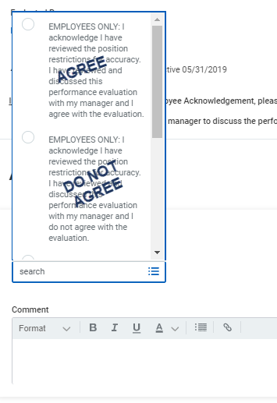
Employee Information
The Employee will acknowledge and choose one of two options:
  I have reviewed the position restrictions for accuracy and I agree with the evaluation
  I have reviewed the position restrictions for accuracy and I do not agree with the evaluation
If the overall rating is partially meets expectations or does not meet expectations, the business process will route to the Manager’s Manager for review before it comes to the Employee
Note: If the Employee selects do not agree, the business process will continue to route

Slide 10
Manager Details

Slide 11
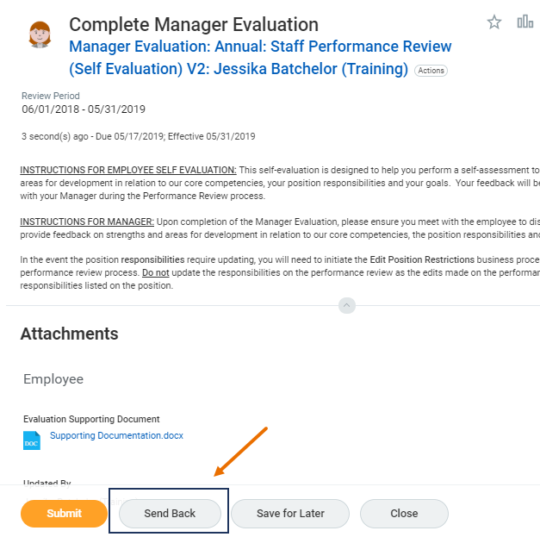
Manager Information
Managers can Send Back a Performance Review if the Employee needs to make changes
  Select Go To Summary Editor
The Manager can go back and make changes to the performance review after the discussion with the Employee but before submission
The Manager should discuss a need for updates to position restrictions with their Employee prior to submission of the review
  WARNING: Once the Manager submits the performance review, if changes are needed, they must use the My Team’s Performance Reviews Report to Send Back

Slide 12
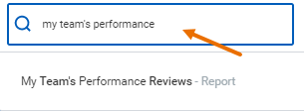
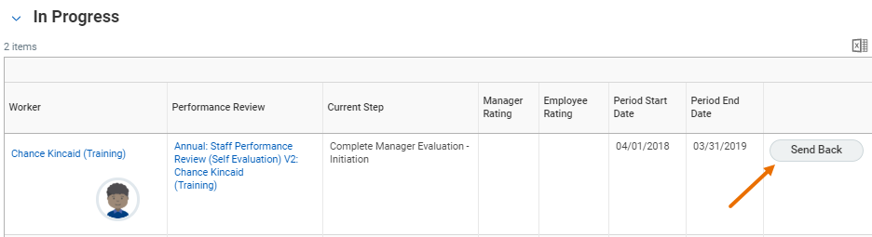
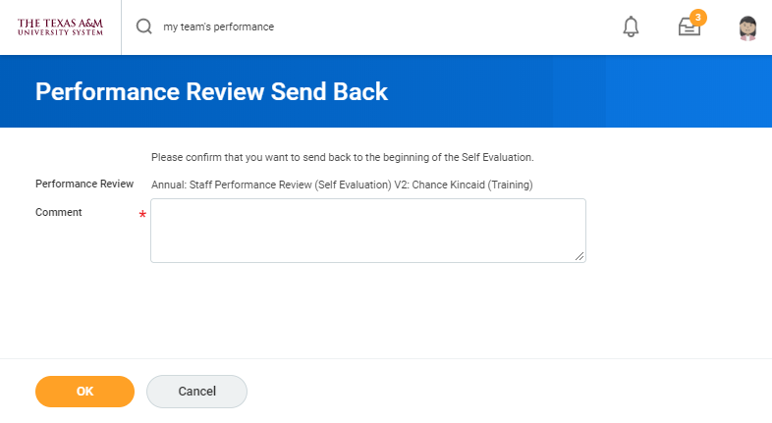
Send Back
Can send the performance review business process back to your Employee or Yourself when needed

Slide 13
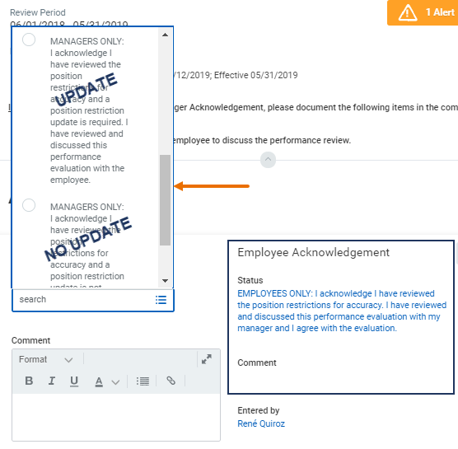
Finalize the Review
The Manager will acknowledge and choose one of two options:
  I have reviewed the position restrictions, an update to position restrictions is required, I have discussed with Employee
  I have reviewed the position restrictions, an update to position restrictions is NOT required, I have discussed with Employee
Performance Review is now complete

Slide 14
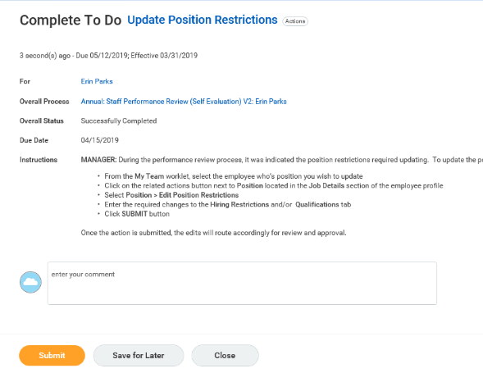
Edit Position Restrictions
Managers who selected “position description update required” will receive a To Do: Edit Position Restrictions
  Do not Do the To Do
  Submit the To Do
  Contact Dawn Santo
  IMPORTANT: Do Not initiate the Edit Position Restrictions business process. System Office will work with Managers to ensure they are updated

Slide 15
Demo: Employee and Manager

Slide 16
Timeline for Completion

Slide 17

Recommended Timeline
May 20th – Performance Review Launch for SO
May 31st – Employee Submits Self-Evaluation
June 5th – Manager Adds Additional Manager / Reviewer*
June 14th – Manager Drafts Evaluation (Does not Submit)
June 21st – Discussion with Employee
June 25th – Manager Submits Evaluation
June 27th – Employee Acknowledges Evaluation
July 3rd – Manager Acknowledges Evaluation
* Optional

