Slide 1
Software Licenses
.
Nicholas E. Chremos, TAMUS Office of General Counsel
November 8, 2012
The Texas A&M University System
Office of Technology Commercialization

Slide 2
Overview
What is a software license?
Software’s components
What to look for in reviewing software license agreements?
Off the shelf-mass market software
Somewhat customizable software
Customized software
Licensing member-owned software

Slide 3
What is a License?
A contract whereby the software owner conveys certain intellectual property rights, assigns certain obligations, assumes certain obligations, and imposes certain risks on a licensee.

Slide 4
Software Components: Software, Service, etc.
The software itself
Source code
Human readable
Never provided in off-the-shelf software
Object code
Machine readable
Always provided in off-the-shelf software
Service and support
User manual

Slide 5
Software Components: intellectual property
Intellectual property rights associated with the software
Copyrights
In the software context, these protect:
The source code as written (totally irrelevant in off-the-shelf software; somewhat relevant in other contexts)
The user interface if it has some originality
Example: The arrangement and choice of icons on a desktop is copyright-protected.

Slide 6
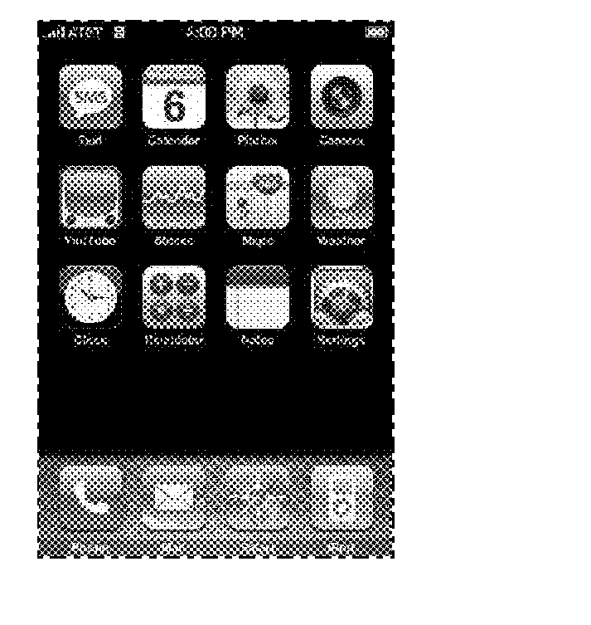
Software Components: intellectual property
Trademarks
Utility Patents
Cover some features of software, nearly always features of which the user is unaware.
Design Patents
In the software context, these, like copyrights, protect the icons on a screen.
Example:
(U.S. D 604,305 S)

Slide 7
Spectrum of Issues
Few issues-------------------------Many issues
Mass Market Custom Designed
Software Software

Slide 8
Mass Market Software

Slide 9
Mass Market Software
Mass market software licenses are not negotiable, so don’t waste time trying to negotiate boilerplate.
Focus on the software vendor’s existing options regarding service and make sure that you purchase the option that is optimal for your organization’s needs.
Make sure that you purchase a license that optimizes your organization’s needs for the number of simultaneous users who can use the software.

Slide 10
Somewhat Customizable, Off-the-Shelf Software

Slide 11
More issues involved in buying somewhat customizable software
Service
Review the license agreement’s terms and conditions of service and support. Make sure that these are consistent with your organization’s needs.
Updates
Ensure that new updates are included as part of the license. New versions, however, won’t be a part of the license.

Slide 12
More issues involved in buying somewhat customizable software
Special features
If you are purchasing software that requires special features, ensure that the license’s terms and conditions obligate the supplier to implement those features by a specified date.
Ensure that the license specifies with particularity the specifications of the special features to be included.

Slide 13
More issues involved in buying somewhat customizable software
Performance Specifications
The license should include performance specifications, such as:
Errors – timeframe for correction. E.g. Within 24 hours of detection.
Downtime – how often, how much.

Slide 14
More issues involved in buying somewhat customizable software
Consequences for failure to meet specs:
Ensure that the contract specifies what happens if the software doesn’t meet the specs set forth in the contract.
After a certain number of repeated failures, the contract should be terminable for cause.

Slide 15
More issues involved in buying somewhat customizable software
Use and users
Many licenses specify how many users can use the software simultaneously. Ensure that the number of simultaneous users is sufficient for your organization’s needs.

Slide 16
Custom Designed Software

Slide 17
Custom Designed Software
These license agreements must be drafted-i.e.-boilerplate doesn’t suffice.
To draft an adequate agreement, must understand the software’s technical requirements and end-user requirements.
These requirements drive all aspects of the license agreement.

Slide 18
Custom Designed Software
Issue 1: Software Function
Ensure that the contract (usually in the statement of work) details the following with particularity:
What the software is intended to do.
Include detailed performance specifications
What constitutes completion of a task such that the supplier will get paid after its completion.
Include detailed operating parameters and specifications.

Slide 19
Custom Designed Software
Issue 2: Software Support
Will the supplier be contractually obligated to provide support?
If so, then:
How much?
For what?
What turn-around time is acceptable?

Slide 20
Custom Designed Software
Issue 2: Intellectual Property
Which party owns the intellectual property?
The supplier will own the copyrights, patents, and any other intellectual property associated with the software development unless the contract specifies otherwise.

Slide 21
Custom Designed Software
Issue 3: If the supplier owns the intellectual property associated with the software, what can your organization do with the software?
At a minimum, must include use rights.
Should probably include the right to make an archival copy.
Should probably permit the display of results involving the software’s use.
Determine whether your organization needs the right to make derivative works based on the software and what your organization can do with these derivative works.

Slide 22
Custom Designed Software
Issue 4: Warranties
If you fail to include an express warranty and the software fails after you have accepted it, then your ability to obtain redress is limited.
If the contract includes express warranties, then must detail:
Timeframe during which the warranty is applicable.
What the warranty covers.
How to exercise the warranty rights.

Slide 23
Custom Designed Software
Issue 5: Risk Shifting Provisions
If the software doesn’t work as specified in the contract and harms third parties which then sue the university or System component, how broad or narrow should the duties to defend and indemnify be?
If you ask for a duty of defense and indemnity and the supplier is small, ensure that the supplier has adequate insurance to be able to meet the defense and indemnity obligations.

Slide 24
Licensing System or Member Owned Software

Slide 25
System or Member Owned IP?

Slide 26
Licensing System or Member Owned Software
Is it system or member owned intellectual property?
System policy 17.01 says that it is System owned if it was created (a)as a result of an individual’s employment responsibilities, (b) with support from the system or any of its members in the form of administered funds, and/or (c) with significant use of resources.
It is member-owned if it was (a) created by an employee who was hired specifically to produce the intellectual property for institutional purposes or (b) commissioned by the member and assigned to the member in writing.

Slide 27
Non-Exclusive or Exclusive License?

Slide 28
Licensing System or Member Owned Software
There are two approaches:
Exclusive license:
The licensee can sue others for infringing the licensed copyrights and patents associated with the software and the institution is a nominal party in the litigation.
The licensee can infringe the intellectual property as specified in the license.

Slide 29
Licensing System or Member Owned Software
There are two approaches:
Non-exclusive license:
The licensee can infringe the intellectual property as specified in the license.

Slide 30
Licensing System or Member Owned Software
The extent of the rights conveyed will depend upon how the licensee expects to commercialize the intellectual property.
Example: Broad rights – “System hereby grants and Licensee now accepts a worldwide, non-transferable, royalty-bearing, and exclusive license under Patent Rights and Copyright Rights to use the Licensed Intellectual Property, to reproduce the Licensed Intellectual Property, to distribute the Licensed Intellectual Property, to import items covered by the Patent Rights and Copyright Rights, and to offer for sublicense and sublicense the rights granted hereunder.”

Slide 31
Other Considerations:
Delivery of code.
Risk shifting provisions.

Slide 32
Licensing System or Member Owned Software
Delivery of source code to licensee usually necessary.
To effectuate the rights granted under the license, the System or member usually must provide the licensee with the software’s source code but there are exceptions.

Slide 33
Licensing System or Member Owned Software
Always disclaim warranties and make the licensee waive them.
All System/Member-developed software is experimental, and neither the System nor the Member want to extensively support the software.
Therefore, licensee takes the software “as is” and this is reflected in the royalty-rate and other fees payable to the licensor.

Slide 34
Licensing System or Member Owned Software
Usually ask the licensee to provide broad defense and indemnification rights to the System/licensor for third party claims arising out of the licensed software.

Slide 35
More information?
Contact:
Nick Chremos
979-458-2635
979-458-6134
nchremos@tamus.edu

